Slide 1




WP7 Society:
Social perspectives on NbTs and social innovation actions
Leader: UNIPD – TESAF
PP participants: ETIFOR, PMU, ISGlobal, UNIVIE
AM25 Padova - 18/09/2025
The Resonate project is funded by the European Union’s Horizons Europe Research and Innovation programme under grant agreement No. 101081420 and co-funded by the UK Research and Innovation grant award No. 10063874

Slide 2




Objectives of WP7
Task 7.1
Awareness and acceptance of NbTs
Task 7.2
Cross-sectoral linkages
Task 7.3
Resilience Hubs for social resilience
Identification of factors that influence stakeholder awareness and acceptance of NbTs in different socio-economic, institutional, and geographical contexts
Identification of possible linkages between sectors based on the analysis of networks and characteristics of the CS4-6
Establishment and scaling of NbT interventions in the CS4-6 helping local communities turn NbTs into innovative opportunities for community resilience, green job
creation and nature protection,thus stimulating Social Innovation Actions and processes
Online survey
Questionnaire to stakeholders at European level and in the countries of CSs 4-9
Social Network Analysis (SNA)
Questionnaire to stakeholders distributed at the beggining and at the end of the RHs
RH establishment, development, monitoring and evaluation
Questionnaire
distributed during the 3 common workshops of the RHs
AM25 Padova - 18/09/2025

Slide 3
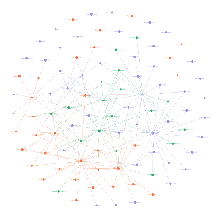
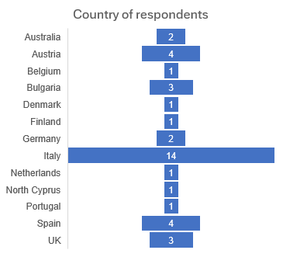
Updates on data collection and analysis (1/5)
Task 7.1
Awareness and acceptance of NbTs
Task 7.2
Cross-sectoral linkages
Task 7.3
Resilience Hubs for social resilience
4 languages: ENG, ITA, ESP, GER
Distribution: since July 2025-open
Answers received up to now: 62
SNA questionnaire: Baseline
Distributed in the 3 RHs:
preparatory and establishment workshop
Establishment of the 3 Resilience Hubs in Padova, Salzburg, and Barcelona
Awareness
Collaboration
Information
Resources
Meetings
Contract
Organization of supplemental meetings according to RHs needs
RH ITA
Distribution of the SIA questionnaire for the Social Innovation monitoring
Abstract submitted at the
World Forum in Forest Therapy
(October 2025, South Korea)
24 missing values
Update to 16th September 2025
AM25 Padova - 18/09/2025
Notes:
T7.1
We will do our best to (NON CHIEDERE AIUTO DEI PPs)
Better distribute the answers (using our channel sending to personal contacts)

Slide 4
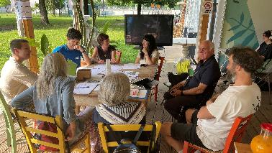
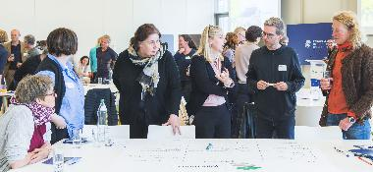
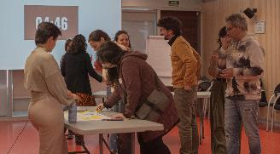
Updates on data collection and analysis – focus on T7.3 (2/5)
RH PADOVA
RH SALZBURG
RH BARCELONA
140 stakeholders identified
54 person involved
26 organisations involved
---
4 workshops done since June 2024
3 working tables activated
---
4 collaborations already activated
2 collaborations under discussion
87 stakeholders identified
43 people involved
14 organisations involved
---
2 workshops done since June 2024
3 neighbourhood walks
9 1-2-1 meetings with stakeholders
---
6 collaboration activated
3 collaborations under discussion
108 stakeholders identified
27 people involved
20 organisations involved
---
3 workshops done since June 2024
---
2 lines of action activated
Integration of the RH in the Taula de Salut i Natura
(civic platform coordinating nature-and-health projects in Catalonia)
AM25 Padova - 18/09/2025
Notes:
RH Padova
collaboration activated → Greenta, Villa Bolasco, CIV, Grace (national+local)
collaboration under discussion → Intervento psicologico in natura per migliorare il rapporto con il corpo per giovani donne a rischio di
sviluppare problemi, collaborazioni con Milkovich per RH e NbTs
RH Salzburg
3 Neigbourhood walks different topics: (1) urban green & health; (2) equity; (3) urban green planning.
RH Barcelona
2 lines of action activated: 1) Green infrainstructure and 2) education
Activities under line 2 (education) are currently being organized

Slide 5

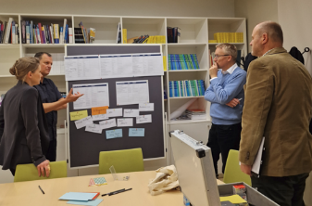
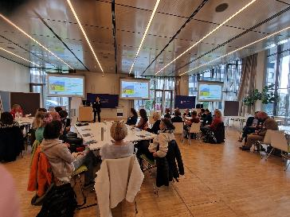
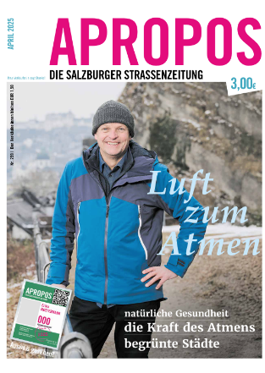
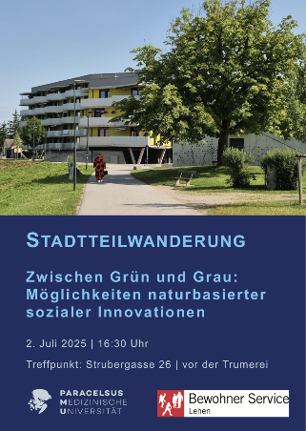
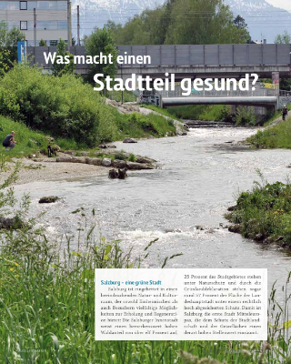
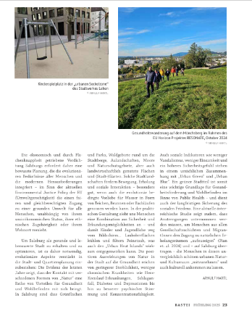

Summer 2025 activities
3 Neigbourhood walks for interested Stakeholders with different topics: (1) urban green & health (Arnulf Hartl, PMU); (2) equity (Christian Reisinger, Resident Services); (3) urban green planning (Christian Stadler).
Output: concrete ideas for NBTs and cooperation networks.
Updates RH Salzburg (3/5)
13 December 2024 - Preparatory workshop
- Core group stakeholders & cooperation partners
- Stakeholder mapping and HIA (WP4)
25 March 2025 - Establishment workshop
- 69 invited | 34 participants
- Positioning of the RH as strategic initiative internally and externally
    - Assessment of the current state of NbT implementation in Salzburg
    - Networking
AM25 Padova - 18/09/2025

Slide 6
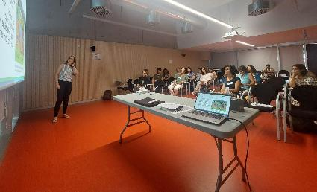
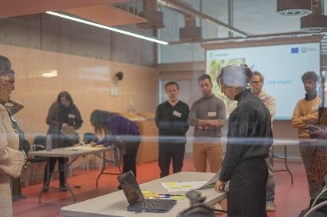
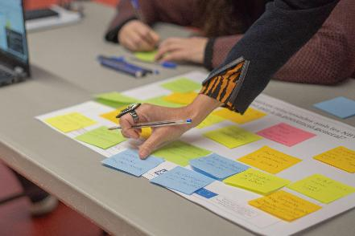
Activation of the Lines of Actions
1) Green and Blue infrastructure
2) Education
Updates RH Barcelona (4/5)
26 September 2024 - Preparatory workshop
- Core group stakeholders: 28 invited | 15 participants
- Stakeholder mapping and HIA (WP4)
18 March 2025 - Establishment workshop
- 28 invited | 15 participants
AM25 Padova - 18/09/2025

Slide 7
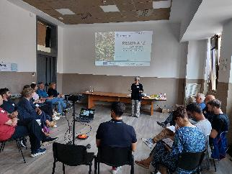
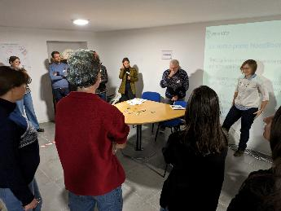
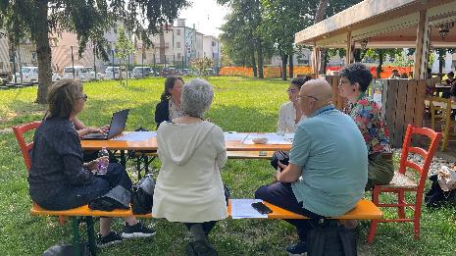
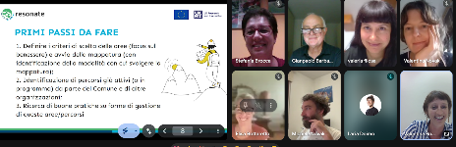
Updates RH Padova (5/5)
13 June 2024 - Preparatory workshop
-Core group stakeholders
-Stakeholder mapping and HIA (WP4)
4 December 2024 - Establishment workshop
- 29 participants
-Identification of main challenges in the local context
10 March 2025
- 20 participants
- Restitution of the previews results and elaboration on the challeges emerges
5 June 2025 – activation of Working Tables
- Establishment of 3 working tables:
- Table 1: Green Spaces
- Table 2: NbT promotion and implementation
- Table 3: Governance
July 2025 - Working Tables online meetings
AM25 Padova - 18/09/2025

Slide 8
Upcoming challenges
Task 7.1
Awareness and acceptance of NbTs
Task 7.3
Resilience Hubs for social resilience
COMMON
Maintaining stakeholders engaged and motivated until the MoUs,
Not overwhelm stakeholders with activities.
Understand the role of the RH in relation to other similar initiative present in the local contexts.
Understand how to respond efficiently to RH-driven requests of collaboration (resources).
How to guarantee: (a) the future of the initiatives developed within the RH and (b) people participation in NbT definition and promotion.
To increase the numbers of respondents.
To incorporate contextual data from other WPs.
Task 7.2
Cross-sectoral linkages
PADOVA
SALZBURG
BARCELONA
Coordination of the 3 working tables activated.
Ensuring their INTER-coherence and cooperation & maintaining the SENSE of UNITY with the RH.
Integration of WP4 (HIA) and WP8 (Scenarios) workshop.
To repeat SIA and SNA questionnaires.
Coordination with other existing initiatives
Balance between encouraging SHs/leave space for self-initiatives
Once the SNA analyses are finalized will became part of the T.7.3
AM25 Padova - 18/09/2025
Notes:
RH BCN:
Coordination others initiatives on NbT and involving Stakholders

Slide 9
Publication ideas
+ needs for collaborations
Task 7.1
Awareness and acceptance of NbTs
Task 7.2
Cross-sectoral linkages
Task 7.3
Resilience Hubs for social resilience
Papers 1-4: multi-actors governance network (SNA results).
Paper 1 – RH Salzburg
Lead: PMU + UNIPD (?)
Paper 2 – RH Barcelona
Lead: ISGlobal+ UNIPD (?)
Paper 3 – RH Padova
Lead: UNIPD + Etifor
Paper 4 – SNA as tool to detect readiness, gaps, and changes for NbTs implementation
Lead: UNIPD
Paper 1-3: Results of the SIA surveys. RH triggering Social Innovation.
Paper 1 – SIA Salzburg
Lead: PMU + UNIPD support
Paper 2 – SIA Barcelona
Lead: ISGlobal+ UNIPD support
Paper 3 – SIA Padova
Lead: UNIPD + Etifor
Paper 4 – Application of SIA framework in the 3 RHs
Paper 1: Awareness and acceptance online survey results.
Lead: UNIPD
Paper XX (?): Regional focus depending on translation feasibility
Comparative papers among the three contexts
AM25 Padova - 18/09/2025
Notes:
Suggestion of paper.
T7.2: Another option could be to add an additional paper considering the 3 RHs together. A methodological paper on SNA as efficient method to detect readiness for NbS implementation depending on analysis on intersectoral linkages.

Slide 10
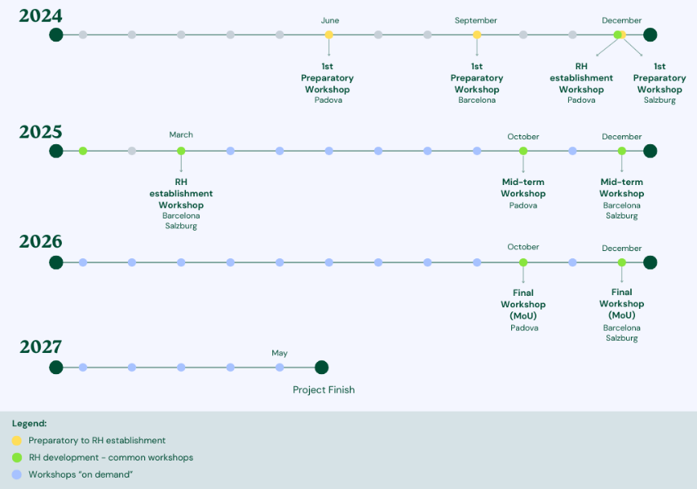





Timeline and next steps
Task 7.1
Awareness and acceptance of NbTs
January 2026
M23: Awareness/acceptance data collection complete
D7.1: NbT awareness/acceptance report
D7.2
“… part of the RESONATE Toolbox + Online Tutorial”
(RESONATE GA)
D4.1+D5.1+D6.1+
D7.2+D8.1
There is a common approach/coordination?
Task 7.3
Resilience Hubs for social resilience
January 2026
M26: Step-by-Step RH guidelines
SIA + SNA questionnaires
October 2026
D7.2: NbT RH Guide
Task 7.2
Cross-sectoral linkages
Internal deadline
August 2025
SNA (baseline) completed
January 2027
M27: Example NbT of MoU
AM25 Padova - 18/09/2025

Slide 11

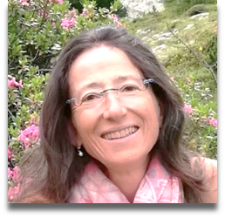
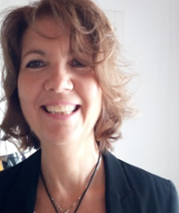
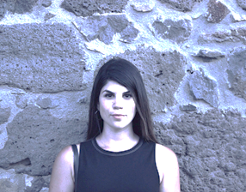



















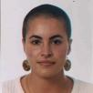





Thank you!
Angelica Moè
Francesca Pazzaglia
Monica Bolognesi
Silvia Bellini
Laura Secco
Ilaria Doimo
Sofia Caiolo
Valentina Romanin
Aynur Mammadova
Todora Rogelja
Giorgia Bottaro
Deborah Vedovetto
Matilda Todesco
Arnulf Artl
Christina Pichler
Yara Meilinger
Elena Pisani
Michela Zanetti
Giovanna De Mas
Elena Andriollo
Jill Litt
Monica Ubalde
Celia Santos Tapia
Inés Valls
AM25 Padova - 18/09/2025
The Resonate project is funded by the European Union’s Horizons Europe Research and Innovation programme under grant agreement No. 101081420 and co-funded by the UK Research and Innovation grant award No. 10063874

