Slide 1
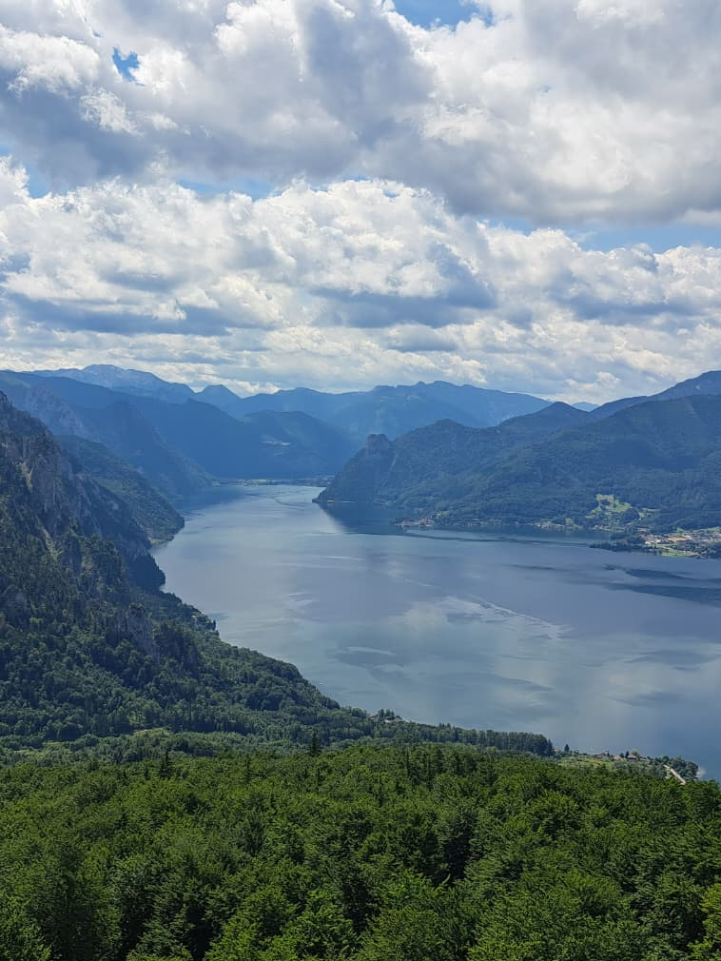



Relationships in Nature:
Building and Maintaining Relationship Resilience through Natural Environments
Anja Heske
PhD-Student at UNIVIE
The Resonate project is funded by the European Union’s Horizons Europe Research and Innovation programme under grant agreement No. 101081420 and co-funded by the UK Research and Innovation grant award No. 10063874

Slide 2

NBRT in Relationships
Equilibrium
Sources
of Stress
Stress
Recovery
Stress Responses
Relationship Dissolution
Preventive Resilience
Response Resilience
Recovery Resilience
(White et al., 2023)

Slide 3
Relational Restoration
(Resilience?) Theory
Individual Resources
Standing Arrangements
Restorative Environments
Relational Resilience
Relational Resources
(Hartig, 2021)

Slide 4

Study Overview
STUDY 1
SCALE DEVELOPMENT
How can we operationalize Relational Restoration/Resilience Theory?
→ Testing factor structure and convergent, divergent, and predictive validity
STUDY 2
LONGITUDINAL STUDY
How does exposure to natural environments influence well-being and individual and relational resilience?
→ Viennese residents, one year, three time points
STUDY 3
EXPERIMENTAL STUDY
To what extent can nature buffer negative effects of stressors on close personal relationships?
→ stressor in natural vs. urban environment, self-report & observations

Slide 5
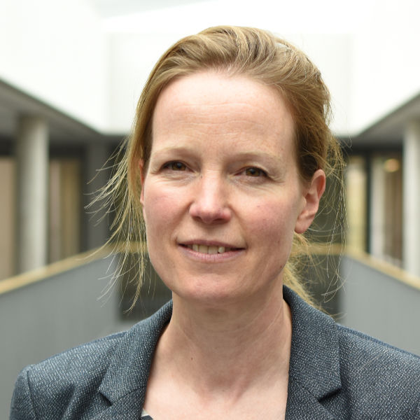
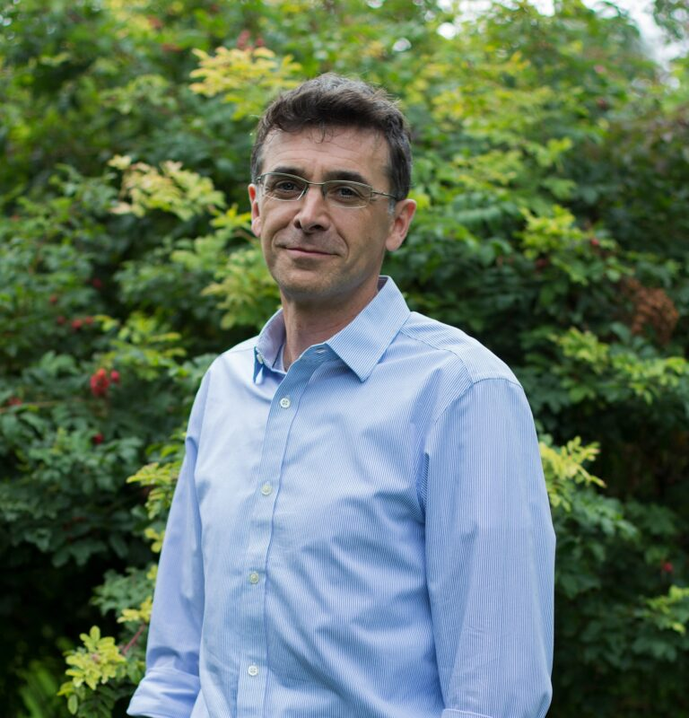
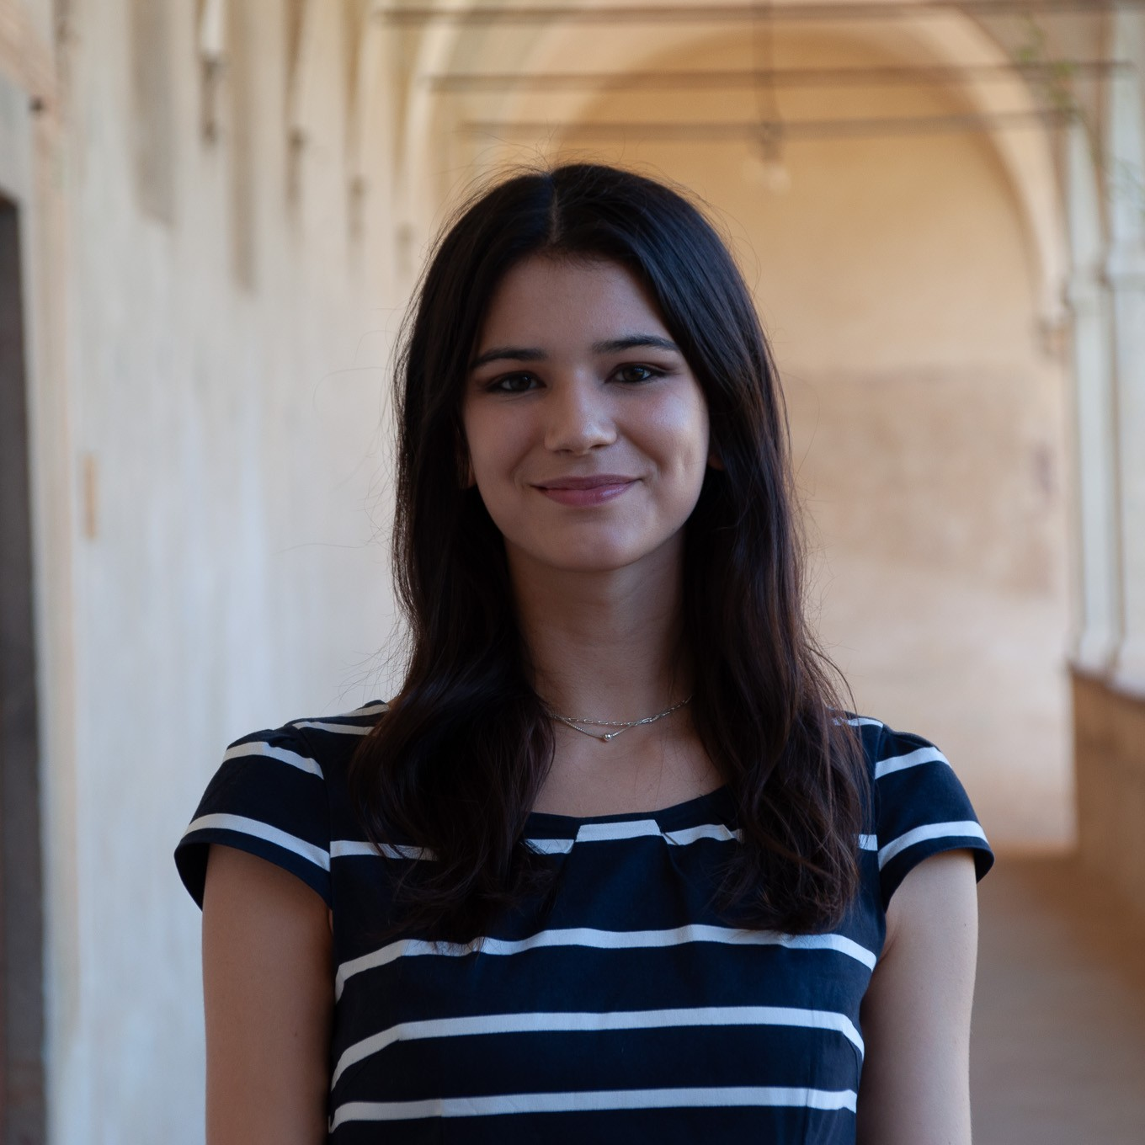

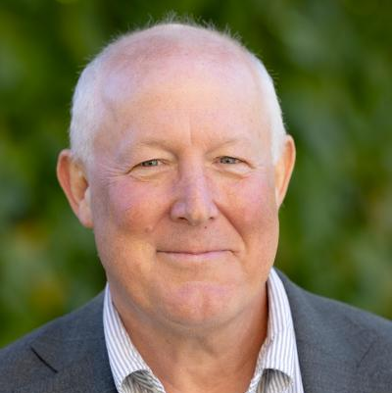


THANK YOU!
anja.heske@univie.ac.at
@anjaheske.bsky.social

