Slide 1
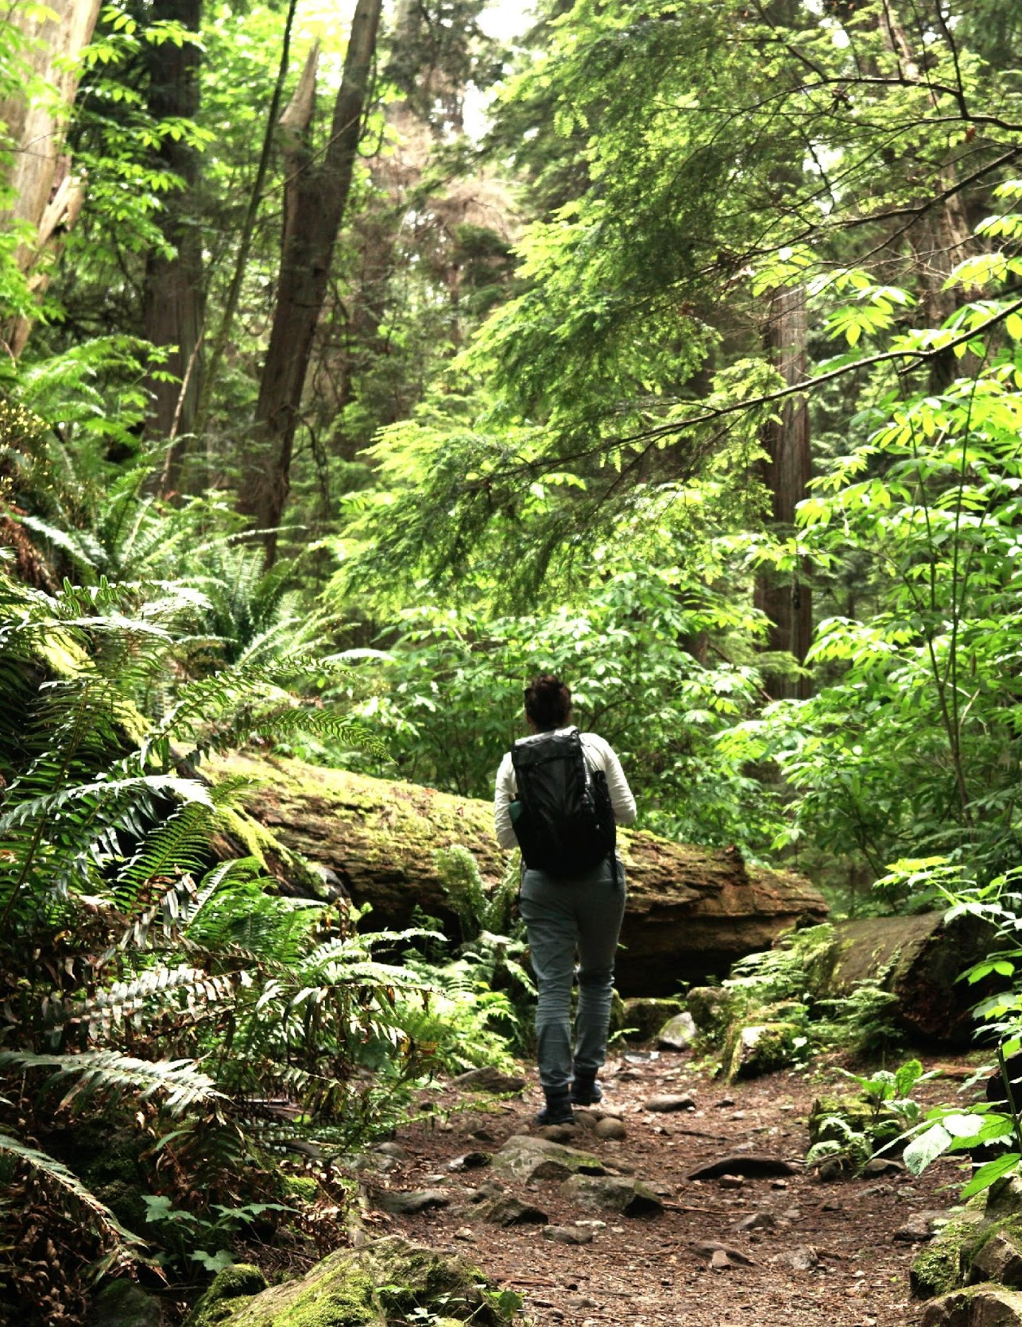
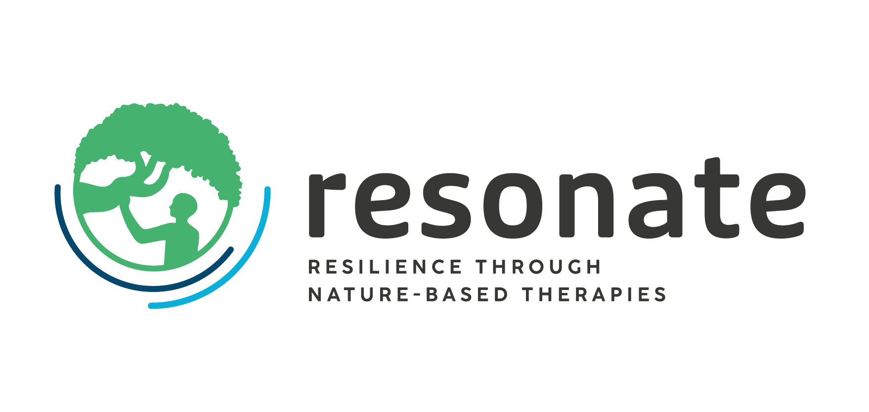


WP2
Patrik Karlsson Nyed (sub for Matilda vd Bosch)
& Jill Litt, ISGlobal
AM25 Padova - 18/09/2025
The Resonate project is funded by the European Union’s Horizons Europe Research and Innovation programme under grant agreement No. 101081420 and co-funded by the UK Research and Innovation grant award No. 10063874

Slide 2
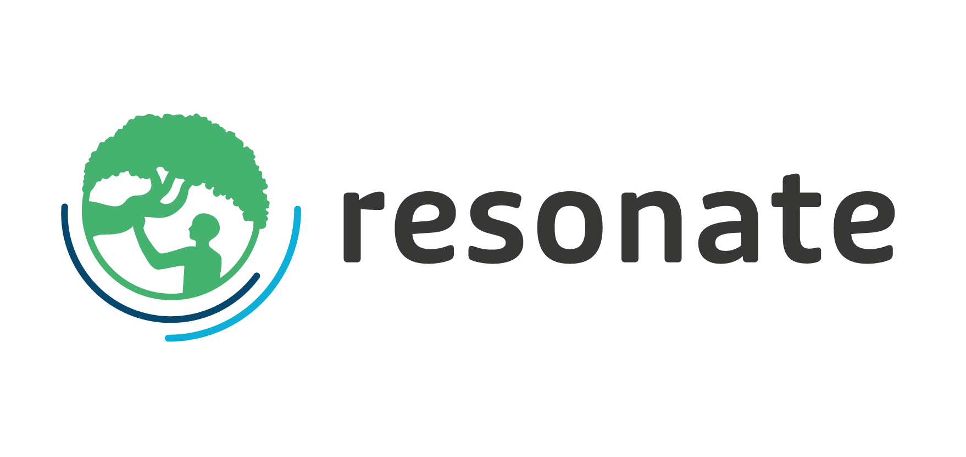
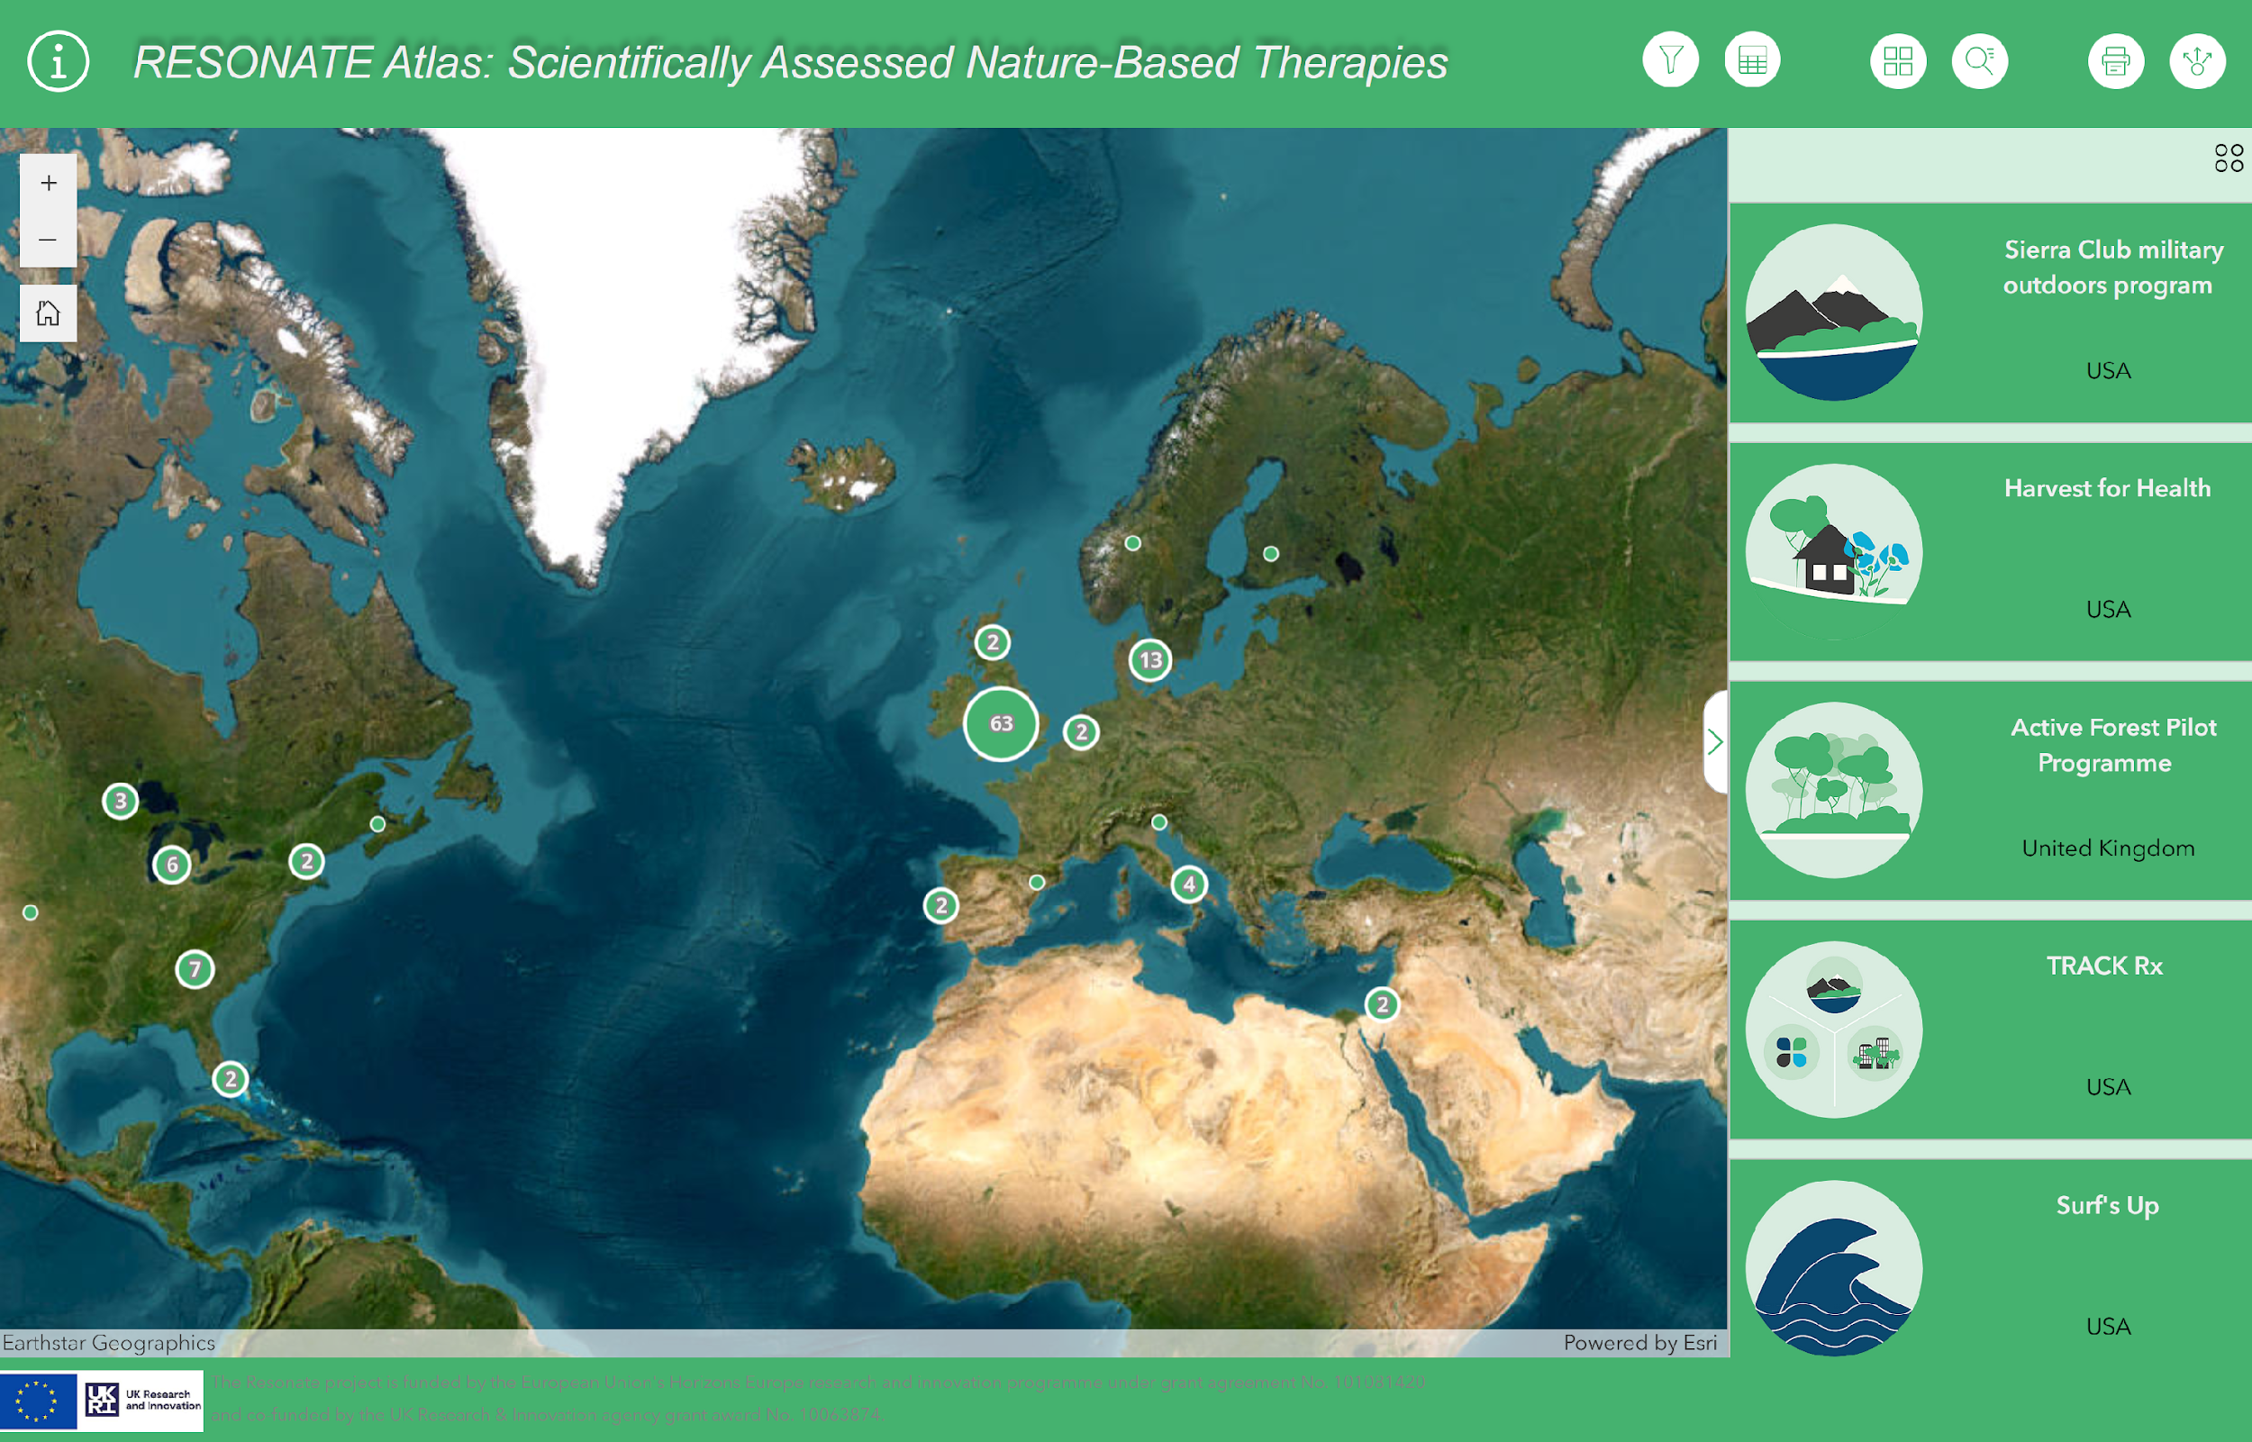
Objectives of the WP2
Scoping Review (Database: Scientifically assessed NbIs AND implemented in practice)
RESONATE Atlas (WebGIS: Mapping tool)

Slide 3
Updates - Global Spotlight Series
Event | Date | Format | Title | Location | Organizers/Participants
1 | Sept 19 2025 14:00 CET | presencial | Challenges of a fragmented governance system in implementing nature-based interventions in Italy | Padova/Italy | Ilaria Domio
2 | Oct 14 2025 11:00 CET | online | Nature’s Role in Urban Well-being: The Impact of Green Spaces in a Tropical City-State | Singapore | Jocelin Yingfen, Rachel Oh, Angelia, Sia
3 | Oct 15 2025 10:00 CET | online | Roots of Wellbeing: Community Connections Through Nature | UK | Nina Smyth, Carly Wood
4 | Oct 17 2025 16:00 CET | online | Nature-based Interventions in Latin America - From Research to Practice: Overcoming Barriers and Building Strengths. | Brazil + Ecuador | Giulia Catissi de Lima; Eliseth Ribeiro Leao; Gabriela Elizabeth Garcia Velez; Roberta Maria Savieto
5 | Oct 27 2025 9:30 CET | presencial | TBD | South Korea, Cheong Ju | Won Sop Prof. Bum-Jin Park
6 | Nov 19 2025 13:00 CET | presencial | TBD | DACH Region (Germany, Austria, Switzerland) | Addi Walla
7 | Nov 24 2025 17:00 CET | online | The Space Between: Nature as a Place to Heal and Reconnect | USA | David Victorson
8 | Nov/Dec | online | Youth aspect and cultural aspect and what that means in an African context OR Gender equity, safety | Southern Africa | Heidi Albert
9 | Dec 11 2025 | online | Gender and NbTs - How can gender affect the effectiveness of nature-based interventions? | Global | Anna Bornioli (ISGlobal)
10 | Dec | presencial | Research on NbT (Systematic review results, key findings on methodologies, conduct a scoping review on complex interventions) | Global | Matilda van den Bosch
11 | jan | tbd |  | Australia | Thomas Astell-Burt
12 | Jan | presencial | The sea heals - but why, for whom and where? | Barcelona/Spain | Monica Ubalde + ISG team
13 | Jan | tbd | Putting a square in a round hole - Incorporating nature-based therapy to the health care system | Quebec | Marie-Ève Langelier
14 | Dec | online | Marine therapies/surf therapies | Potentially Portugal + Australia + NZ (Portugal) | In Progress

Slide 4
Padova’s Spotlight: Nature-Based Therapies in Italy
What’s Happening and the Value of Creating Connections
To explore recent trends and development in nature-based therapies (NBTs) in Italy highlighting national and international experiences – from global mapping initiatives to forest therapy, mountain therapy, and local resilience networks.
The event aims to foster dialogue on how nature-based therapies can support community health, well-being, and resilience, while also addressing opportunities for collaboration and policy development in Italy.

Slide 5
AGENDA
14:30 Welcome and introduction 14:35 Global mapping of NBTs (English) | Mat White, University of Vienna 14:45 Forest Therapy in the National Rural Network Project: Towards a Law Proposal | Raoul Romano & Rosa Rivieccio, CREA 15:00 The Experience of the Mountain Therapy Network | Massimo Galiazzo, SiMonT 15:15 Co-building a Network for Nature-based Therapies in Padua: The Resilience Hub Experience | TESAF, University of Padua & Etifor | Valuing Nature 15:30 Open Discussion and Q&A 15:55 Closing remarks

Slide 6
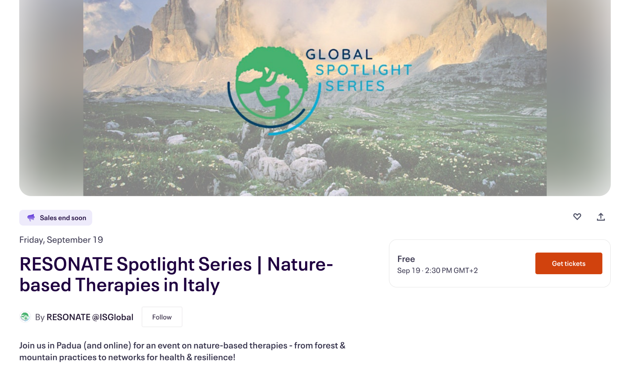
Link to register
43 total attendes
27 are attending online
17 are attending in person

Slide 7
Upcoming challenges
For the spotlight series, we will be short 1-3 events and are looking for volunteers to host a session
Anticipate concerns from participants who are not included in the global atlas produced by WP2
Still not entirely global as there are gaps in coverage of the spotlight series
Potential challenges with mixed-language, hybrid events and the ability to facilitate/moderate the sessions under these circumstances

Slide 8
Publication ideas + Needs for collaborations
Write here

Slide 9
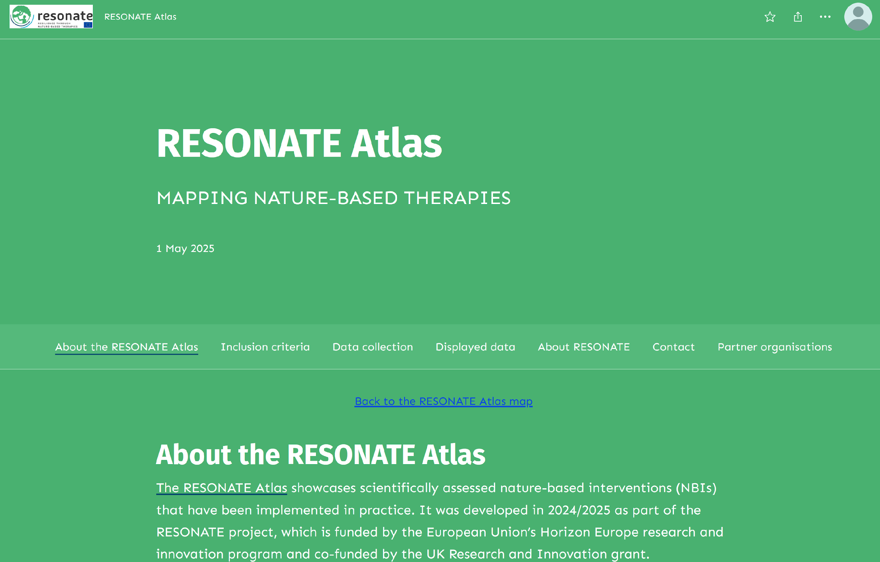
Timeline and next steps
RESONATE Atlas:
Adjusted for smartphone use
Spice up the ABOUT webpage
Afterlife beyond the RESONATE project (e.g. Editable version curated by UNIVIE?)

Slide 10
Thank you
The Resonate project is funded by the European Union’s Horizons Europe Research and Innovation programme under grant agreement No. 101081420 and co-funded by the UK Research and Innovation grant award No. 10063874

