Slide 1





CS9 Care farms
The Resonate project is funded by the European Union’s Horizons Europe Research and Innovation programme under grant agreement No. 101081420 and co-funded by the UK Research and Innovation grant award No. 10063874

Slide 2
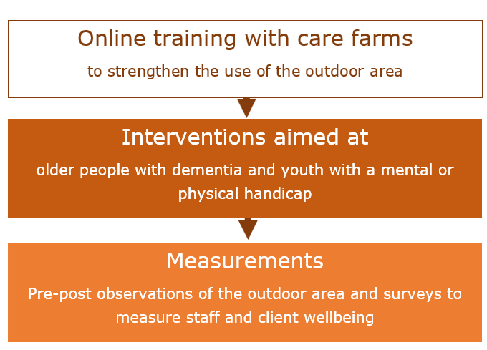
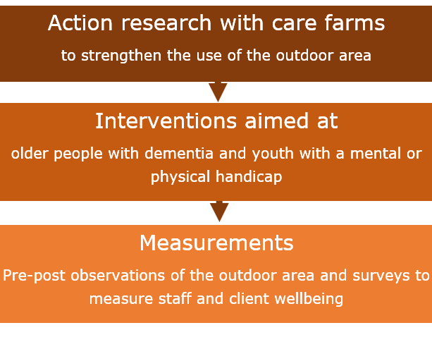
Recap: Study design CS9
Phase 1 - 2024
Phase 2- 2025
→ 4 papers

Slide 3
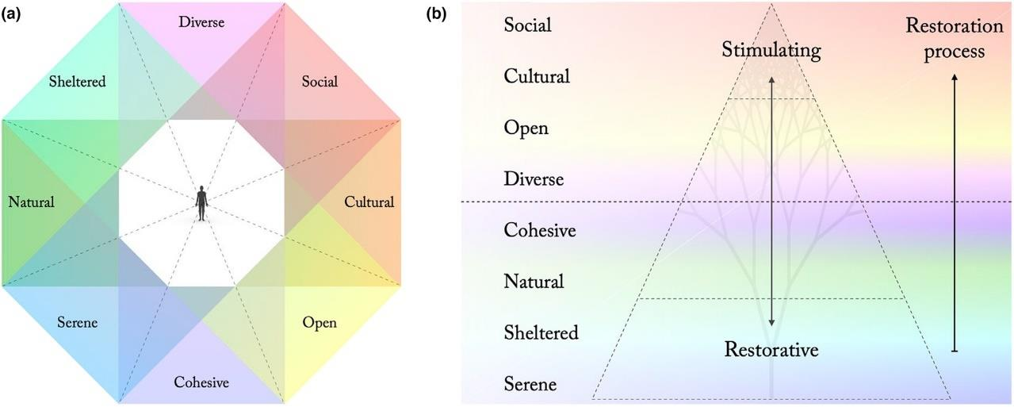
Paper 1: Observation tool
Based on Perceived Sensory Dimensions
Status: in preparation
Van den Berg, A. E., Van den Berg, M.M.H.E., Venema, J. & Van Rompay, T (2025). An outdoor area evaluation tool for healthcare settings. Environment and Planning

Slide 4
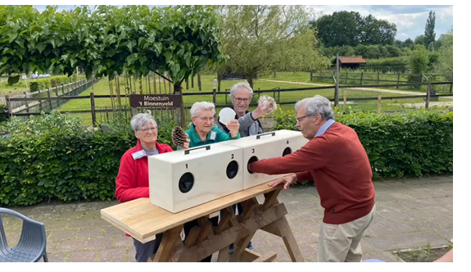
Paper 2: Action research at care farms
Status: concept
Van den Berg, A. E., Van den Berg, M.M.H.E. & Van Rompay, T (2025). Action research for a better use of the outdoor area at care farms. Environmental Research.

Slide 5



Paper 3: Walk of Life
A grassroot initiative to support people with mental problems
Status: submitted
Van den Berg, A. E., Klemann, K. & Van Rompay, T (2025). Walk of Life: A Grassroots Nature-Based Coaching Initiative complements formal Mental Healthcare. Environmental Psychology Open.

Slide 6
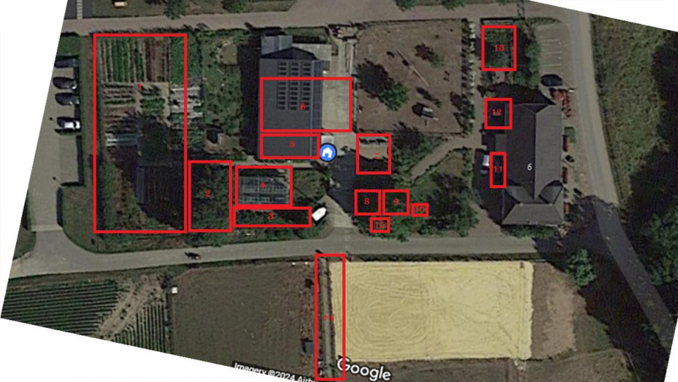
Paper 4: Design implications for green spaces at healthcare settings
Status: forthcoming
Van Rompay, T. J. L., M.M.H.E, Kranenburg, M. & Van den Berg, A.E. (2025). Promoting resilience in the outdoor area: A design perspective. Journal to be decided.

Slide 7



Thank you
CS9 Team
The Resonate project is funded by the European Union’s Horizons Europe Research and Innovation programme under grant agreement No. 101081420 and co-funded by the UK Research and Innovation grant award No. 10063874

Slide 8
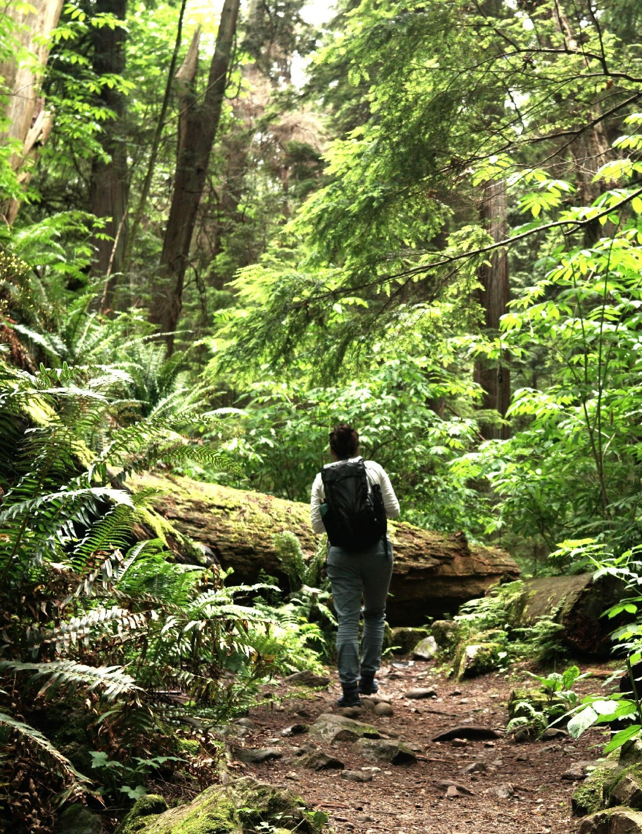
CS7
Uppsala University
Freddie Lymeus
AM25 Padova - 18/09/2025
The Resonate project is funded by the European Union’s Horizons Europe Research and Innovation programme under grant agreement No. 101081420 and co-funded by the UK Research and Innovation grant award No. 10063874

Slide 9

Objectives of the CS
Factorial RCT for students with common mental health symptoms:
ReST (nature+mindfulness)
HMOU (nature)
MBSR (mindfulness)
passive control

Slide 10
Objectives of the CS
Build evidence for NbT’s vs feasible alternatives
Disentangle nature- and mindfulness-effects
Scale up and out from earlier projects (large N, two cities)
Pilot a standardized ”stress management task” for evaluating resilience-building psychological interventions

Slide 11
Updates on data collection and analysis
Main RCT
Wave 1: N = 24
Wave 2: N = 68
Wave 3: N = 129
Wave 4: ongoing, target ≈ 40
Stress management task
N = 83 (finished)
Participant interviews
N = 24 done, N = 12 pending

Slide 12
Upcoming challenges
Final round of groups for remaining waitlist participants
Proper understanding of heart rate data
Statistical considerations and execution (ITT, missing data, multiple testing...)

Slide 13
Publication ideas
+ Needs for collaborations
Evaluation of/with the stress management task (Hampejs, Hartl, White....)
Types/qualities of NbT nature engagement (Spiegelaar, Stahl, Elliott...)
Roles of intervention acceptability, experience and compliance (conditional process analyses)

Slide 14
Publication ideas
+ Needs for collaborations
Main RCT evaluation: self-reported mental health and resilience outcomes (MLM support, possible evaluator blinding...)
6-month follow-up of mental health and resilience (same as above)

Slide 15
Timeline and next steps
Final wave Sept-Oct 2025
Final long-term follow-up Apr 2026
Analyses and writing up of stress management and interview data (starting November)
Analyses and writing up of self-reported health & resilience outcomes, acceptability & compliance (starting spring ’26)

Slide 16
Thank you
The Resonate project is funded by the European Union’s Horizons Europe Research and Innovation programme under grant agreement No. 101081420 and co-funded by the UK Research and Innovation grant award No. 10063874

Slide 17

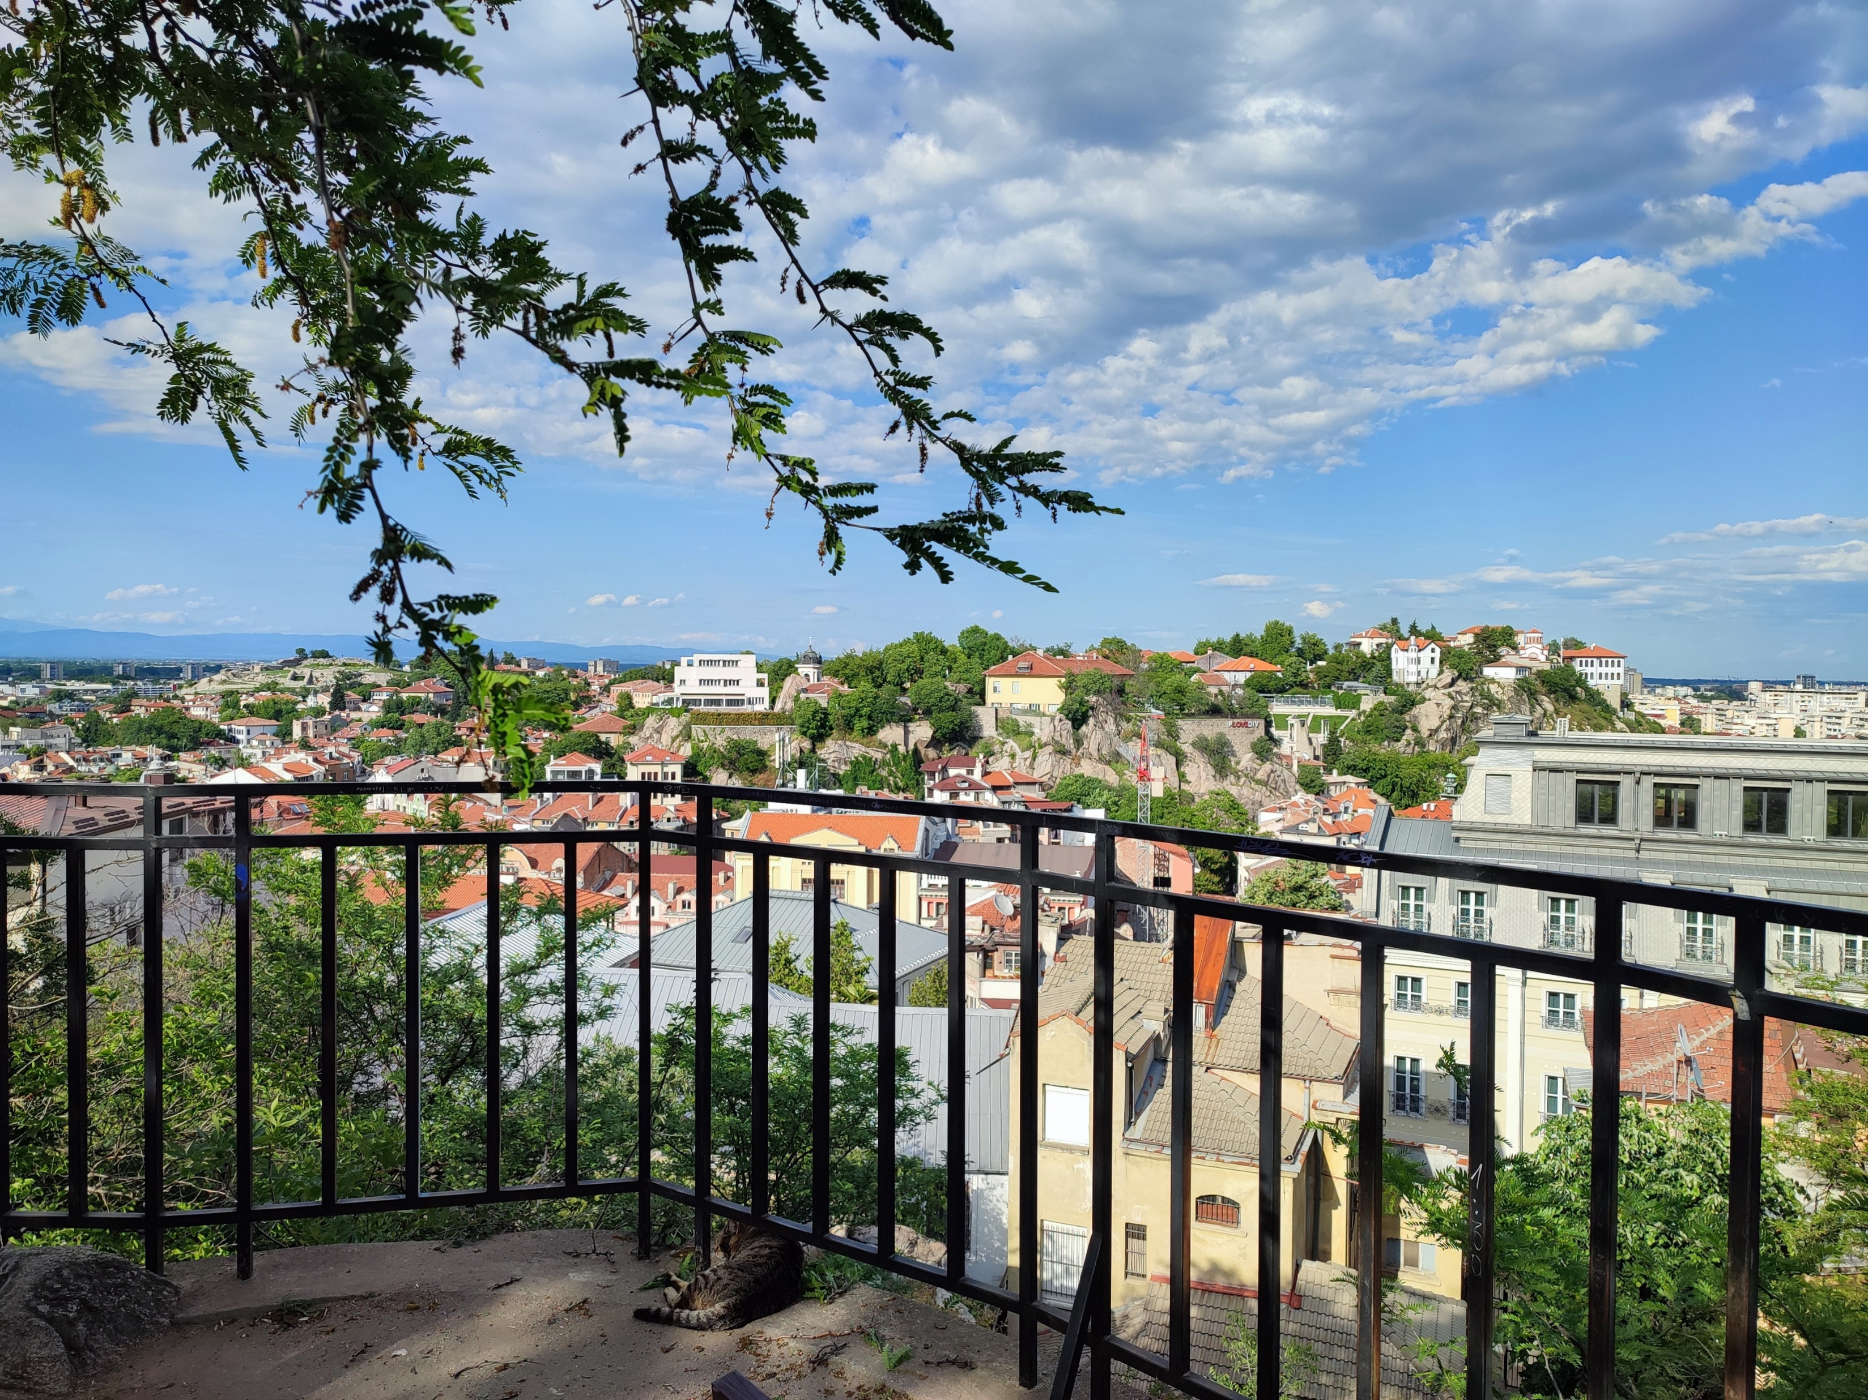
Case Study 3
Angel Dzhambov
Environmental Health Division,
Research Institute,
Medical University of Plovdiv, Plovdiv, Bulgaria
AM25 Padova - 18/09/2025
The Resonate project is funded by the European Union’s Horizons Europe Research and Innovation programme under grant agreement No. 101081420 and co-funded by the UK Research and Innovation grant award No. 10063874

Slide 18
Objectives of CS3
Explore the frequency, duration, and form of habitual exposure to green/blue spaces and, in general, contact with nature
Explore the contribution of nature contact to different types of biopsychosocial resilience and, through that, mental/physical health
Test if nature contact mitigates the impact of everyday and environmental stressors on mental and physical health via enhanced biopsychosocial resilience
Explore the underlying pathways linking nature contact, resilience, and mental health, including the potential of nature contact to buffer the impact on mental health of harmful physical exposures
Explore the patterns and determinants of proenvironmental behaviours and attitudes

Slide 19
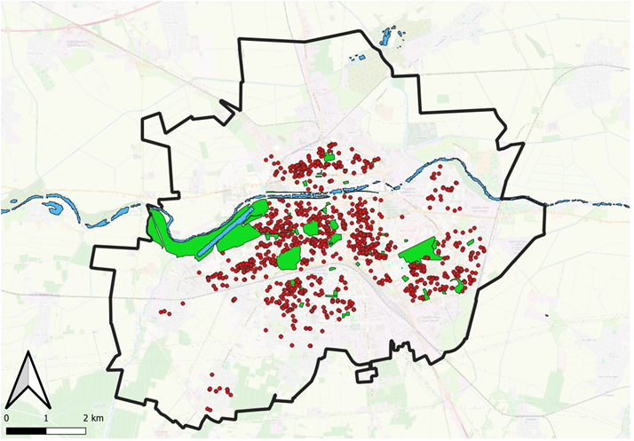
Updates on survey data collection
Data collection completed on 20.06.2025
    First wave (May-July 24): N=1506
    Second wave (Oct-Dec 24): N=1348
    Third wave (May-June 25): N=1103
27% attrition

Slide 20
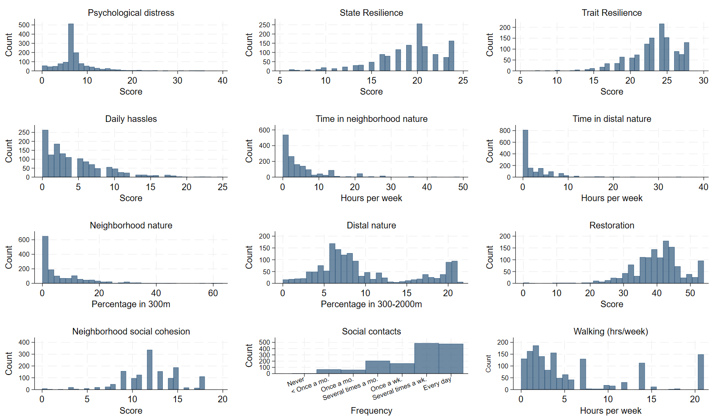
Survey data
Participant characteristics (Wave 1):
  Age: 48 (18-94) years
  Female: 53%
  Bulgarian: 92%
  Primary/no education: 9%
  Representative of the city population

Slide 21
Update on laboratory data collection
1st Wave data collection completed on 28.05.2025 (N=256)
    Questionnaire completed: May 2024-Mar 2025
    Blood collected: Oct 2024-Mar 2025
Original sample N=62 (24%)
    Age: 55 (20-76) years
    Female: 76%
    Bulgarian: 97%
    Primary education: 6%
Snowball sample N=194 (76%)
Age: 49 (19-87) years
Female: 71%
Bulgarian: 99%
Primary education: 0%
2nd Wave data collection completed on 09.09.2025 (N=170, 34% attrition)
      Questionnaire completed: May 2025-July 2025
      Blood collected: June 2025-Sep 2025

Slide 22
Updates on laboratory data
HBA1C
Cortisol
CRP
NK cells
IL-6
IL-10
TNF-a
Thyroid disease N= 40 (16%), CVD N=38 (15%), Diabetes N=17 (7%), Autoimmune N=17 (7%), Kidney disease N=4 (2%), Liver disease N=3 (1%), Leukemia ~2 (1%)

Slide 23
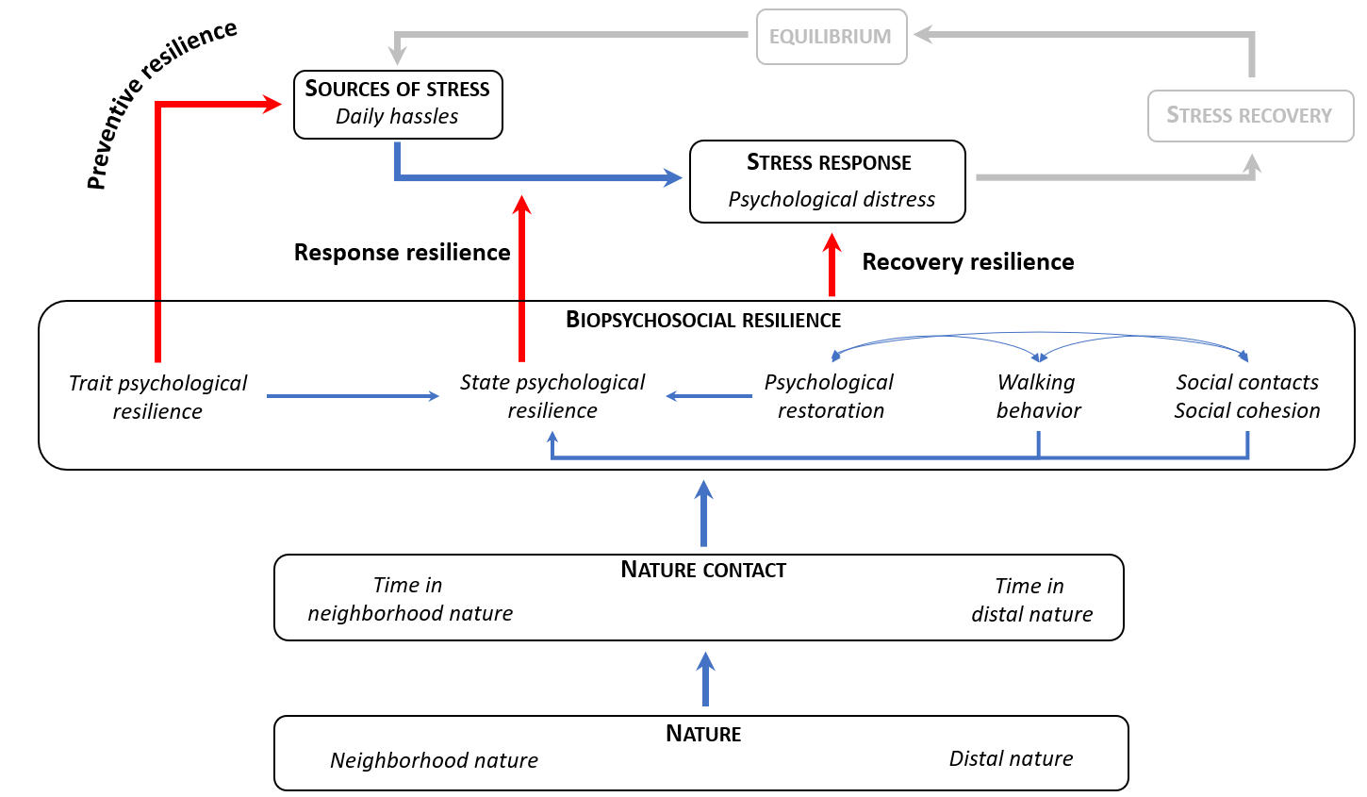
Testing NBRT with the CS3 Wave 1 survey data

Slide 24
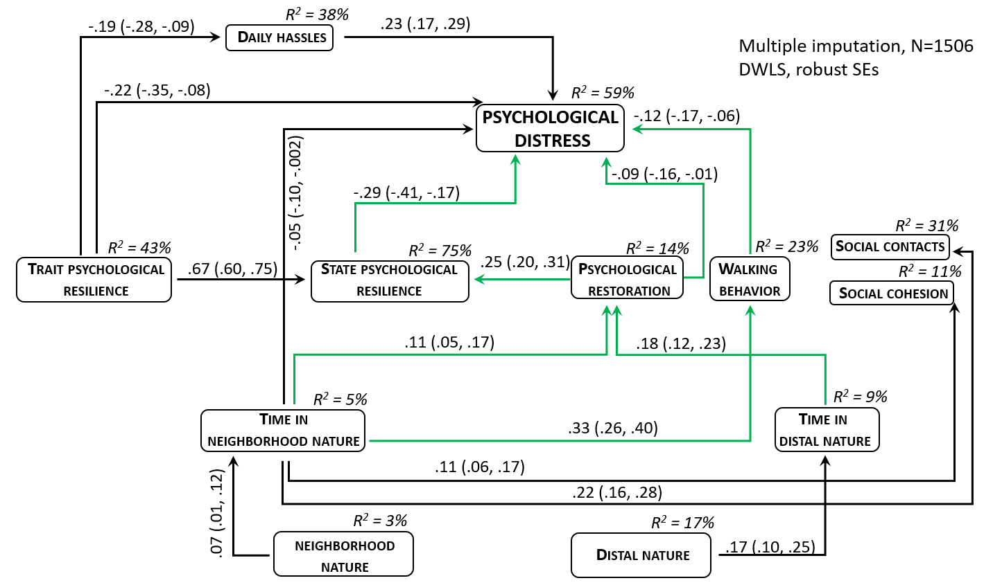
Nature contact associated with better mental health via a series of pathways involving resilience
Model fit:
χ² ₍₅₀₎ = 442.07, p < 0.001
CFI = 0.92
RMSEA = 0.06
SRMR = 0.06
PNFI = 0.23
Variables not displayed:
Age, Gender, Ethnicity, Education, Marital Status, Perceived Income

Slide 25
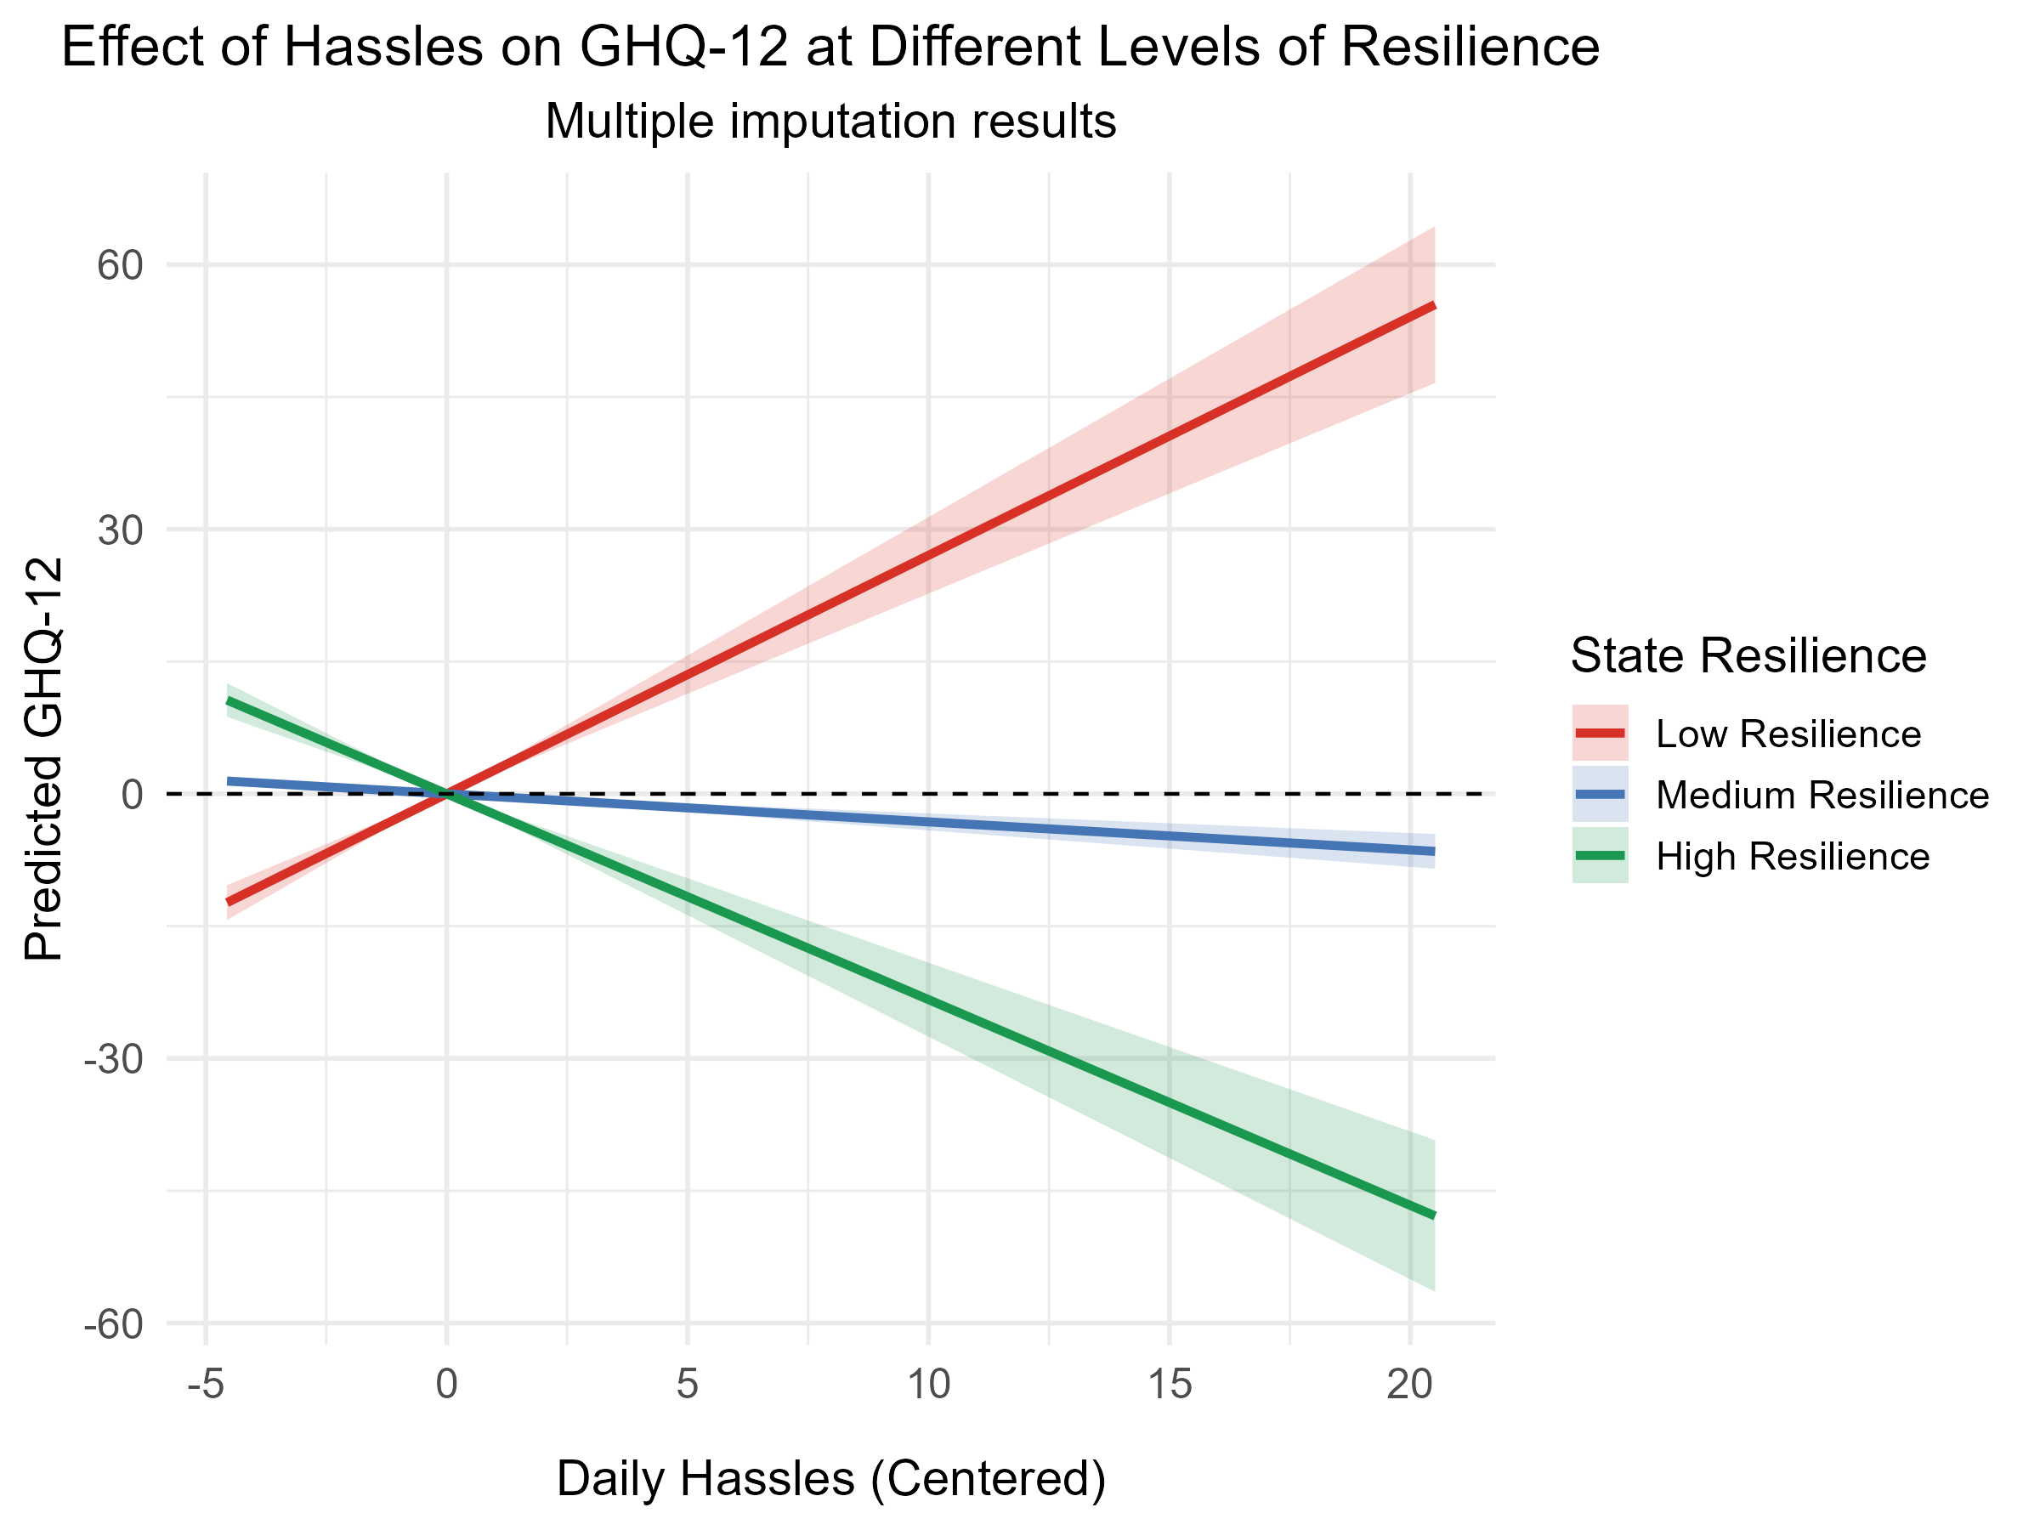
Resilience buffers the effect of daily hassles on mental health but not because of nature contact
Interaction “state resilience*daily hassles” = -0.50 (-0.59, -0.42)
Index of mediated moderation (“nature time->state resil.” * ”interaction term->GHQ-12”)
= 0.0001 (-0.02, 0.02) for neigh. nature time
= -0.02 (-0.03, 0.002) for distal nature time

Slide 26
Publication ideas
+ Needs for collaborations
Nature resilience mediated moderation paper – collaboration with UniVie, UU …
Natural and built environment exposures and biomarkers paper – collaboration with PMU (CS5), UniVie …
Nature and loneliness paper – collaborations with ISG, UniVie, UU, Iana Markevych

Slide 27
Timeline and next steps
Nature resilience mediated moderation paper – completed by the end of 2025
Data management and cleaning of laboratory datasets – completed by the end of 2025
Linkage of additional GIS variables to all survey waves – Spring 2026
Deliverable D3.1 – Level 1 CS synthesis report – M34 (March 2026)
Natural and built environment exposures and biomarkers paper – completed by Spring 2026
Nature and loneliness paper – completed by Summer 2026

Slide 28
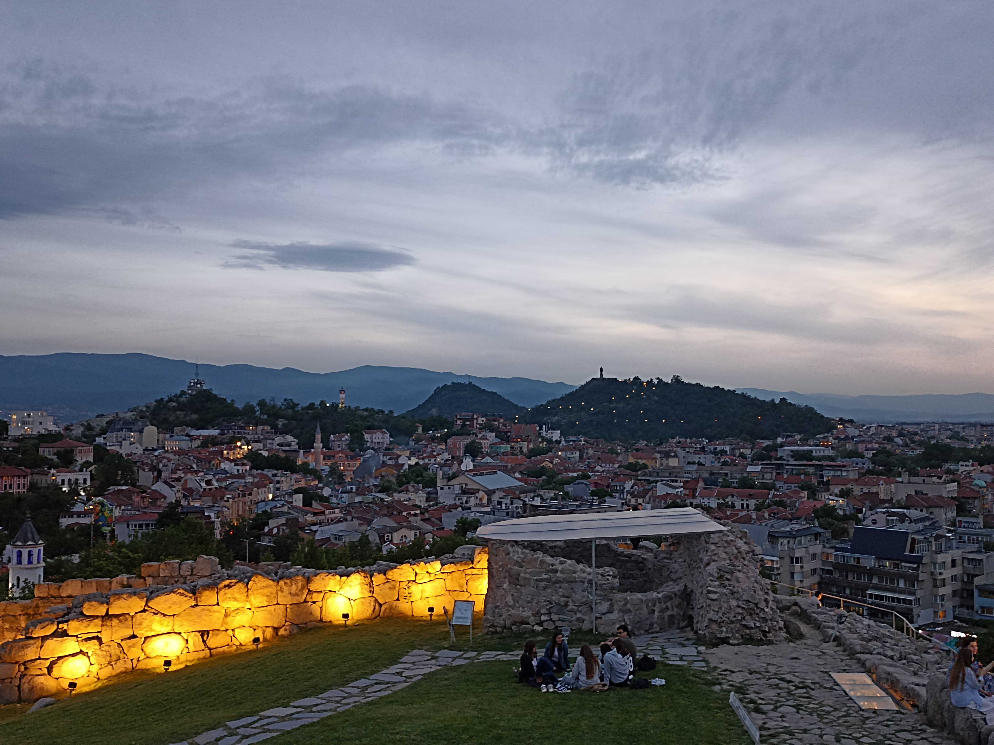
Thank you
Angel Dzhambov
Enviroentmal Heath Dsiviosn,
Research Insittue at MU-Plovdiv
angel.dzhambov@mu-plovdiv.bg
The Resonate project is funded by the European Union’s Horizons Europe Research and Innovation programme under grant agreement No. 101081420 and co-funded by the UK Research and Innovation grant award No. 10063874

Slide 29
Case Study 2
University of Exeter
Leanne Martin
AM25 Padova - 18/09/2025
The Resonate project is funded by the European Union’s Horizons Europe Research and Innovation programme under grant agreement No. 101081420 and co-funded by the UK Research and Innovation grant award No. 10063874

Slide 30
CS2 Objectives
Examine whether nature exposure attenuates adverse mental health trajectories associated with societal (e.g. Covid-19) and individual-level (e.g. major life events) stressors.
And if so, are nature-wellbeing associations mediated by better psychological and/or social resilience.
3 sub- studies:
      Secondary analysis of the UCL Covid-19 Social Study
      Secondary analysis of PROTECT data (pre, during and post Covid-19)
      Bespoke survey - PROTECT participants who experienced a stressful life event (e.g. divorce, bereavement).

Slide 31

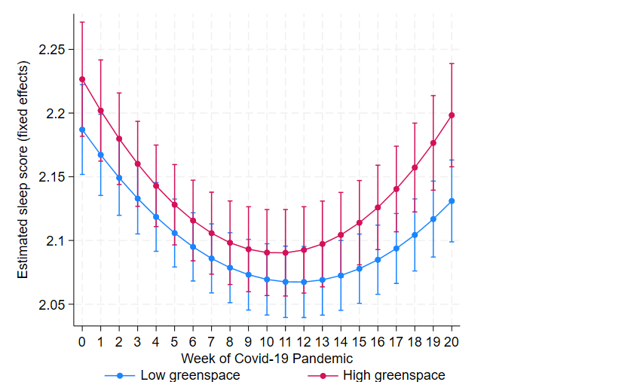
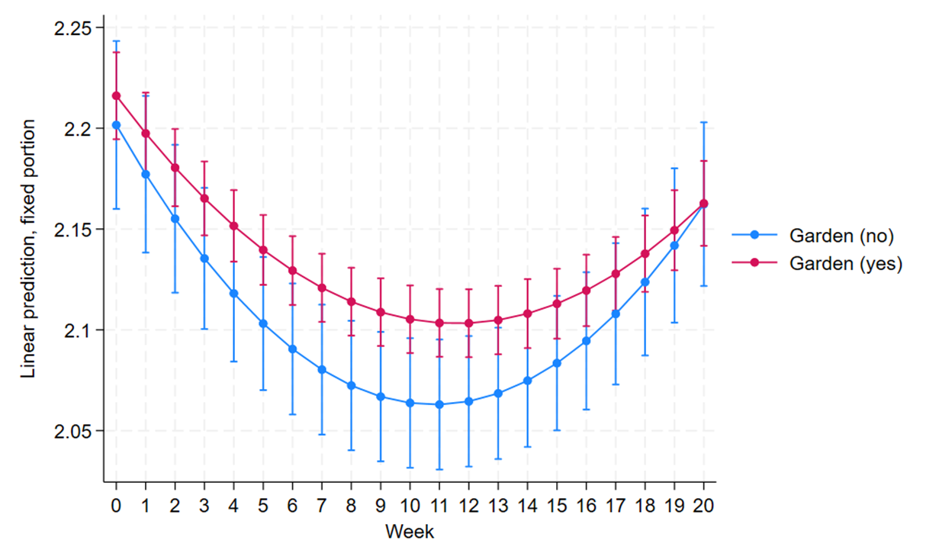

Updates on data collection and analysis
UCL Covid-19 Social study (N = 12,903)
1) Did nearby nature exposure attenuate adverse sleep trajectories during the COVID-19 lockdown?
  2) And if so, are nature-sleep associations mediated by better psychological resilience (mental wellbeing)?
Evidence of nature buffering stress?
Response resilience
Recovery resilience
Evidence of mediation via mental wellbeing?
Preliminary evidence that is does, but…
Notes:
Completed the analysis of the first RQ using Latent Growth Curve Models (LGCM).
Keep brief and focus on main findings…. sleep trajectories during weeks of the lockdown as a function of having a garden….
Both groups have classic u shape – where we see a general decline in sleep during the first several weeks of the pandemic, followed by a steady return to near baseline levels. (This is broadly what has been demonstrated in other covid-sleep studies).
Terms of resilience Week 0–10: Clear difference — those with gardens (red) consistently report better sleep than those without. The group without gardens shows a deeper and longer dip in sleep quality.
Evidence of response resilience = supports garden access as a buffer to the sleep-disrupting effects of early pandemic stress.
In terms of recovery resilience - Week 10–20: Both groups improve, but the garden group maintains a higher level of sleep quality throughout.
Suggests continued benefit from gardens — they aid not just protection but support ongoing recovery.
In terms of mediation via mental wllebing, we found preliminary evidence to support this hypothesis but this analysis is stillonging.

Slide 32

Updates on data collection and analysis
UCL Covid-19 Social study (N = 12,903)
Unbalanced dataset with 20 timepoints and a quadratic time effect
Approach | Mediation Type | Captures Time? | Strengths | Limitations
SEM with shared random intercept | Concurrent (same-wave) | Nonlinear trend (week + week²) + clustering | Feasible, interpretable, adjusts for repeated measures | Doesn’t model trajectories; mediation only contemporaneous
Two-step LGCM (BLUPs) | Approx. trajectory-level | Yes (slopes + quadratic) | Easy to run, lighter than full LGCM | BLUPs treated as observed → attenuates effects
Parallel-process LGCM | Latent trajectory-level | Yes (growth factors for both outcomes) | Gold standard for developmental mediation | Very heavy; convergence issues with 20 waves + covariates
Wave-by-wave SEM | Cross-sectional snapshots | No (separate per wave) | Simple, identifies when mediation strongest | Ignores clustering & longitudinal structure
Notes:
20-wave unbalanced dataset, quadratic time effect, makes modelling longitudinal mediation challenging.
Several approaches feasible more feasible (SEM with shared intercept, Two-step LGCM, wave-by-wave SEM).
BUT Parallel-process LGCM = gold standard but computationally heavy → so far resulted in convergence issues.
Currently refining model specifications to overcome this -

Slide 33

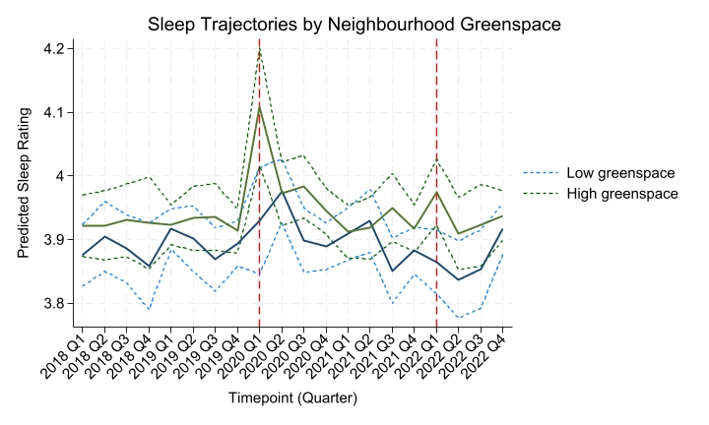
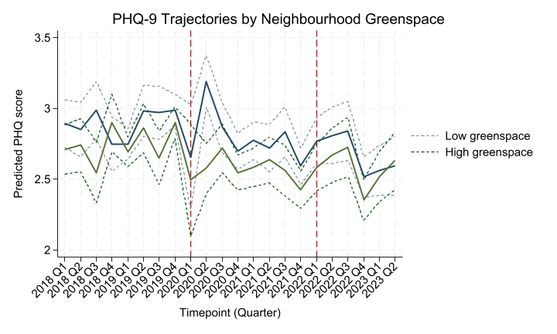
Updates on data collection and analysis
PROTECT secondary data (N = 13,110)
Datasets cleaned and merged with environmental data (LSOA greenspace, distance from coast)
Partially–adjusted LGCMs are looking promising but need further adjustment for Covid-19 covariates (missing from the original dataset).
Notes:
PROTECT data cleaned, linked with environmental measures (greenspace, coastal proximity).
Initial LGCM models are encouraging — showing plausible sleep and mental health trajectories.
Clear signal of Covid-19 period disruption (highlighted) across outcomes – which appears to differ as a function of neighbourhood greenspace
Next step: adjust fully for Covid-19 covariates which were missing in the original dataset and run the mediation models

Slide 34

Updates on data collection and analysis
PROTECT Nested Study
T1 PROTECT DATA (BASELINE)
2023-2024
Residential nature (LSOA)
T2 NESTED SURVEY (response resilience)
2024-2025
Nature measures (current and retrospective for T1)
T3 NESTED SURVEY (recovery resilience)
2025-2026
Nature measures
Wellbeing (GAD-7; PHQ-9)
Resilience (psych, social)
Wellbeing (GAD-7; PHQ-9)
Wellbeing (GAD-7; PHQ-9)
Resilience (psych, social)
PROGRESS:
Survey live: Jan 2025
344 participants completed.
3 months remaining until T2 data available
Notes:
Designed a bespoke nested survey, sent only to existing PROTECT participants who reported a stressful life event in the last six months.
This allows us to capture resilience processes (response and recovery) in real time.
Builds on PROTECT baseline data, adding targeted measures of nature, resilience, and wellbeing.
T2 survey live since Jan 2025, with 344 completions so far — full T1 dataset expected in 3 months.

Slide 35
Upcoming challenges
  Convergence issues for UCL Covid-19 Social Study mediation models
  Anticipated to be an issue for all datasets
Publication ideas
  Three (potentially four) papers:
          1) Does Nature Buffer the Impact of Stress on Sleep? A Longitudinal Analysis of Mediation through Mental Wellbeing in the UK (in prep)
          2) Executive Function as a Longitudinal Mediator Between Stress and Health Outcomes in Later Life: Evidence from the PROTECT Study
          3) Does Contact with Nature Buffer the Health Impact of Stressful Life Events? Initial Evidence from a Two-Year Longitudinal Study
          4) Nature as a Buffer Against the Health Impact of Stressful Life Events: Findings from a Two-Year Longitudinal Study
Notes:
Upcoming Challenges:
Convergence issues already evident in UCL Covid-19 Social Study mediation models.
Expect these challenges to arise across other datasets too, given complexity (many waves, unbalanced data, covariates).
Work underway to refine model specifications and test alternative estimation strategies.
Publications
At least three, possibly four papers planned.
UK study: nature, stress, sleep → mediation via wellbeing.
PROTECT: executive function mediating stress–health link.
Bespoke 2-year survey: Year 1 initial evidence + full dataset follow-up.

Slide 36
Timeline and next steps
UCL Covid Social Study - finalise mediation approach (Oct 25) and finish paper write up (November 25).
PROTECT secondary data – merge Covid-19 data/adjust models (winter 25) and write up paper (March 26)
Year 1 nested study analyses (Spring/ Summer 26)
Notes:
Winter 25 – time time for MUPs level 1 synthesis (D3.1) in Dec

Slide 37
Thank you
Leanne Martin | University of Exeter
The Resonate project is funded by the European Union’s Horizons Europe Research and Innovation programme under grant agreement No. 101081420 and co-funded by the UK Research and Innovation grant award No. 10063874

Slide 38

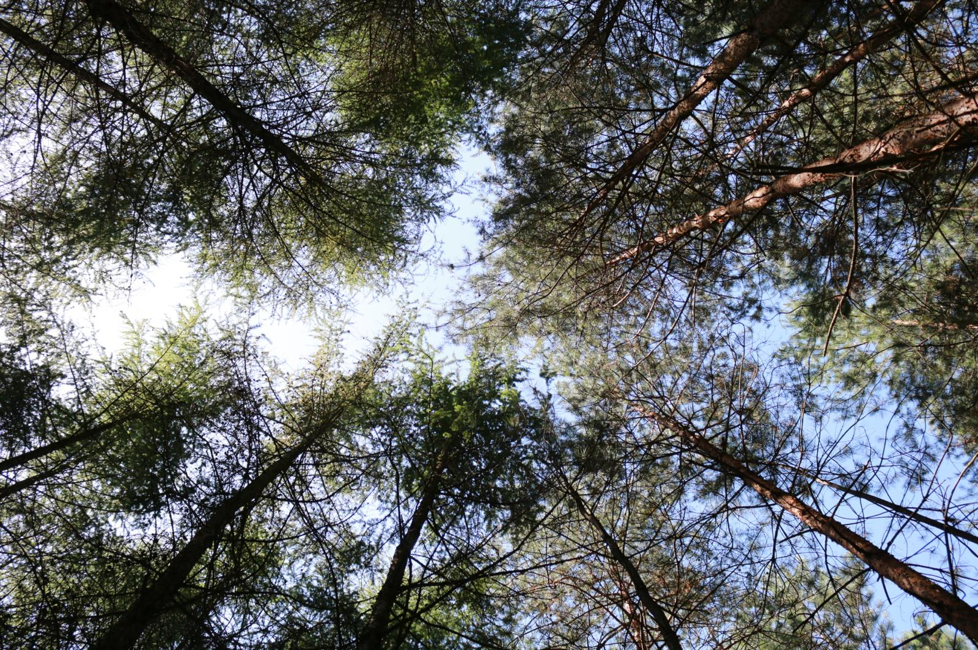
CS1 Associations between nature contact and well-being: mediation by self-efficacy
University of Exeter
James Grellier
AM25 Padova - 18/09/2025

Slide 39

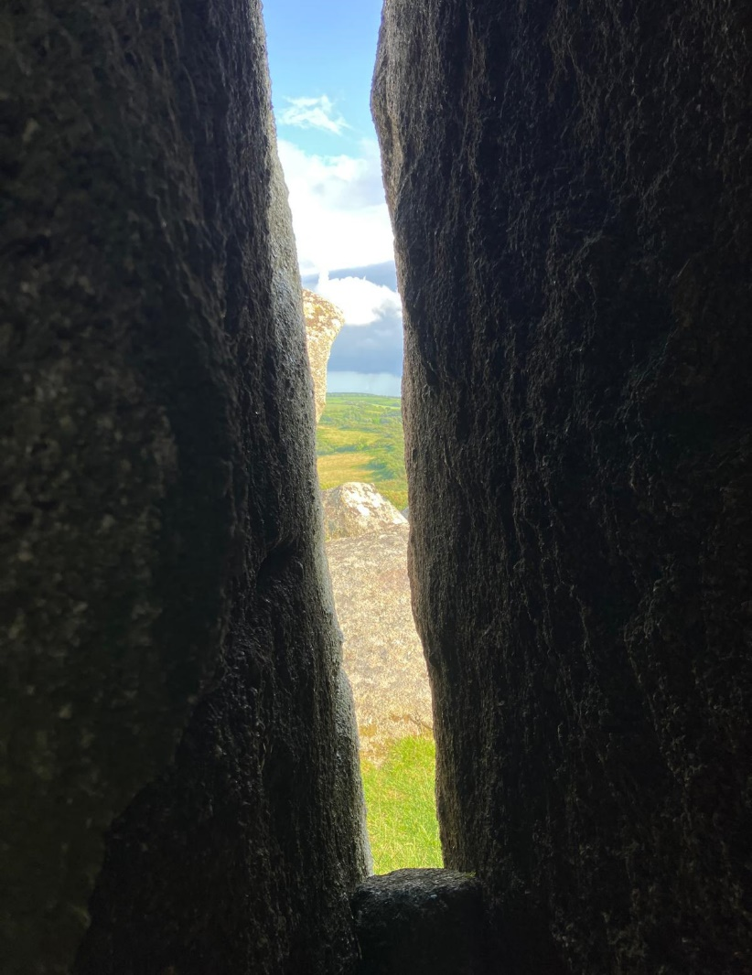
Objectives of CS1
Analysis of
secondary
longitudinal
panel survey
data
Research question
  Does contact with nature help adults build resilience (self-efficacy) that allows them to cope better (in terms of their subjective well-being) with stress (specifically, with increased volatility in their income)?
Hypotheses
  Higher nature contact is associated with higher levels of SWB (specifically GHQ-12 score (the “main effect” hypothesis).
  Association between nature contact and SWB in subsequent waves is due to increased resilience (specifically generalised self-efficacy) (the “mediation hypothesis”)
  Increase in income volatility attenuates the nature contact-SWB relationship; no change or a decrease in income volatility is associated with a stronger nature-SWB relationship (the “moderation hypothesis”).
UKHLS
www.understandingsociety.ac.uk

Slide 40
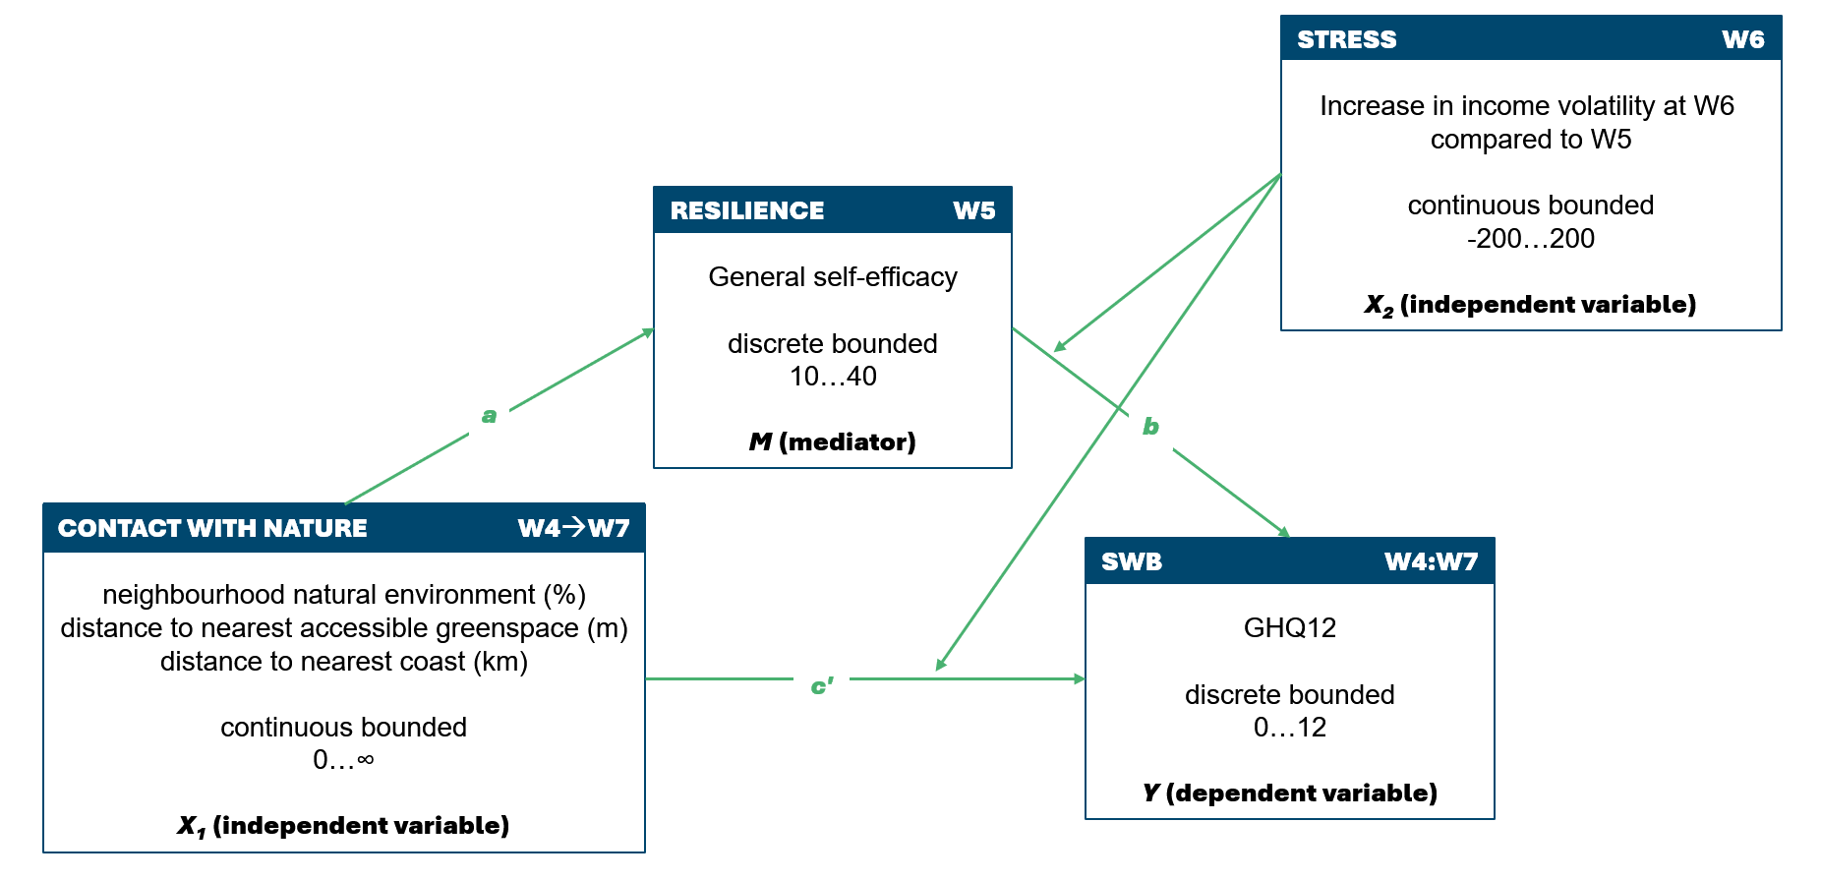

Slide 41
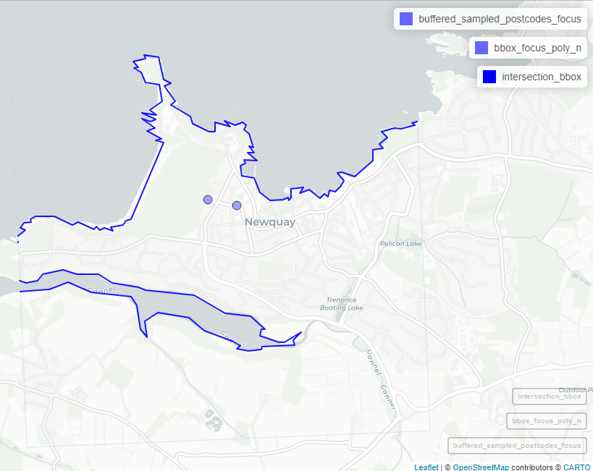
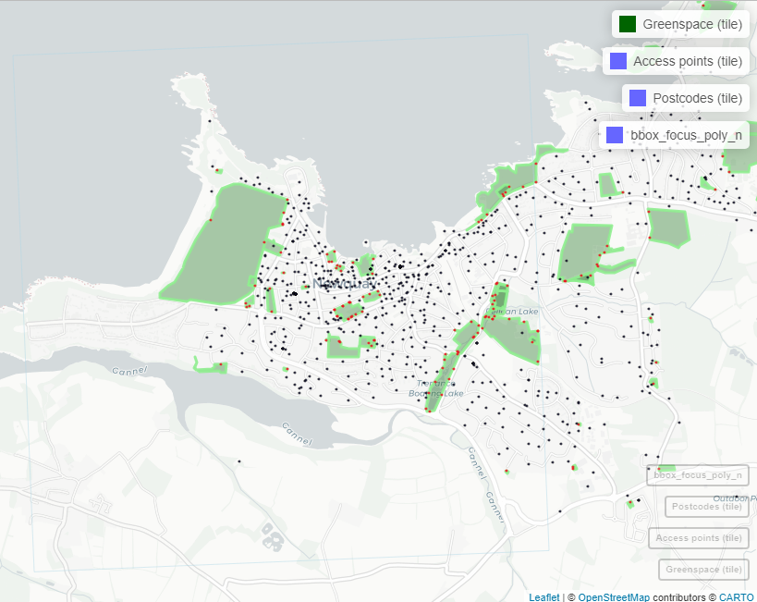
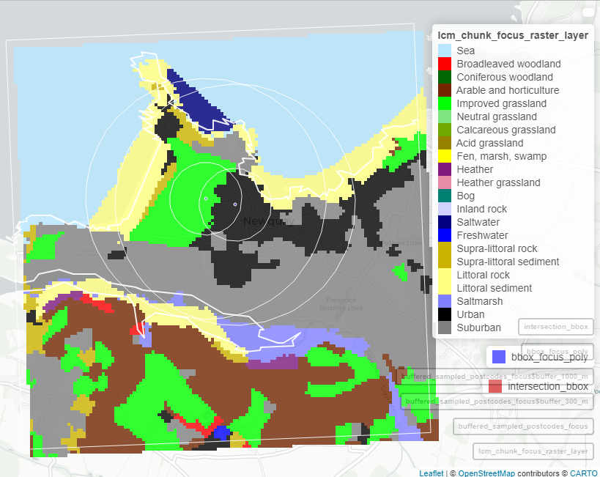
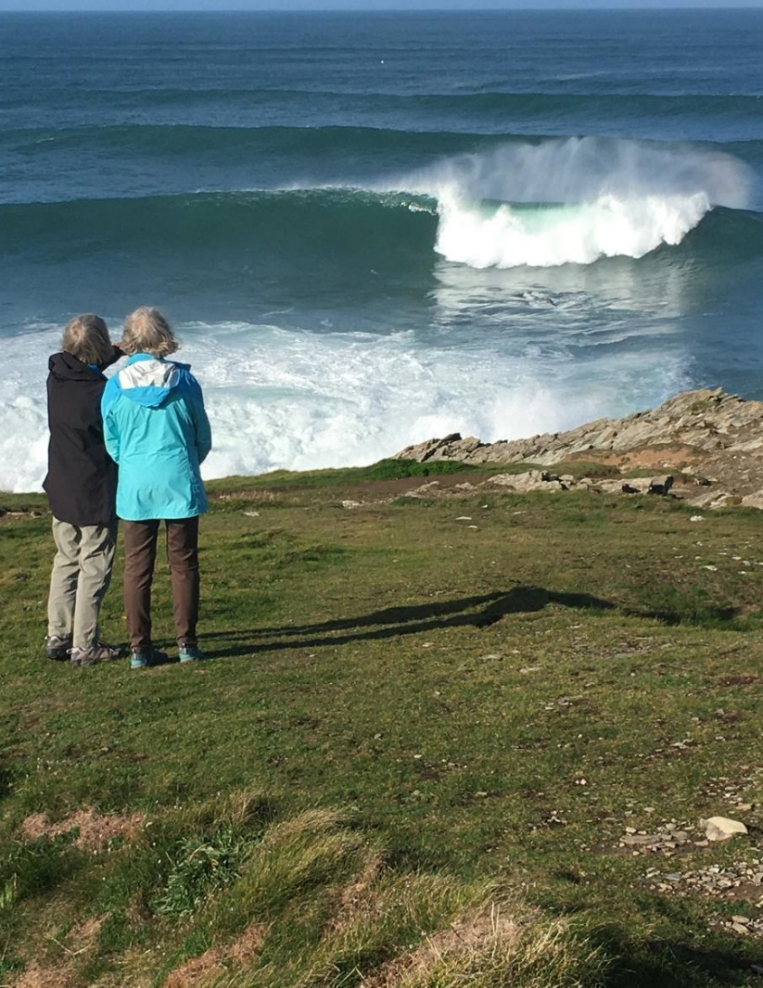
Update on data collection and analysis
        Three derived exposure metrics assigned to 2.5 million GB postcodes
          Proportions of 21 classes of land cover in 300m and 1000m radial buffers of postcode centroids
          Euclidean distance (m) to nearest greenspace and greenspace access points from postcode centroids
          Euclidean distance (m) to nearest coastline
        Draft structural equation modelling (SEM) script developed in R, using lavaan package
          Based on conceptual SEM
          Pending import into SecureLab
Notes:
All analysis takes place on the UKDataService SecureLab.
SecureLab is a highly secure environment on which all postcode-level UKHLS data analysis takes place.
For reference, a UK postcode typically contains up to 100 households, but usually is nearer to 15.
Producing nature exposure data can be done inside the SecureLab, but it is cumbersome, as data imports are all subject to application and approval processes, which take into consideration licensing issues etc.
I therefore decided to use Geographical Information Systems packages in R to produce full nature exposure data sets for every postcode centroid in Great Britain ~2.5 million postcodes.
The scale of the data made it necessary to implement chunked pipelines, avoiding memory overload and prohibitively long processing times.
These derived data have now been approved and imported into the SecureLab.

Slide 42
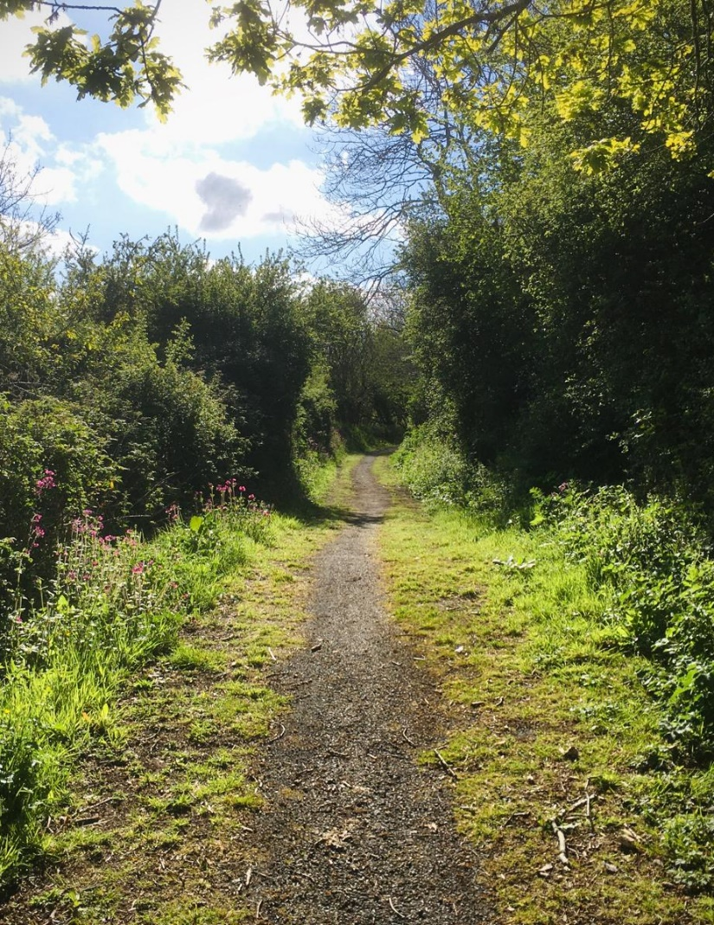
Upcoming challenges
Wrangling UKHLS data
  Very large data set: 40,000 households, 2,000-4,000 variables per wave
  Documentation
  Secure environment – import
  Managing disclosure risk – export
Analytical challenges
  Accounting for multiple respondents living in the same household (treatment of clustering in longitudinal/multilevel SEM? randomly select on respondent per household?)
  Weighting (necessary? use lavaan.survey?)

Slide 43
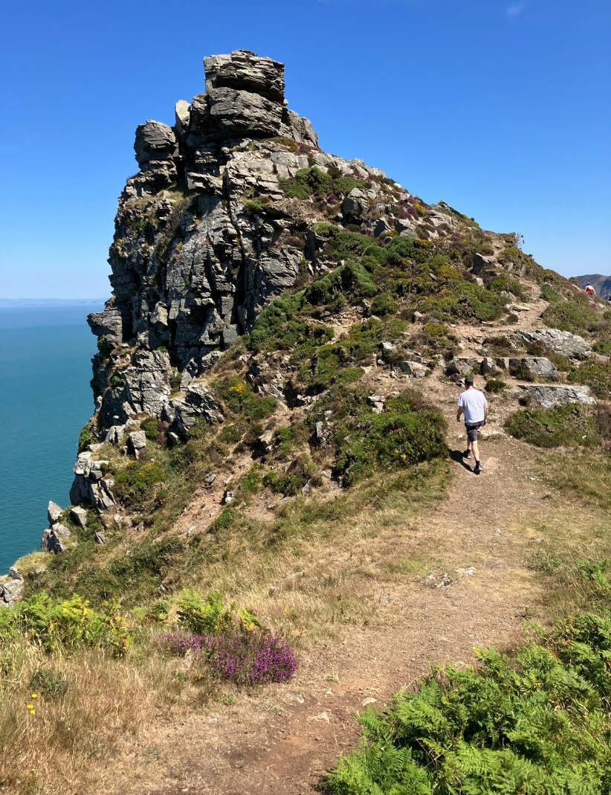
Publication ideas
+ Needs for collaborations
“The mediating role of self-efficacy in nature contact’s moderation of stress and wellbeing”
Aim to submit to Environ Int by March 2026

Slide 44

Timeline and next steps
Wrangle UKHLS data Sept 2025
Linkage between exposure metrics and UKHLS households/respondents Sept 2025
Run SEM and interpret results Oct 2025
Provide results to MUP for level 1 synthesis (D3.1) Dec 2025
Write manuscript and submit February 2026

Slide 45

Thank you
j.grellier@exeter.ac.uk

