Slide 1

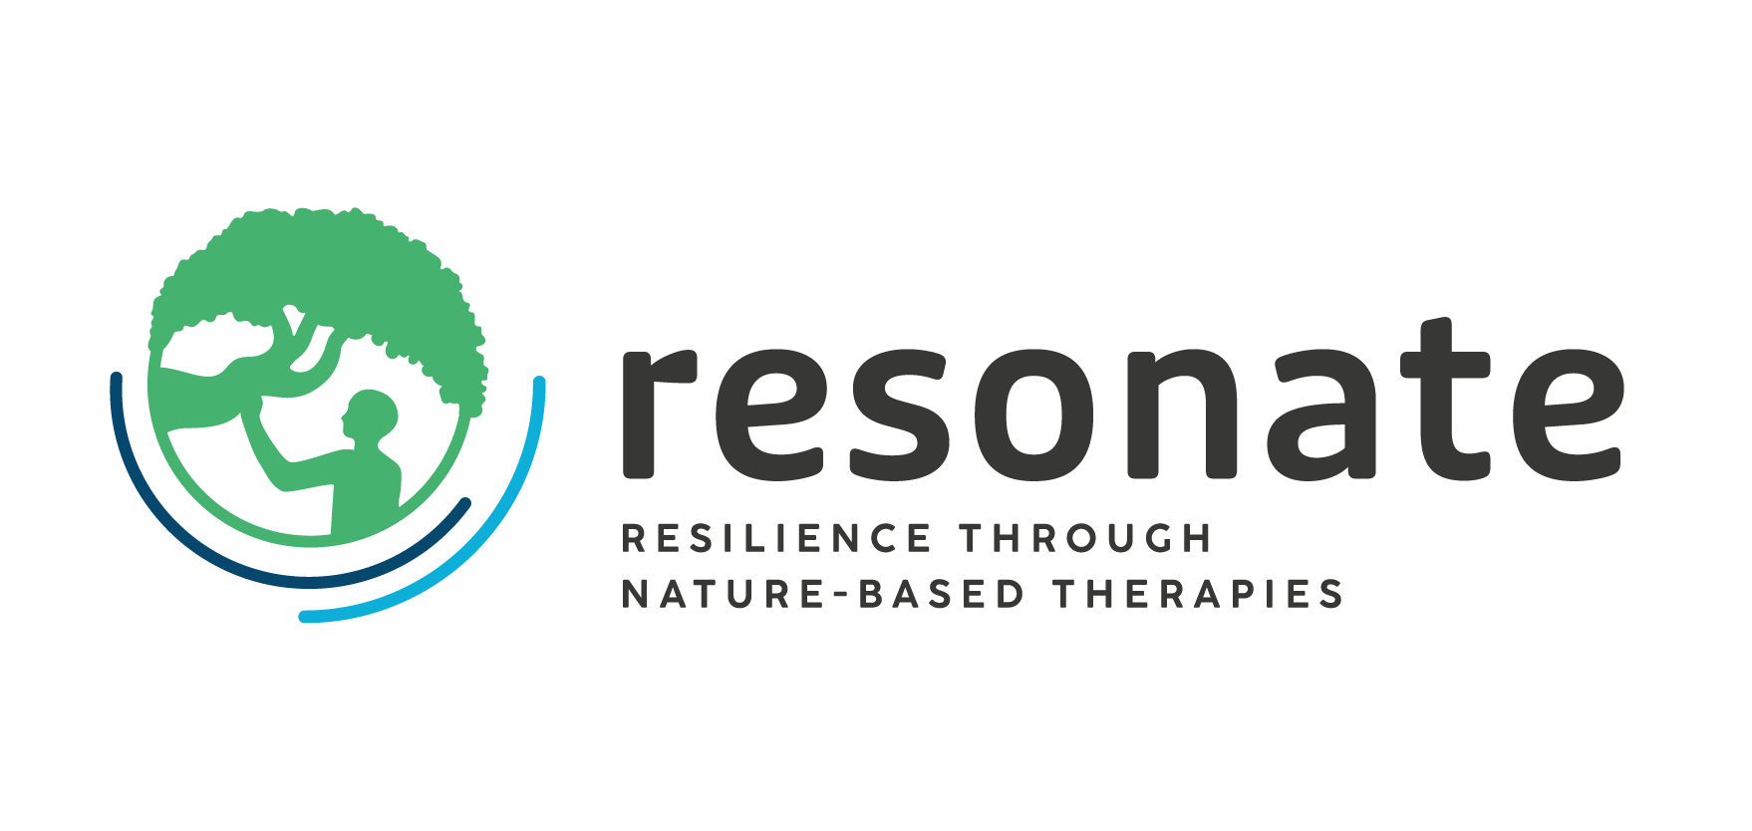


WP4 – Health Equity
Ensuring equitable outcomes for NbTs
EuroHealthNet: Sébastien Libert, Sofia Romagosa, and Afsaneh Nejat
AM25 Padova – 18 September 2025
The Resonate project is funded by the European Union’s Horizons Europe Research and Innovation programme under grant agreement No. 101081420 and co-funded by the UK Research and Innovation grant award No. 10063874

Slide 2

Objectives of WP4
Objective 1
Improve understanding of:
the distributional health impacts of NbTs
differences in access, capacity, opportunity and motivation, across different population groups
Activity: comprehensive and rapid Health Impact Assessments (HIAs) with CS4-9
Outcomes:
Policy recommendations to promote positive and mitigate negative health effects of NbTs → “What Works”? (WP8)
Objective 2
Greater clarity about:
the concerns, challenges, barriers, facilitators, needs and opportunities for health professionals to implement NbTs and increase uptake
Activity: literature review & interviews with health professionals
Outcome:
Guidance for health professionals on how to implement NbTs – accompanied by an online tutorial

Slide 3
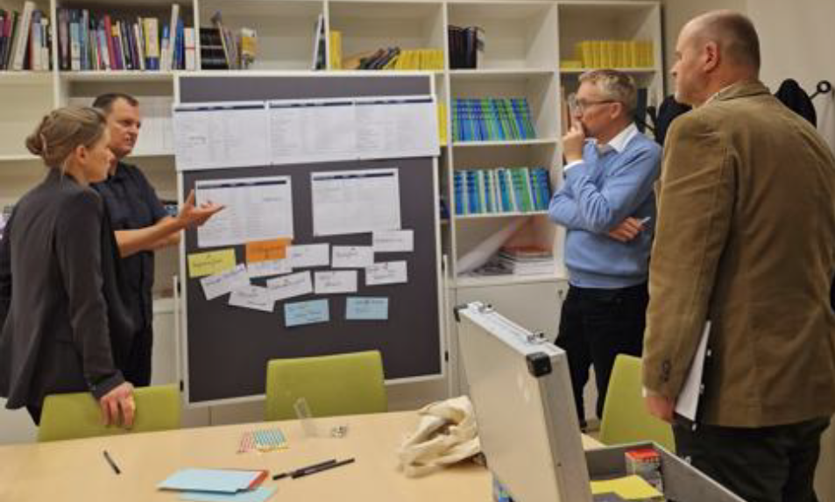
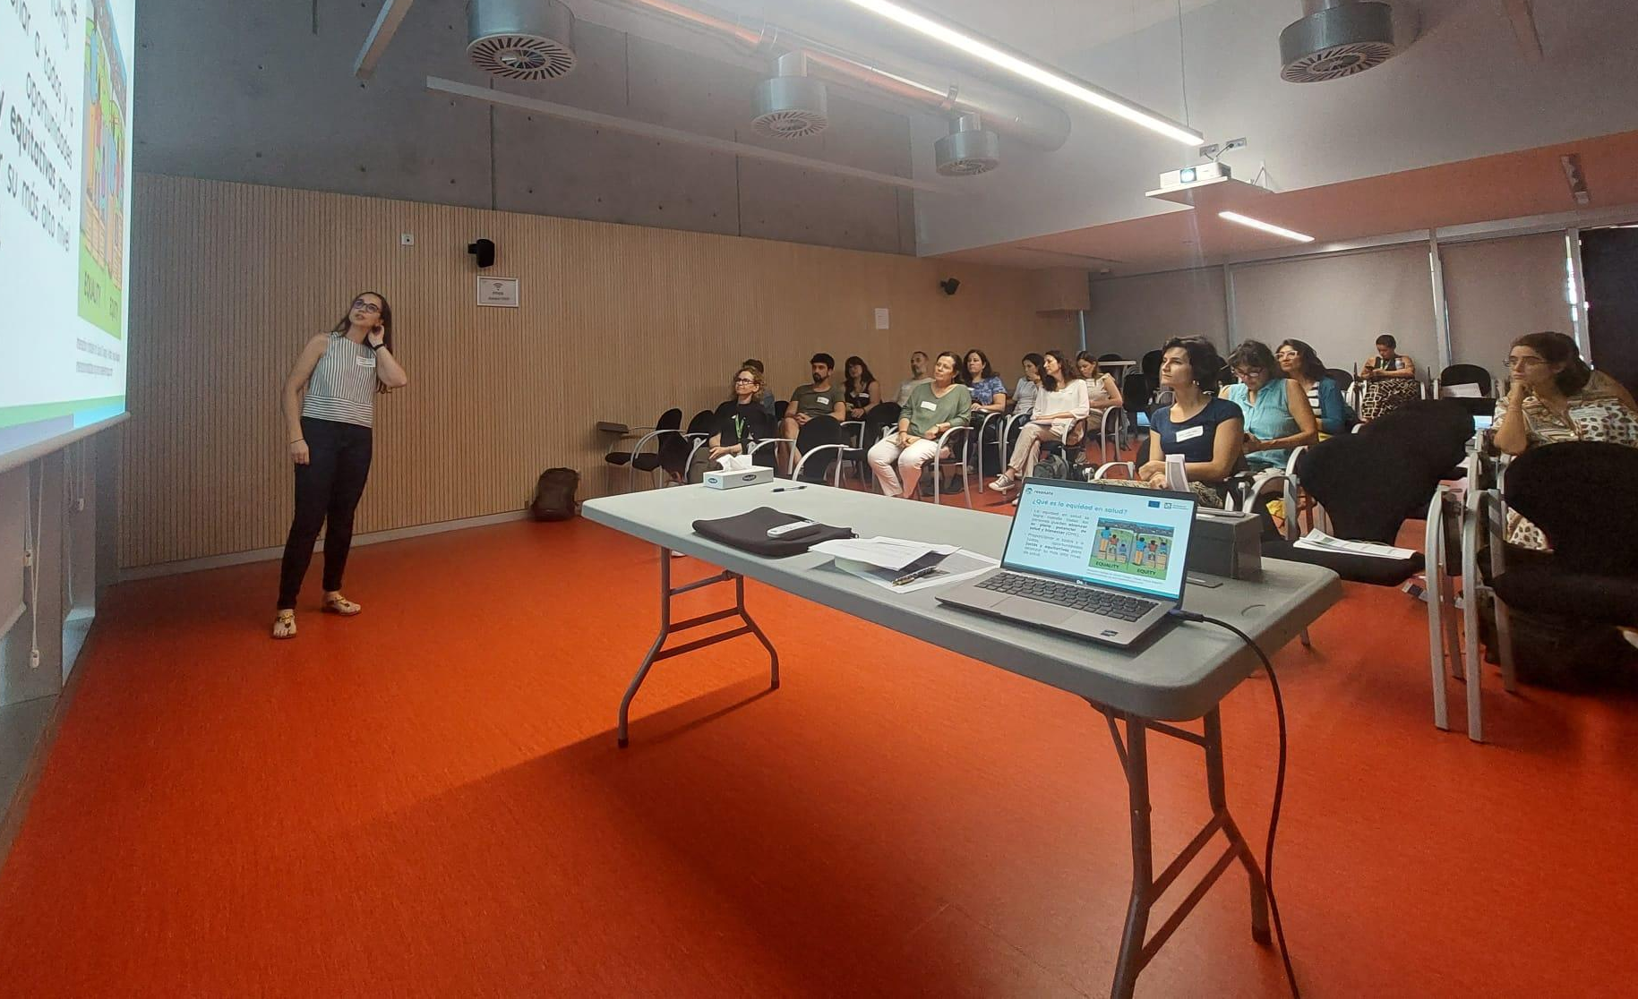
Updates on data collection and analysis
First HIA workshop round – lays the foundations for community resilience by identifying key challenges, resources and opportunities.
Took place in:
CS4 Padova (11 June 2024 – 13+ participants)
CS5 Salzburg (13 Dec 2024 – 7 participants)
CS6 Barcelona (26 Sept 2024 – 17 participants)
Notes:
CS 1University of Exeter (UNEXE) United Kingdom
CS 2University of Exeter (UNEXE) United Kingdom
CS 3Meditsinsky Universitet‑Plovdiv (MUP) Plovdiv, Bulgaria
CS 4Università degli Studi di Padova (UNIPD) Padova, Italy
CS 5Paracelsus Medizinische Privatuniversität (PMU) Salzburg, Austria
CS 6Fundación Privada Instituto de Salud Global Barcelona (ISGLOBAL) Barcelona, Spain
CS 7Uppsala Universitet (UU) Uppsala, Sweden
CS 8Københavns Universitet (UCPH) Copenhagen, Denmark
CS 9Natuurvoormensen Omgevingspsychologisch Onderzoek (NVM) & University of Twente (UNTWE) Netherlands

Slide 4
Updates on data collection and analysis
Second HIA workshop round – nature, likelihood, scale and distribution of the impact of health determinants on the uptake of the NbT intervention
CS4 Padova (25 June 2025 – 13+ participants)
Thanks to Salzburg, Barcelona and Padova teams for their great support !
Notes:
CS 1University of Exeter (UNEXE) United Kingdom
CS 2University of Exeter (UNEXE) United Kingdom
CS 3Meditsinsky Universitet‑Plovdiv (MUP) Plovdiv, Bulgaria
CS 4Università degli Studi di Padova (UNIPD) Padova, Italy
CS 5Paracelsus Medizinische Privatuniversität (PMU) Salzburg, Austria
CS 6Fundación Privada Instituto de Salud Global Barcelona (ISGLOBAL) Barcelona, Spain
CS 7Uppsala Universitet (UU) Uppsala, Sweden
CS 8Københavns Universitet (UCPH) Copenhagen, Denmark
CS 9Natuurvoormensen Omgevingspsychologisch Onderzoek (NVM) & University of Twente (UNTWE) Netherlands

Slide 5
Updates on data collection and analysis
T4.5. Develop the NbT Health Practitioner Guide
Study conducted in canada
                Ethics application granted beginning of 2025,
      Interviews in canada completed in April 2025,
      UNIVIE to support with data analysis
Interviews of healthcare professionals in Europe
(2 already conducted, 2 planned, recruitment in process. Complete 15 in total)
We would appreciate partners help to connect us with a GP/nurse/link worker/mental health provider/physiotherapist/occupational therapist within their local site.
Notes:
CS 1University of Exeter (UNEXE) United Kingdom
CS 2University of Exeter (UNEXE) United Kingdom
CS 3Meditsinsky Universitet‑Plovdiv (MUP) Plovdiv, Bulgaria
CS 4Università degli Studi di Padova (UNIPD) Padova, Italy
CS 5Paracelsus Medizinische Privatuniversität (PMU) Salzburg, Austria
CS 6Fundación Privada Instituto de Salud Global Barcelona (ISGLOBAL) Barcelona, Spain
CS 7Uppsala Universitet (UU) Uppsala, Sweden
CS 8Københavns Universitet (UCPH) Copenhagen, Denmark
CS 9Natuurvoormensen Omgevingspsychologisch Onderzoek (NVM) & University of Twente (UNTWE) Netherlands

Slide 6
Timeline and next steps
Implementation of Health Impact Assessment (HIA) methodology
Conduct HIA workshops in October 2025 with CS5 (Salzburg), CS6 (Barcelona), CS7 (Uppsala), CS8 (Copenhagen), and CS9 (Netherlands) | To be completed by Oct 2025 – Milestone
Data analysis to be completed | March 2026 – Milestone
NbT health practitioner Guide
Complete interviews with healthcare professionals in Europe | December 2025
Data analysis to be completed | March 2026 – Milestone
Deliver NbT Health Practitioner Guide (D4.1) | Aug 2026

Slide 7
Needs for collaborations
Planning of upcoming workshops for October include:
CS 5 Salzburg (22 October 2025)
CS 6 Barcelona (2nd October 2025)
CS 7 Uppsala (24 October 2025 – TBC)
CS 8 Copenhagen (21 October 2025)
CS 9 Netherlands (October 2025)
+ individual interviews (online/in person) with key stakeholders in CS4-6
4 out of 5 concept notes have been sent to CS partners, and planning for the HIA workshops is ongoing (participants, logistics)

Slide 8
Needs for collaborations
Invitation:
  Breakout session on WP3-WP4 collaboration and HIA workshop planning at 14:15 today.
  Our suggestion:
    CS5-7 at 14:15, for 30 minutes
    CS8-9 at 14:45, for 30 minutes
Publication ideas
Publication:
Prescribers’ views of nature-based therapies: Barriers and facilitators – A qualitative study in Europe and Canada

Slide 9
Thank you
Sébastien Libert, Senior Project Coordinator, s.libert@eurohealthnet.eu
Sofia Romagosa, Research Officer, s.romagosa@eurohealthnet.eu
Afsaneh Nejat, Policy and Practice Officer, a.nejat@eurohealthnet.eu
The Resonate project is funded by the European Union’s Horizons Europe Research and Innovation programme under grant agreement No. 101081420 and co-funded by the UK Research and Innovation grant award No. 10063874

