Slide 1
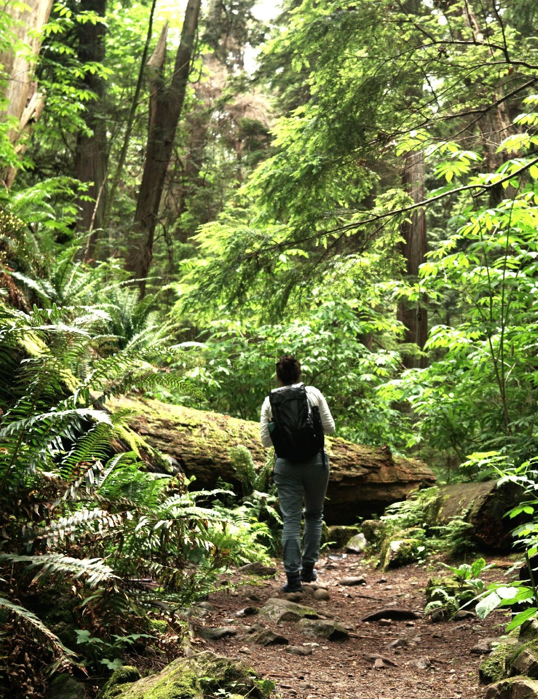



Case Study 2
University of Exeter
Leanne Martin
AM25 Padova - 18/09/2025
The Resonate project is funded by the European Union’s Horizons Europe Research and Innovation programme under grant agreement No. 101081420 and co-funded by the UK Research and Innovation grant award No. 10063874

Slide 2

CS2 Objectives
Examine whether nature exposure attenuates adverse mental health trajectories associated with societal (e.g. Covid-19) and individual-level (e.g. major life events) stressors.
And if so, are nature-wellbeing associations mediated by better psychological and/or social resilience.
3 sub- studies:
Secondary analysis of the UCL Covid-19 Social Study
Secondary analysis of PROTECT data (pre, during and post Covid-19)
Bespoke survey - PROTECT participants who experienced a stressful life event (e.g. divorce, bereavement).

Slide 3

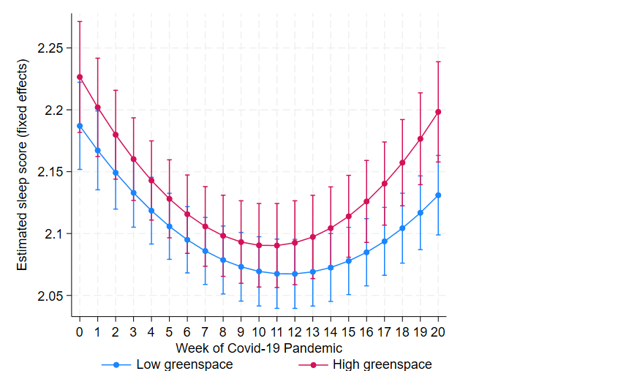
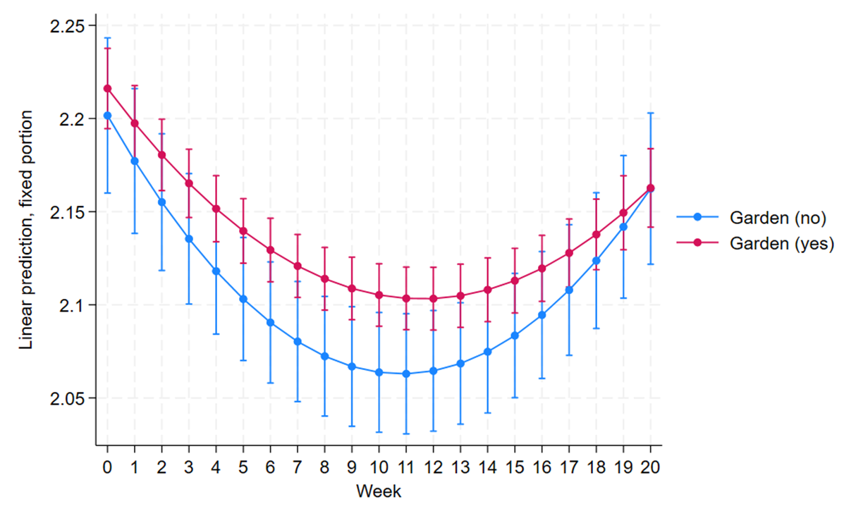

Updates on data collection and analysis
UCL Covid-19 Social study (N = 12,903)
1) Did nearby nature exposure attenuate adverse sleep trajectories during the COVID-19 lockdown?
2) And if so, are nature-sleep associations mediated by better psychological resilience (mental wellbeing)?
Evidence of nature buffering stress?
Response resilience
Recovery resilience
Evidence of mediation via mental wellbeing?
Preliminary evidence that is does, but…
Notes:
Completed the analysis of the first RQ using Latent Growth Curve Models (LGCM).
Keep brief and focus on main findings…. sleep trajectories during weeks of the lockdown as a function of having a garden….
Both groups have classic u shape – where we see a general decline in sleep during the first several weeks of the pandemic, followed by a steady return to near baseline levels. (This is broadly what has been demonstrated in other covid-sleep studies).
Terms of resilience Week 0–10: Clear difference — those with gardens (red) consistently report better sleep than those without. The group without gardens shows a deeper and longer dip in sleep quality.
Evidence of response resilience = supports garden access as a buffer to the sleep-disrupting effects of early pandemic stress.
In terms of recovery resilience - Week 10–20: Both groups improve, but the garden group maintains a higher level of sleep quality throughout.
Suggests continued benefit from gardens — they aid not just protection but support ongoing recovery.
In terms of mediation via mental wllebing, we found preliminary evidence to support this hypothesis but this analysis is stillonging.

Slide 4

Updates on data collection and analysis
UCL Covid-19 Social study (N = 12,903)
Unbalanced dataset with 20 timepoints and a quadratic time effect
Approach | Mediation Type | Captures Time? | Strengths | Limitations
SEM with shared random intercept | Concurrent (same-wave) | Nonlinear trend (week + week²) + clustering | Feasible, interpretable, adjusts for repeated measures | Doesn’t model trajectories; mediation only contemporaneous
Two-step LGCM (BLUPs) | Approx. trajectory-level | Yes (slopes + quadratic) | Easy to run, lighter than full LGCM | BLUPs treated as observed → attenuates effects
Parallel-process LGCM | Latent trajectory-level | Yes (growth factors for both outcomes) | Gold standard for developmental mediation | Very heavy; convergence issues with 20 waves + covariates
Wave-by-wave SEM | Cross-sectional snapshots | No (separate per wave) | Simple, identifies when mediation strongest | Ignores clustering & longitudinal structure
Notes:
20-wave unbalanced dataset, quadratic time effect, makes modelling longitudinal mediation challenging.
Several approaches feasible more feasible (SEM with shared intercept, Two-step LGCM, wave-by-wave SEM).
BUT Parallel-process LGCM = gold standard but computationally heavy → so far resulted in convergence issues.
Currently refining model specifications to overcome this -

Slide 5

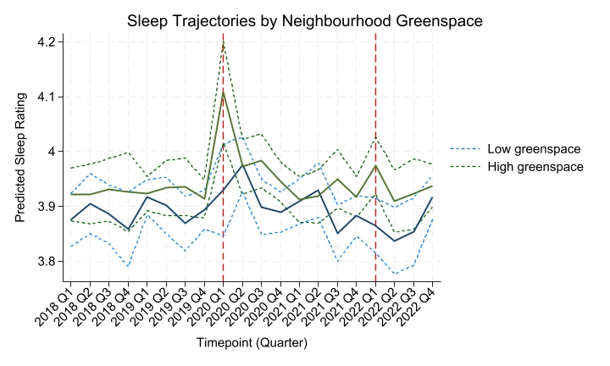
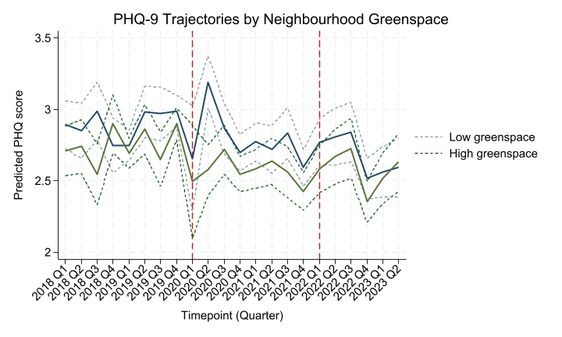
Updates on data collection and analysis
PROTECT secondary data (N = 13,110)
Datasets cleaned and merged with environmental data (LSOA greenspace, distance from coast)
Partially–adjusted LGCMs are looking promising but need further adjustment for Covid-19 covariates (missing from the original dataset).
Notes:
PROTECT data cleaned, linked with environmental measures (greenspace, coastal proximity).
Initial LGCM models are encouraging — showing plausible sleep and mental health trajectories.
Clear signal of Covid-19 period disruption (highlighted) across outcomes – which appears to differ as a function of neighbourhood greenspace
Next step: adjust fully for Covid-19 covariates which were missing in the original dataset and run the mediation models

Slide 6

Updates on data collection and analysis PROTECT Nested Study
T1 PROTECT DATA (BASELINE)
2023-2024
Residential nature (LSOA)
T2 NESTED SURVEY (response resilience)
2024-2025
Nature measures (current and retrospective for T1)
T3 NESTED SURVEY (recovery resilience)
2025-2026
Nature measures
Wellbeing (GAD-7; PHQ-9)
Resilience (psych, social)
Wellbeing (GAD-7; PHQ-9)
Wellbeing (GAD-7; PHQ-9)
Resilience (psych, social)
PROGRESS:
Survey live: Jan 2025
344 participants completed.
3 months remaining until T2 data available
Notes:
Designed a bespoke nested survey, sent only to existing PROTECT participants who reported a stressful life event in the last six months.
This allows us to capture resilience processes (response and recovery) in real time.
Builds on PROTECT baseline data, adding targeted measures of nature, resilience, and wellbeing.
T2 survey live since Jan 2025, with 344 completions so far — full T1 dataset expected in 3 months.

Slide 7
Upcoming challenges
Convergence issues for UCL Covid-19 Social Study mediation models
Anticipated to be an issue for all datasets
Publication ideas
Three (potentially four) papers:
1) Does Nature Buffer the Impact of Stress on Sleep? A Longitudinal Analysis of Mediation through Mental Wellbeing in the UK (in prep)
2) Executive Function as a Longitudinal Mediator Between Stress and Health Outcomes in Later Life: Evidence from the PROTECT Study
3) Does Contact with Nature Buffer the Health Impact of Stressful Life Events? Initial Evidence from a Two-Year Longitudinal Study
4) Nature as a Buffer Against the Health Impact of Stressful Life Events: Findings from a Two-Year Longitudinal Study
Notes:
Upcoming Challenges:
Convergence issues already evident in UCL Covid-19 Social Study mediation models.
Expect these challenges to arise across other datasets too, given complexity (many waves, unbalanced data, covariates).
Work underway to refine model specifications and test alternative estimation strategies.
Publications
At least three, possibly four papers planned.
UK study: nature, stress, sleep → mediation via wellbeing.
PROTECT: executive function mediating stress–health link.
Bespoke 2-year survey: Year 1 initial evidence + full dataset follow-up.

Slide 8
Timeline and next steps
UCL Covid Social Study - finalise mediation approach (Oct 25) and finish paper write up (November 25).
PROTECT secondary data – merge Covid-19 data/adjust models (winter 25) and write up paper (March 26)
Year 1 nested study analyses (Spring/ Summer 26)
Notes:
Winter 25 – time time for MUPs level 1 synthesis (D3.1) in Dec

Slide 9
Thank you
Leanne Martin | University of Exeter
The Resonate project is funded by the European Union’s Horizons Europe Research and Innovation programme under grant agreement No. 101081420 and co-funded by the UK Research and Innovation grant award No. 10063874

