Slide 1
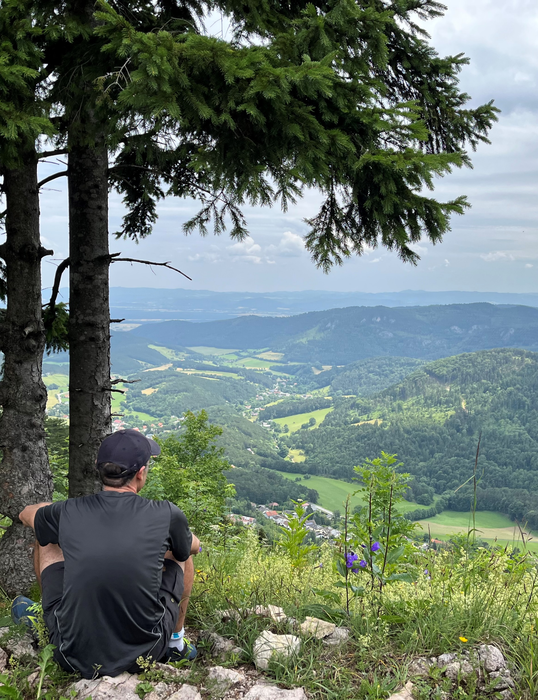



UPDATES from UNIVIE WP1 – Management & Cross-Project Collaboration WP3 – Case Studies+ WP10 – Ethics & Open Science
Mat White, Julia Egger, Valentina Hampejs, Addi Wala, Anja Heske, and Sabine Pahl
The Resonate project is funded by the European Union’s Horizons Europe Research and Innovation programme under grant agreement No. 101081420 and co-funded by the UK Research and Innovation grant award No. 10063874

Slide 2

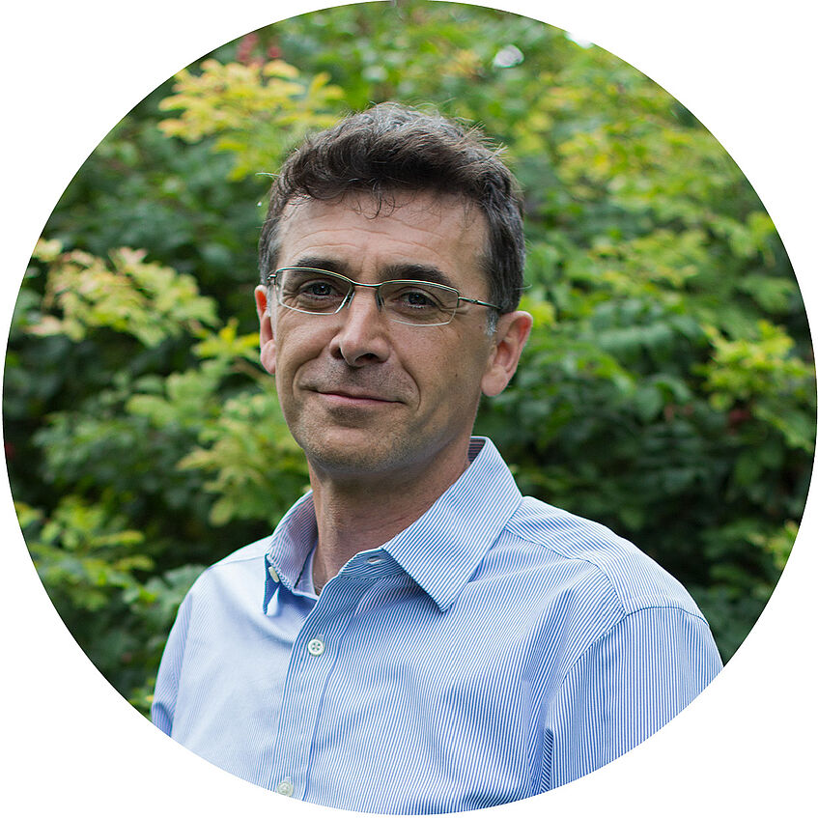
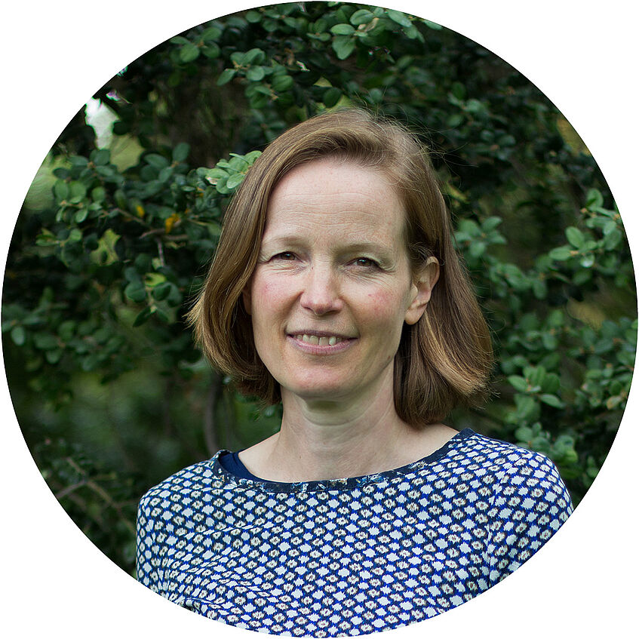


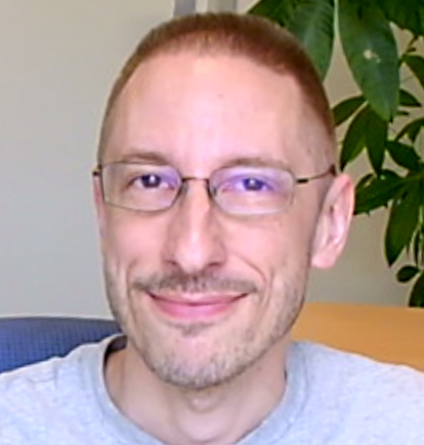
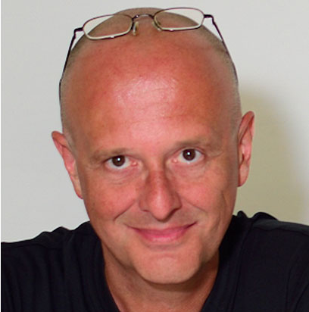
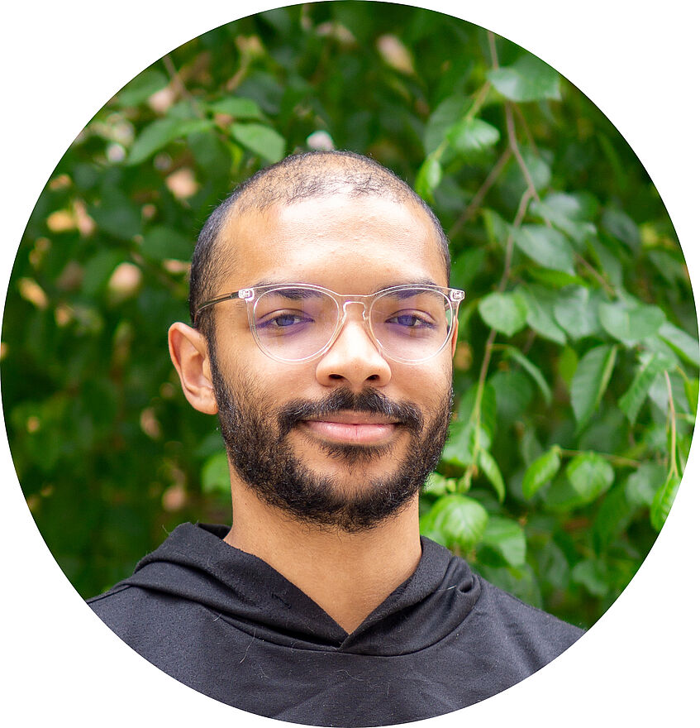
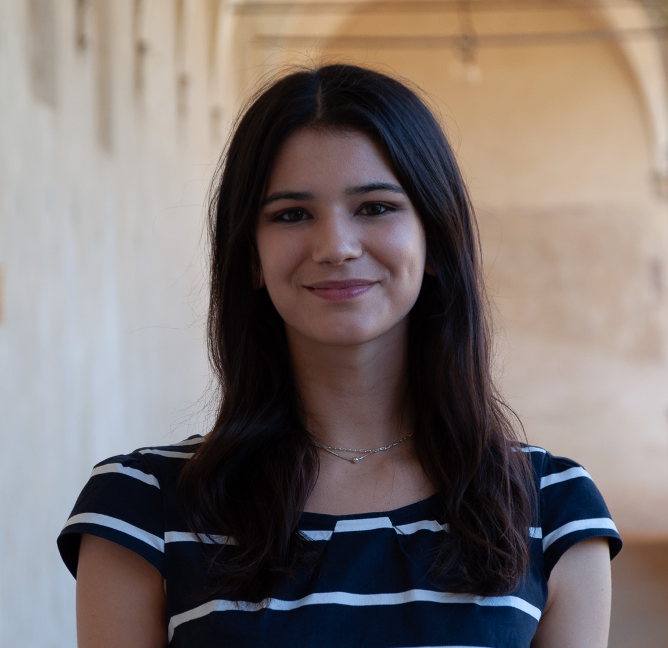
University of Vienna

Slide 3
Updates WP1
Continually managing administrative and financial aspects
Contact Channel for our Project Officer
Working together with PMU on organising a DACH region Spotlight series

Slide 4
Updates WP10
Supporting Ethics Applications for WP4 & WP8
Completed the Joint Control Agreement (JCA) and sent it out to every CS and WP to sign
Outstanding from:
ISGLOBAL (WP2/CS6)
ETIFOR (WP6)
UNIPD (WP7/CS4)
MUP (CS3)
UU (CS7)
UCPH (CS8)
NVM (CS9)
UNTWE (CS9)

Slide 5
Updates WP3
Assisted in finalisation of CS4-5-6 data collection
Assisted WP7 & WP8 in survey data collection
Hosted a Stats Workshop on R-Coding and Model Building
Actively facilitating data sharing between the CSs and WPs

Slide 6
Data Analysis
Learnings from the Stats Workshop:
Get to know what data has been collected
Think through how the variables relate to our NBRT framework and let theory guided assumptions lead the model building (aka What variables should be where in the model?)
Consider performing a Little’s missing completely at random test (R package “naniar”, mcar_test() ).
Information on systematic missing data is of particular importance to WP8!

Slide 7
Data Analysis
Many tests can be done, and there are pros and cons!
Heterogeneity in skills across institutions

Slide 8
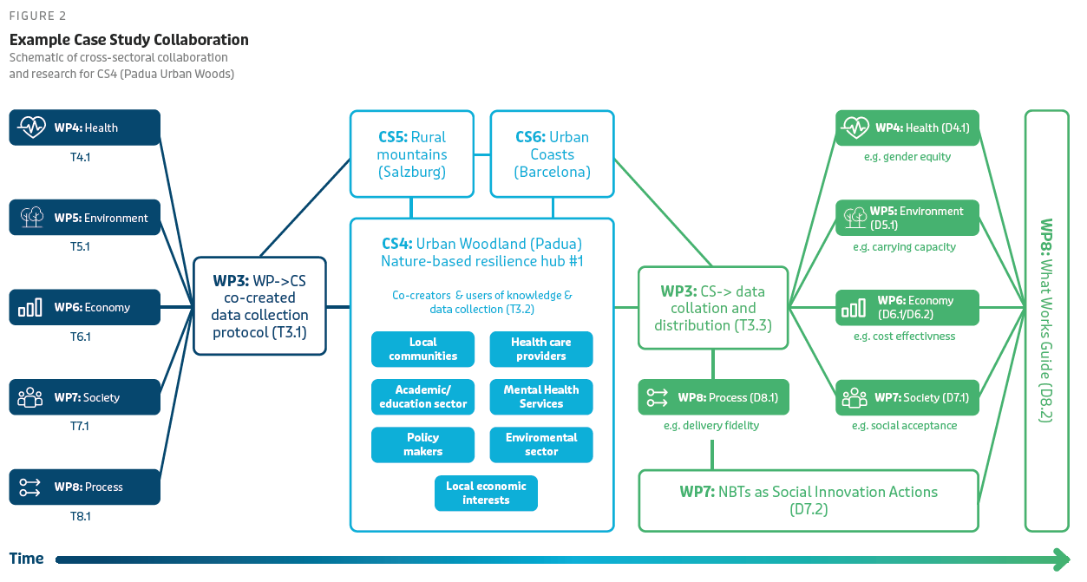
Data Sharing

Slide 9
Data Sharing
Data can be shared between two partners once both have signed the JCA.
First CSs/WPs have already exchanged data (YAY!)
Please keep UNIVIE involved when exchanging
Record of Processing / Data Transfer

Slide 10
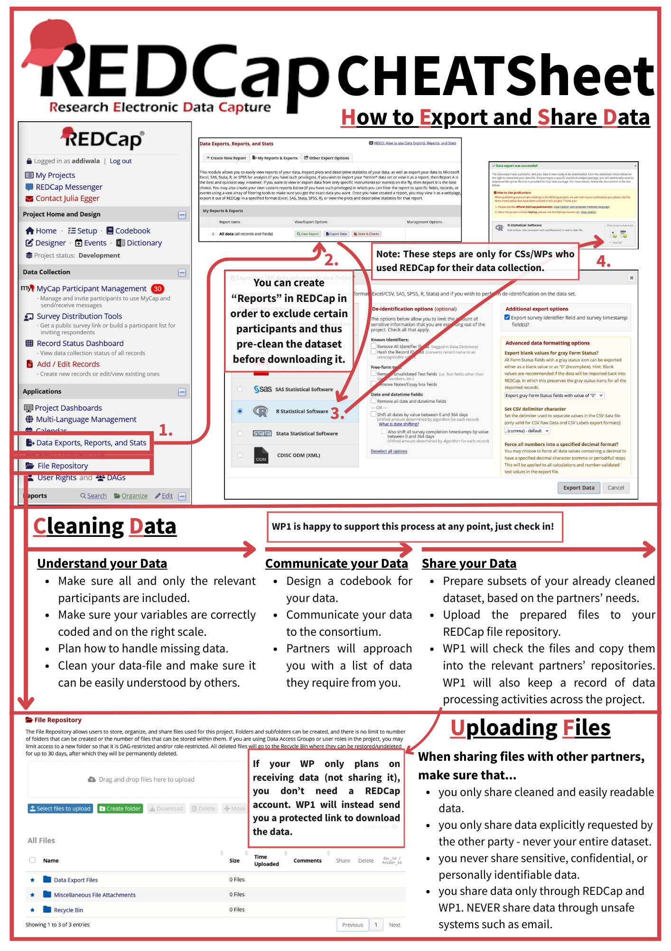
REDCap Data Sharing
Cheat-Sheet available

Slide 11
Data Sharing
CSs
WPs
Codebooks!
Add variable to participants according to their completion (only pre survey, or all, etc.)
Clean the data and protocol the process
Make notes of any changes necessary
Treat received data confidentially!
Contact UNIVIE if variables are missing that you should have received
Check with CSs for details of studies
Ms 12|17|20|29|32 – Completed Data Collection – Oct 25
M 9 – Finalised ”Database” – Nov 25

Slide 12
Thank you!
The Resonate project is funded by the European Union’s Horizons Europe Research and Innovation programme under grant agreement No. 101081420 and co-funded by the UK Research and Innovation grant award No. 10063874

Slide 13
Data Analysis
CS4-5-6 likely to perform linear mixed models (LMM), structure equation models (SEM), and growth curve modelling.
Side note at @everyone: Consider performing a Little’s missing completely at random test (R package “naniar”, mcar_test() ). Information on systemic missing data is f particular importance to WP8.

