Slide 1





CS9 Care farms
The Resonate project is funded by the European Union’s Horizons Europe Research and Innovation programme under grant agreement No. 101081420 and co-funded by the UK Research and Innovation grant award No. 10063874

Slide 2
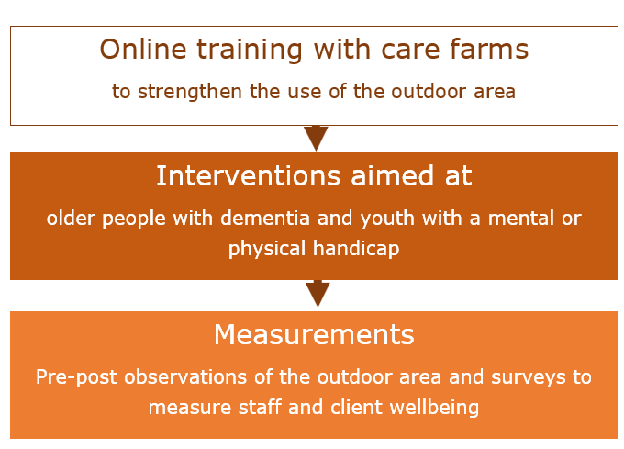
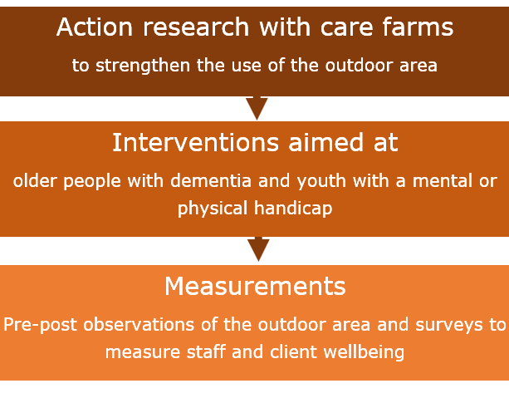
Recap: Study design CS9
Phase 1 - 2024
Phase 2- 2025
→ 4 papers

Slide 3
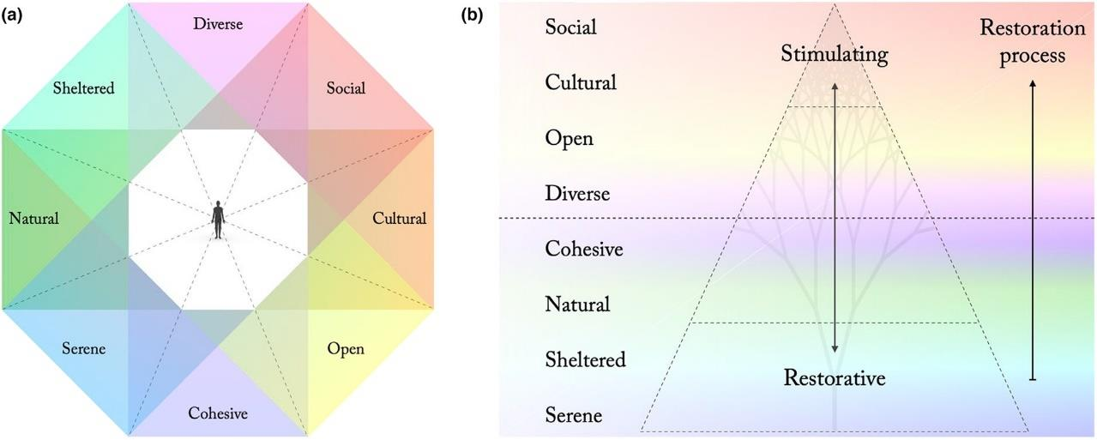
Paper 1: Observation tool Based on Perceived Sensory Dimensions
Status: in preparation
Van den Berg, A. E., Van den Berg, M.M.H.E., Venema, J. & Van Rompay, T (2025). An outdoor area evaluation tool for healthcare settings. Environment and Planning

Slide 4
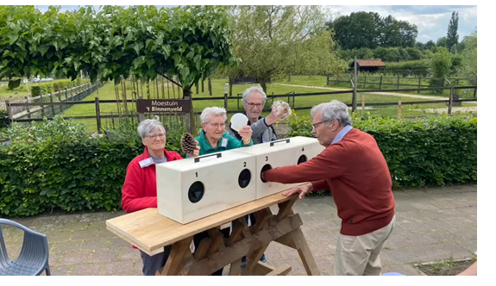
Paper 2: Action research at care farms
Status: concept
Van den Berg, A. E., Van den Berg, M.M.H.E. & Van Rompay, T (2025). Action research for a better use of the outdoor area at care farms. Environmental Research.

Slide 5



Paper 3: Walk of Life A grassroot initiative to support people with mental problems
Status: submitted
Van den Berg, A. E., Klemann, K. & Van Rompay, T (2025). Walk of Life: A Grassroots Nature-Based Coaching Initiative complements formal Mental Healthcare. Environmental Psychology Open.

Slide 6
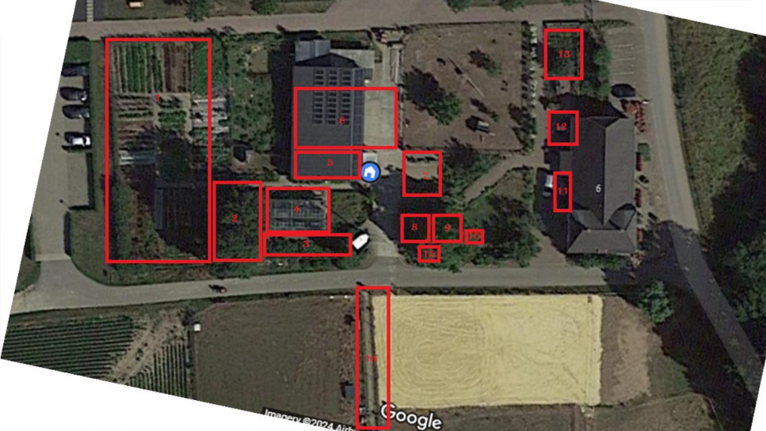
Paper 4: Design implications for green spaces at healthcare settings
Status: forthcoming
Van Rompay, T. J. L., M.M.H.E, Kranenburg, M. & Van den Berg, A.E. (2025). Promoting resilience in the outdoor area: A design perspective. Journal to be decided.

