Slide 1
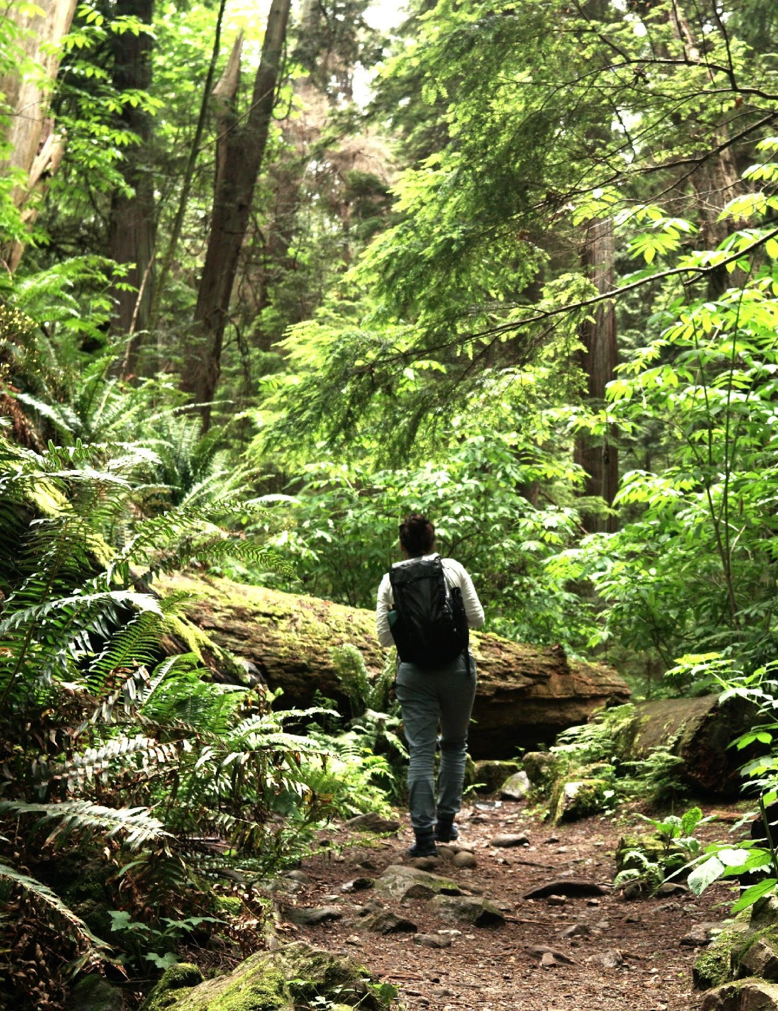
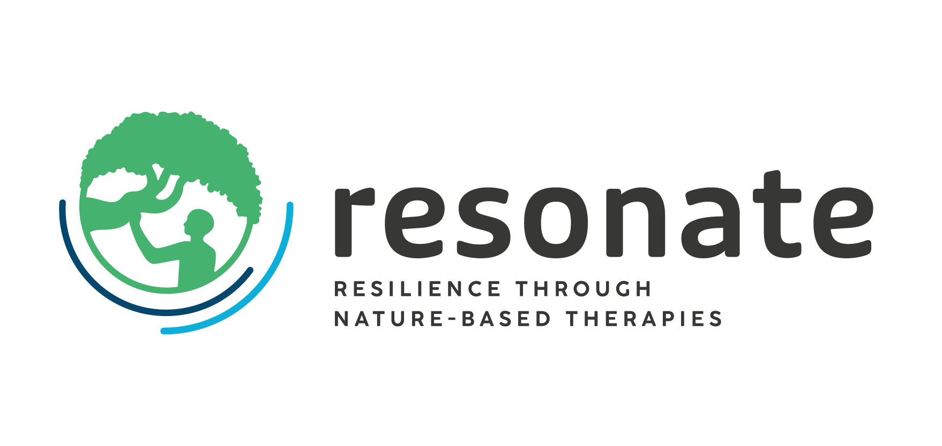


WP9 – Dissemination, Exploitation and Communication
Nature Based Solutions Institute
Victoria Ossbahr and Cecil Konijnendijk
AM25 Padova - 18/09/2025
The Resonate project is funded by the European Union’s Horizons Europe Research and Innovation programme under grant agreement No. 101081420 and co-funded by the UK Research and Innovation grant award No. 10063874

Slide 2
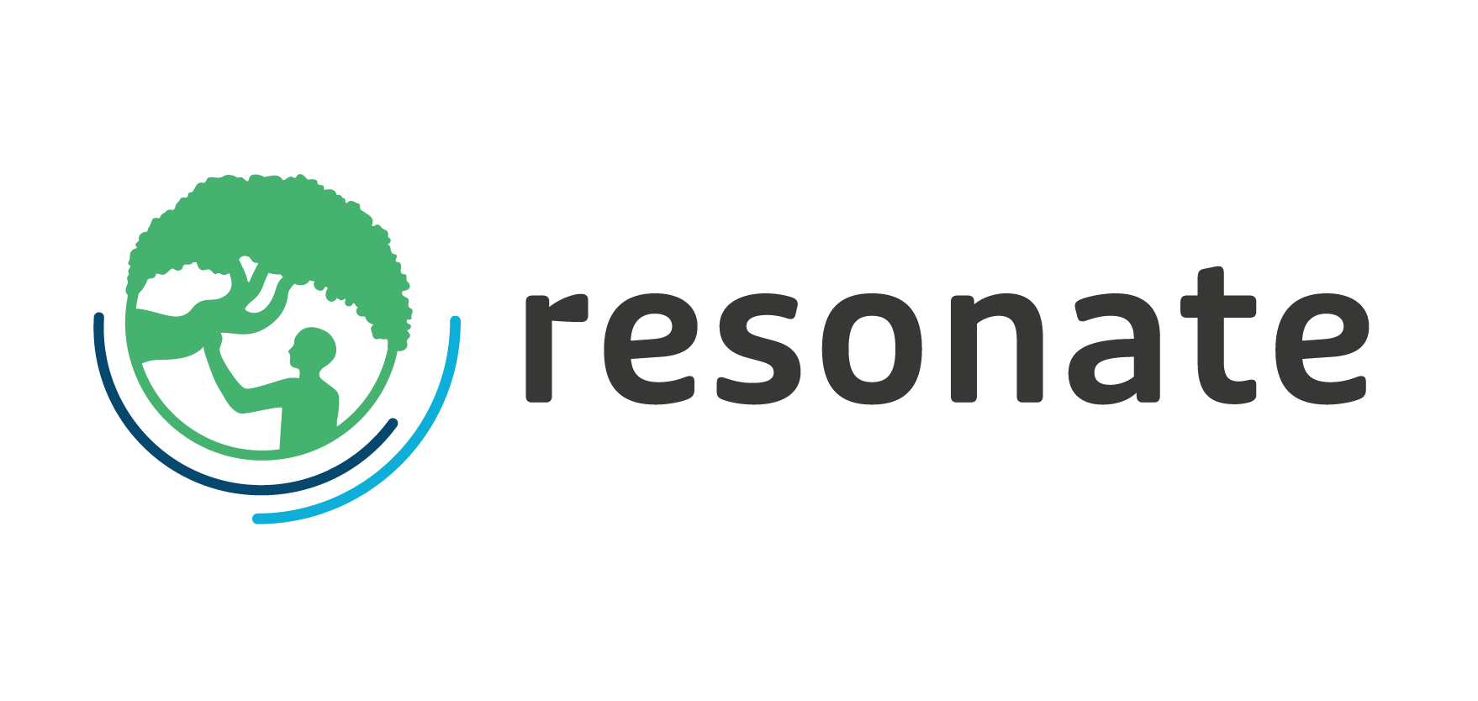
Objectives of the WP
Communicating and disseminating project findings with a range of target audiences;
Enhancing project impact and ensuring the project’s legacy by supporting the planning of longer-term exploitation of project results, e.g., through wider adoption of good practice and making available a knowledge base that has a legacy beyond the project.

Slide 3
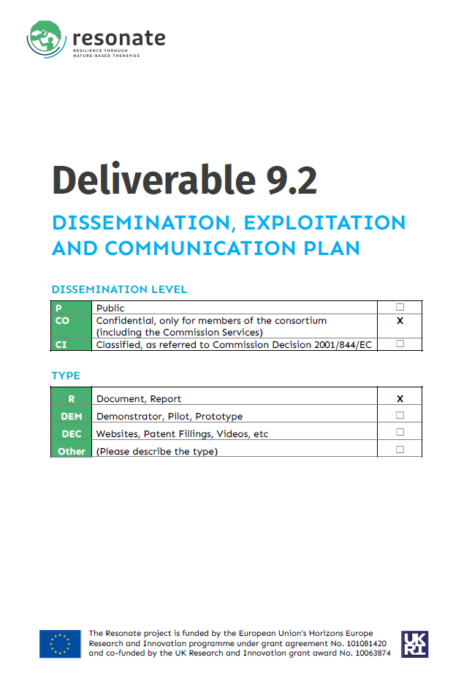
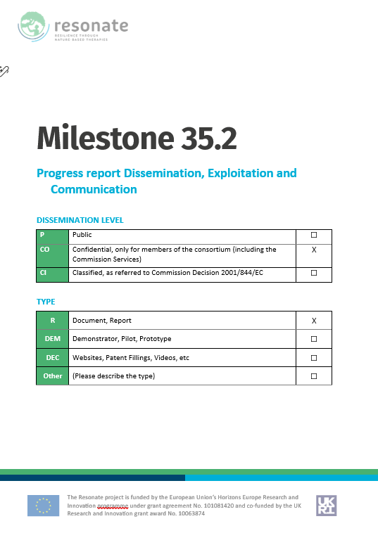
WP9 Tasks
T9.1 – RESONATE website development and legacy T9.2 – Develop a Dissemination, Exploitation & Communication Plan T9.3 – Support and coordinate communication & dissemination activities T9.4 – Stakeholder (incl. practitioner/policy) engagement T9.5 – Engage academic audiences (papers/conferences) T9.6 – Co-produce ‘Project Impact Report’

Slide 4
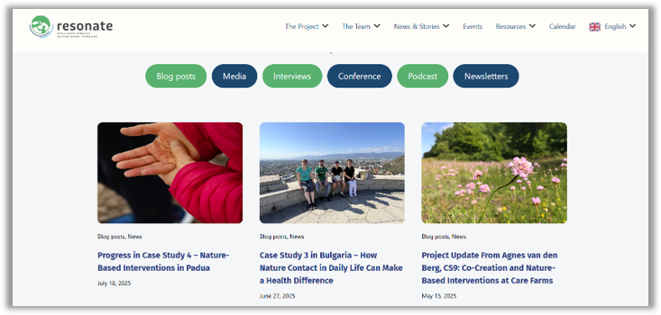
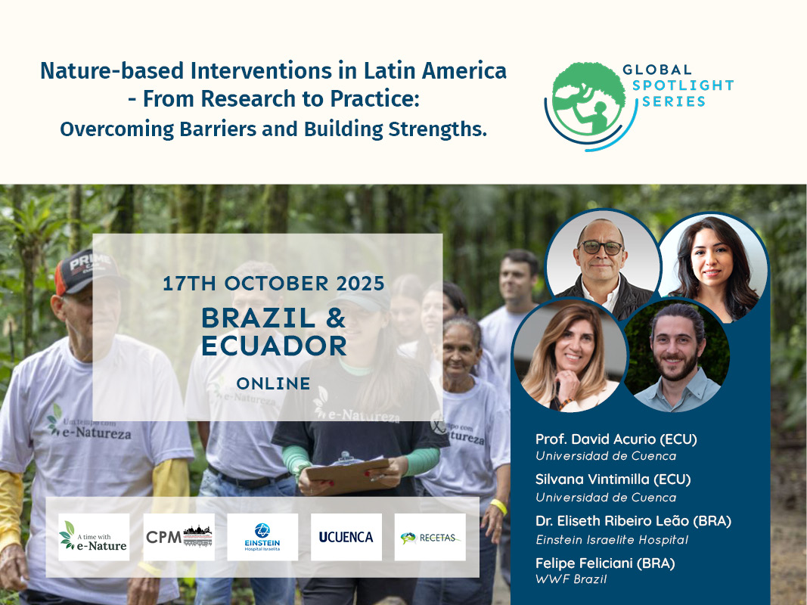
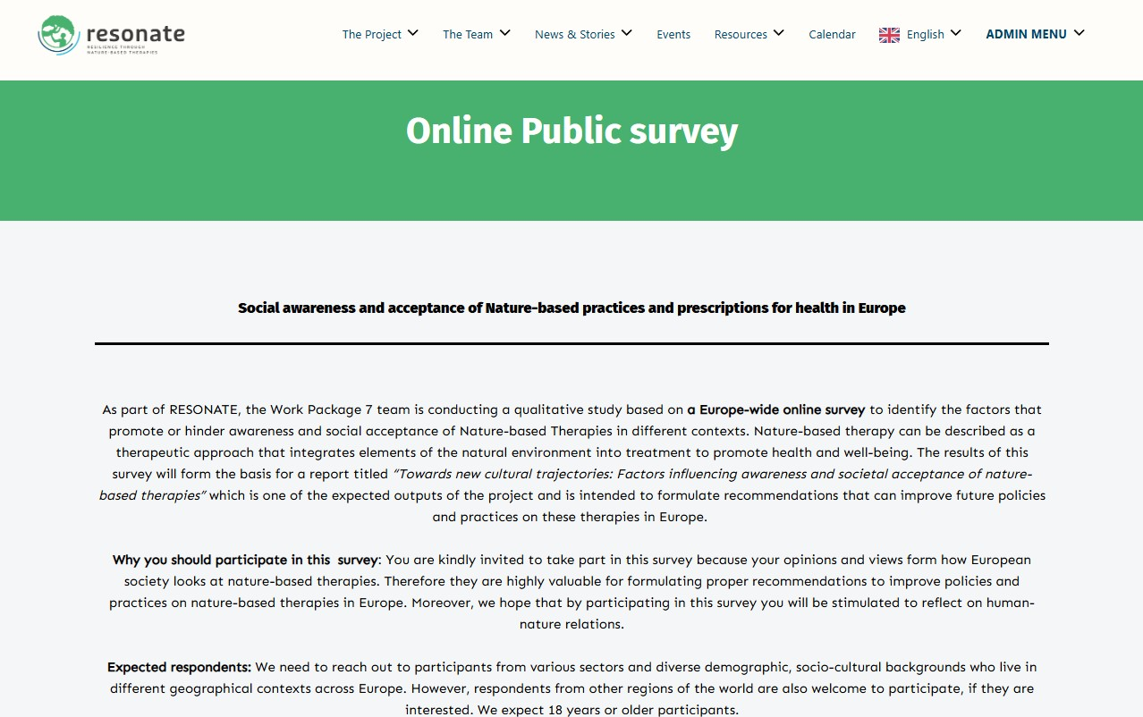
Updates on progress and activities (1)
- Website

Slide 5
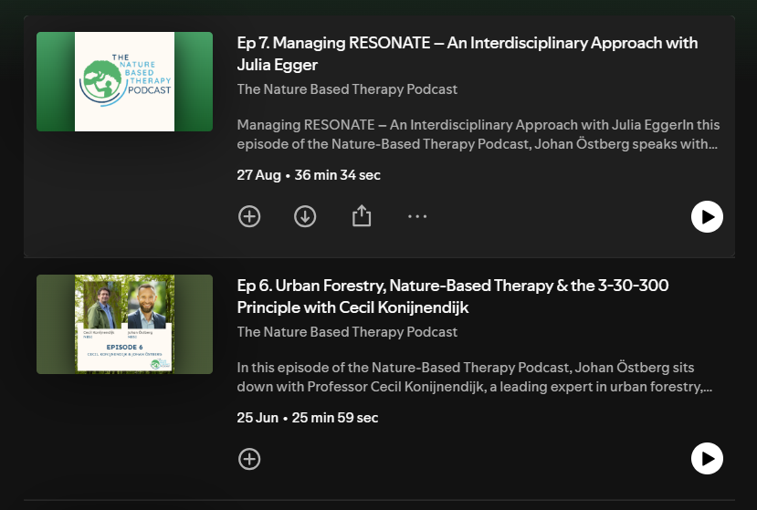
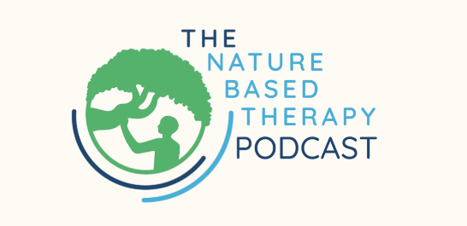
Updates on progress and activities (2)
- Podcast

Slide 6
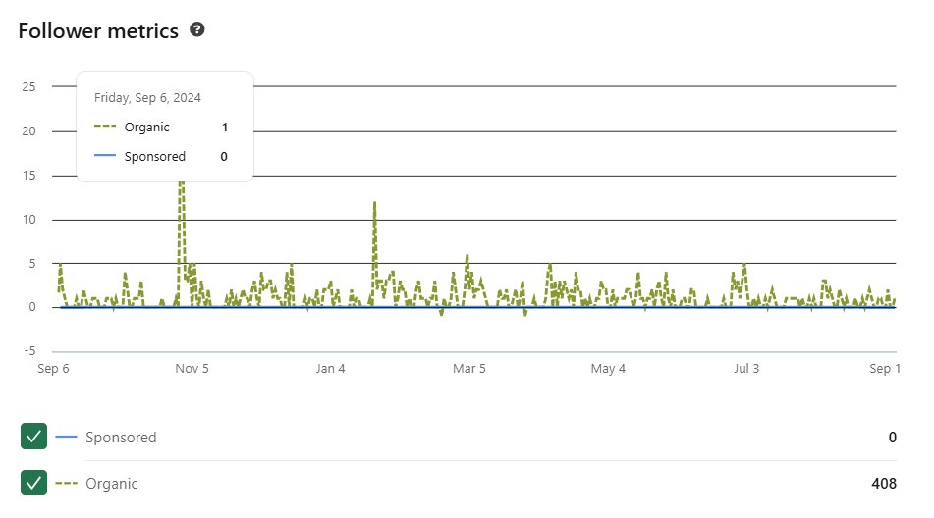
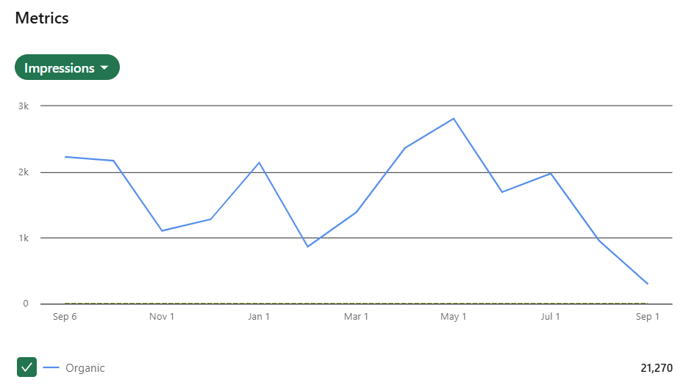
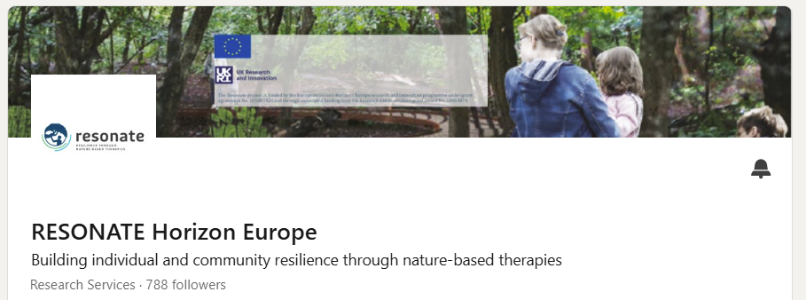
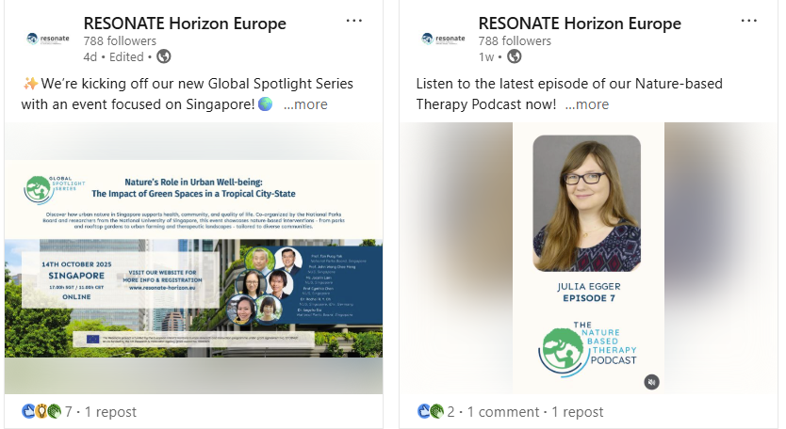
Updates on progress and activities (3)
- Social media

Slide 7
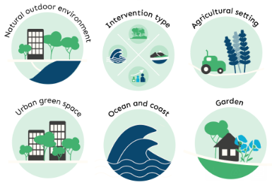
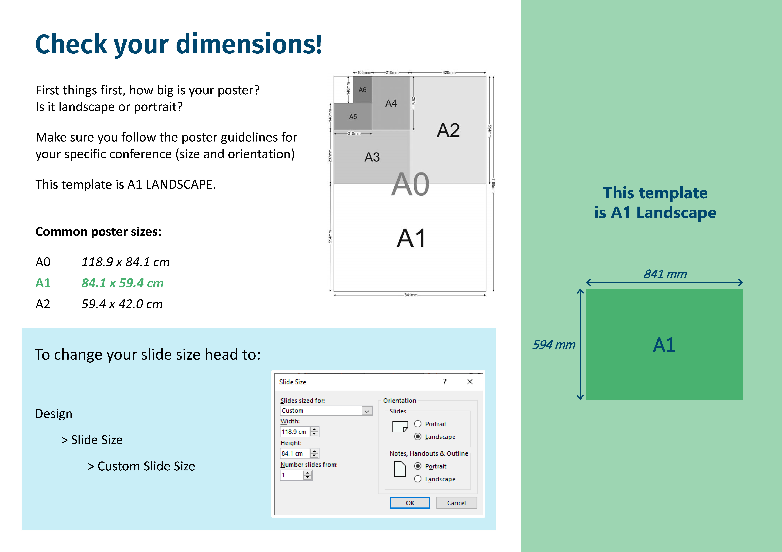

Updates on progress and activities (4)
- Graphics & templates

Slide 8
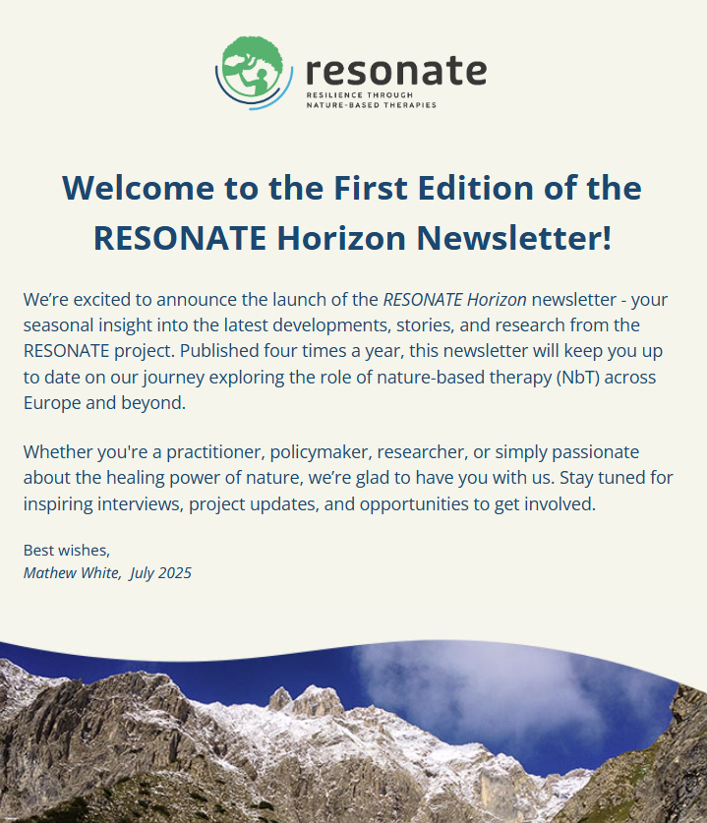
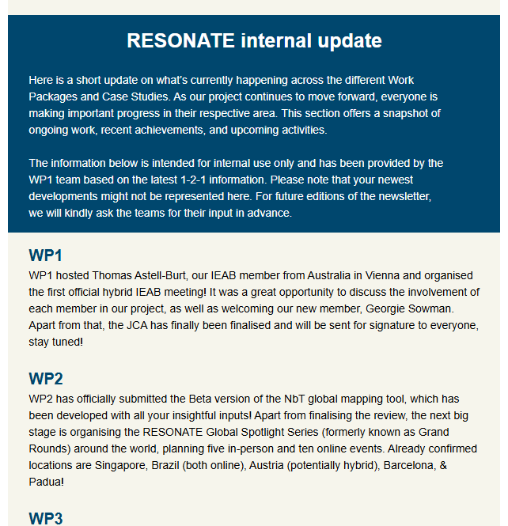
Updates on progress and activities (5)
- Newsletter (external & internal)

Slide 9
Challenges and opportunities
Increasing our audiences and followers in a time of competing time demands
Making sure that our messages reach the right audiences
Motivating all partners to actively contribute to DEC activities, also to ensure we have sufficient resources
Greater collaboration with our sister projects (GreenME and NATURELAB) and other relevant initiatives
Starting to work towards greater impact and project legacy

Slide 10
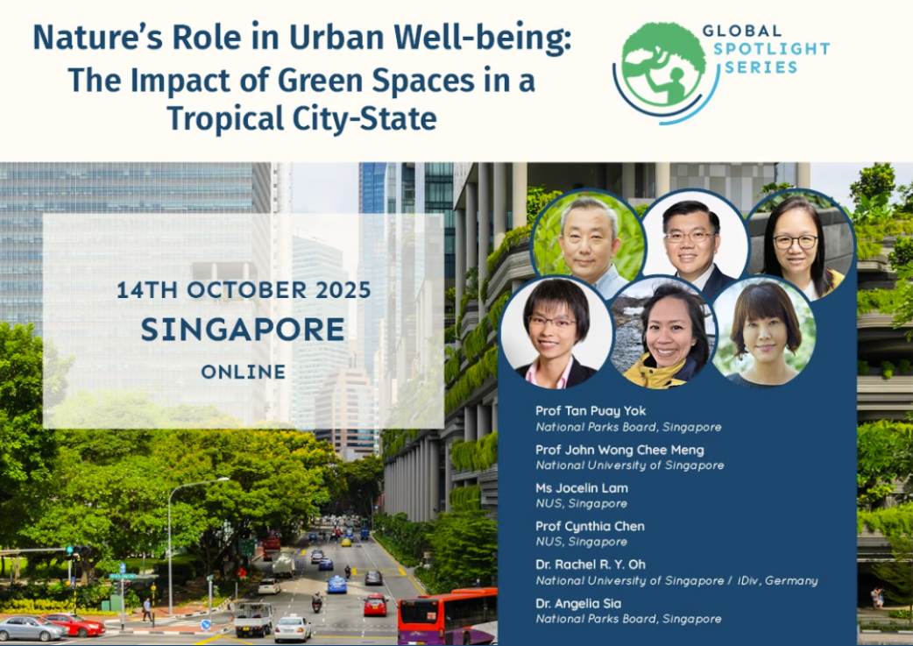
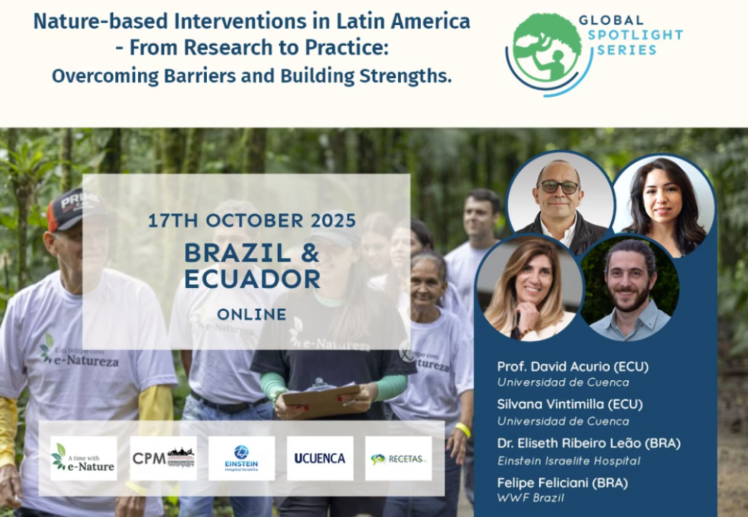
Timeline and next steps
Promoting the Global Spotlight Series
New blogs, podcast episodes, newsletters, social media posts
Messaging to increasingly focus on project results
’What works’ reports, guidelines

Slide 11

Thank you
Nature Based Solutions Institute
The Resonate project is funded by the European Union’s Horizons Europe Research and Innovation programme under grant agreement No. 101081420 and co-funded by the UK Research and Innovation grant award No. 10063874

