Slide 1
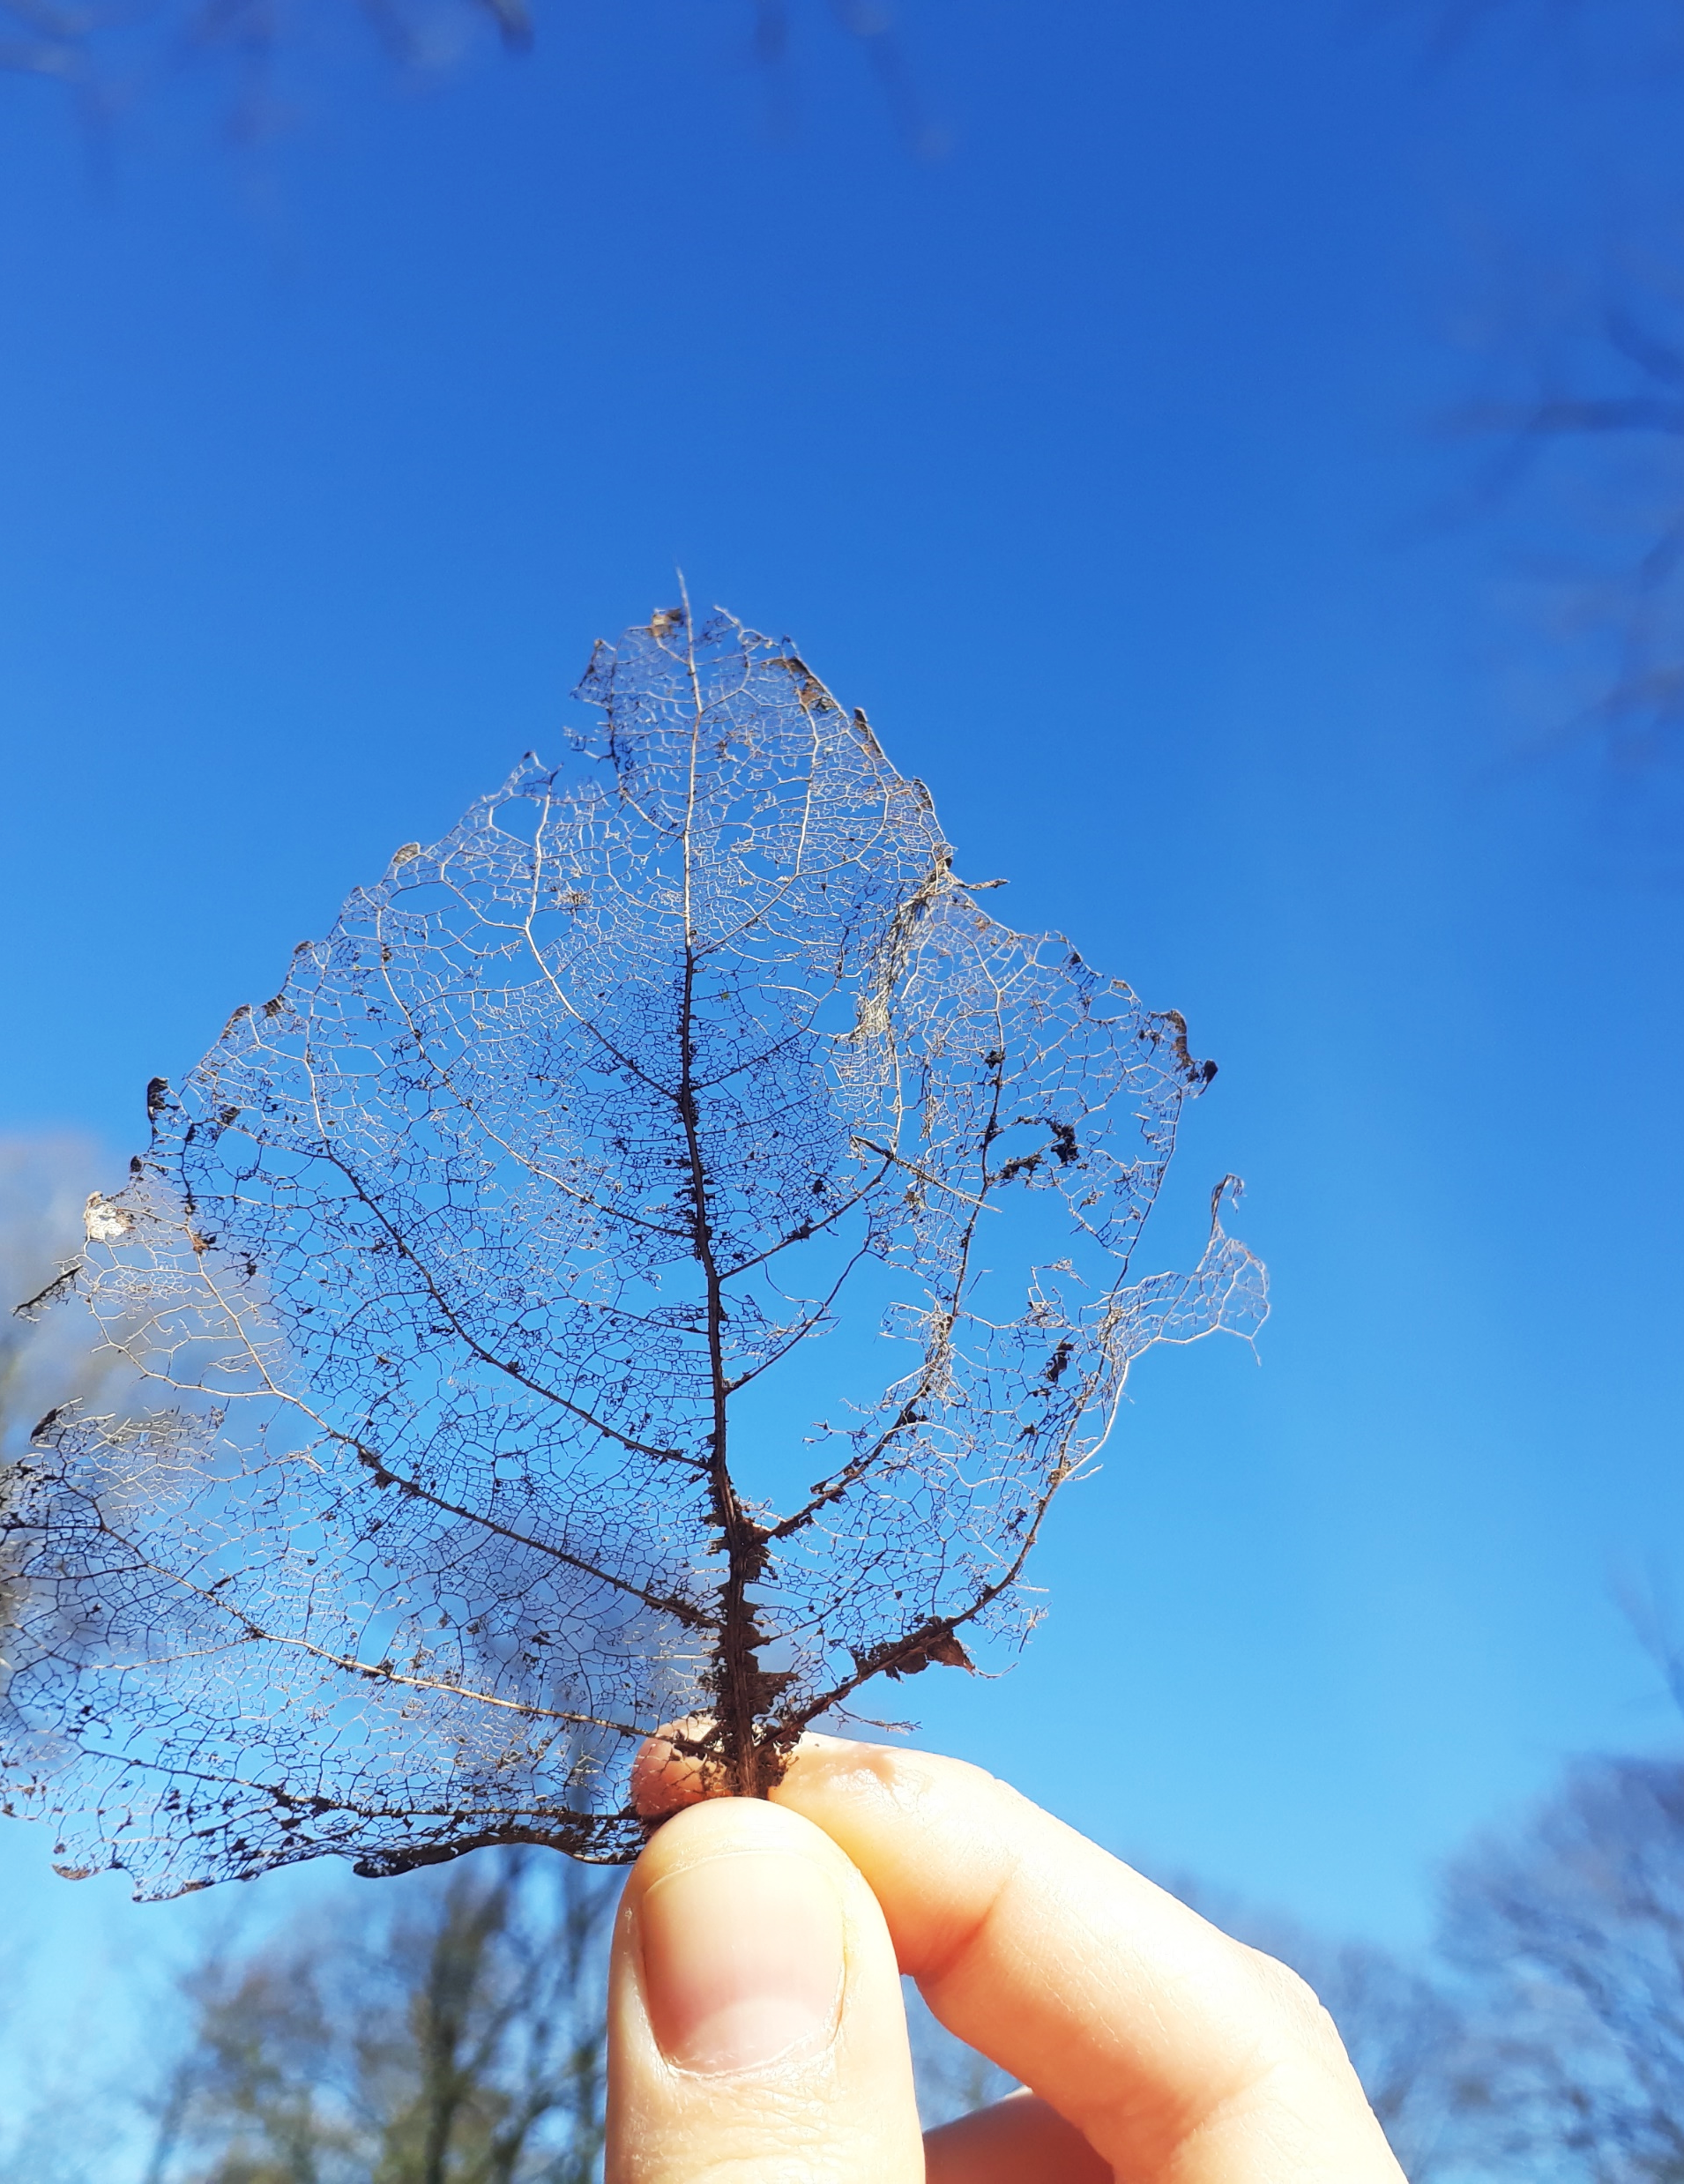
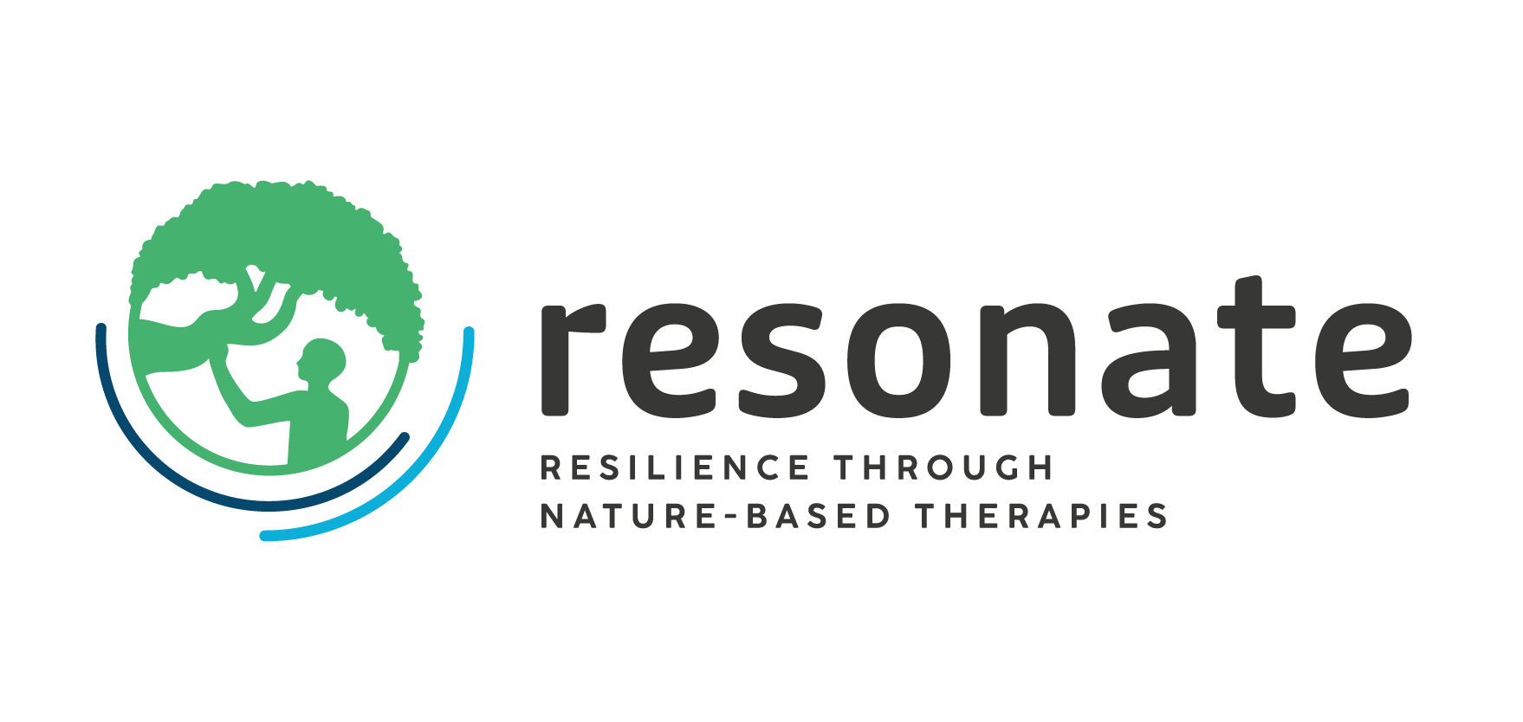


WP2: Global perspective
Patrik Karlsson Nyed (UCPH)
Jill Litt (ISGLOBAL)
Julia Egger (UNIVIE
AM25 Padova - 18/09/2025
The Resonate project is funded by the European Union’s Horizons Europe Research and Innovation programme under grant agreement No. 101081420 and co-funded by the UK Research and Innovation grant award No. 10063874

Slide 2
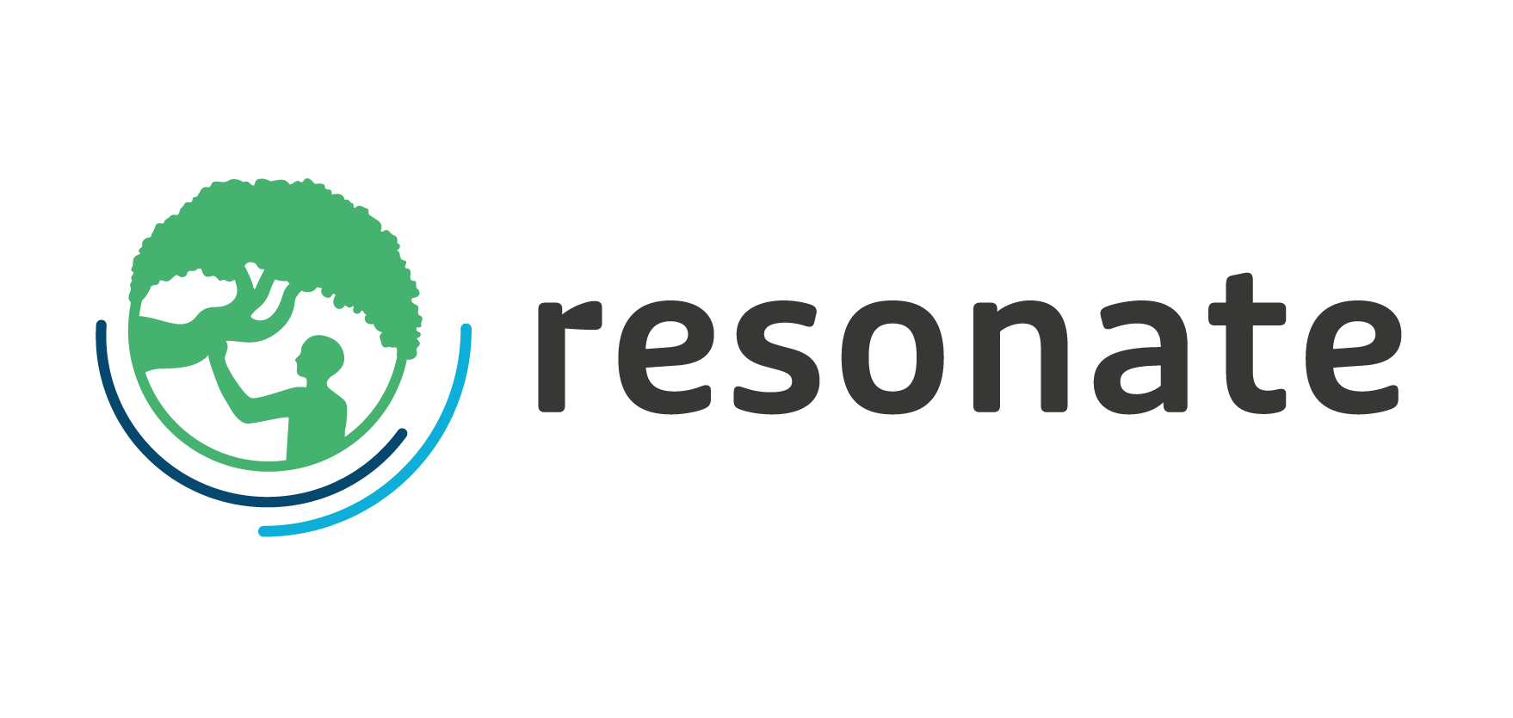

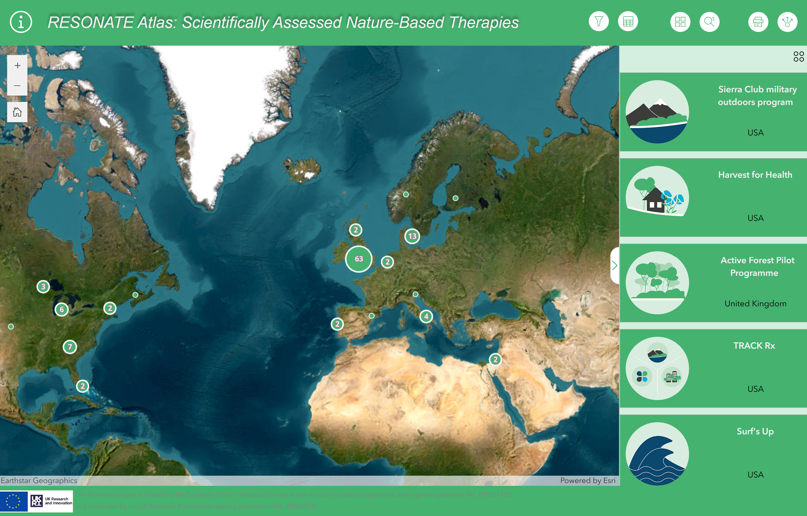
Objectives of WP2
Scoping Review (T2.1 & T2.2) (Database: Scientifically assessed NbIs AND implemented in practice)
RESONATE Atlas (T2.3) (WebGIS: Mapping tool)
(T2.4)

Slide 3
Updates on progress
Finalised data extraction (September 2024) (thank you to all the collaborators in consortium!)
Finalised Alpha & Beta Version of the map (May 2025)
Planning of the Spotlight Series

Slide 4
Upcoming challenges
Numbers and attendance of Global Spotlight Series events (We need your help!)
Refinements of the RESONATE Atlas

Slide 5
Publication ideas + Needs for collaborations
Main Publication for WP2: Scoping review ” Nature-based therapy as an evidence-based practice - a scoping review of what works”
First draft almost complete, will be updated after Spotlight Series in July 2026 (M6) and aimed for publication in Jan 2027 (D.2.3)
Again thanks to everyone for the help in data extraction!

Slide 6
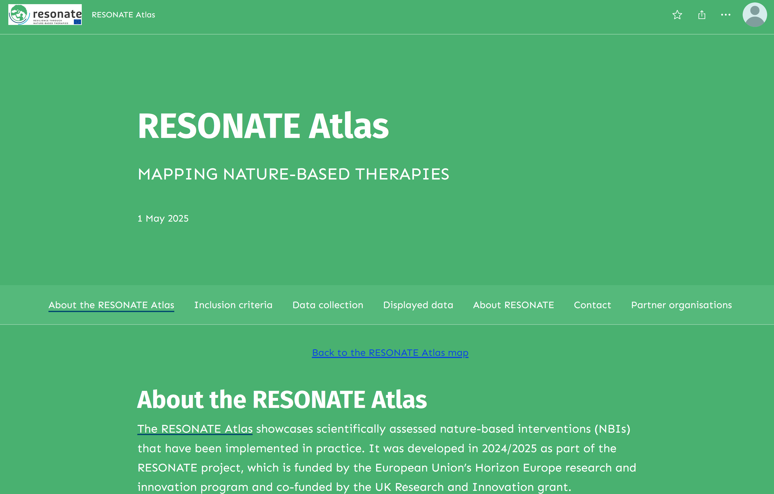
Timeline and next steps RESONATE Atlas
Adjusting for smartphone use
Spice up the ABOUT webpage
Preparing the stable release of the tool (D2.2 due in Oct 26)
Afterlife beyond the RESONATE project (e.g. Editable version curated by UNIVIE?)

Slide 7
Timeline and next steps Global SPOTLIGHT Series
Date | Geography | Topic | Collaborators
19.09 | Padova | Challenges of a fragmented governance system in implementing nature-based interventions in Italy | Ilaria Doimo, Laura Secco
14.10 | Singapore | Nature’s Role in Urban Well-being: The Impact of Green Spaces in a Tropical City-State | Jocelin Yingfen, Rachel Oh, Angelia, Sia
15.10 | UK | Roots of Wellbeing: Community Connections Through Nature | Nina Smyth, Carly Wood
17.10 | Ecuador and Brazil | Nature-based Interventions in Latin America - From Research to Practice: Overcoming Barriers and Building Strengths. | Giulia Catissi de Lima; Eliseth Ribeiro Leao; Gabriela Elizabeth Garcia Velez;
27.10 | South Korea | To be finalised | Won Sop Shin Prof. Bum-Jin Park
19.11 | Germany/Austria/ Switzerland | Building on the ”kur” tradition: Integrating NbTs into modern health insurance programmes | Arnulf Hartl, Christina Pichler
Nov/Dec | USA | The Space Between: Nature as a Place to Heal & Reconnect (young adult cancer survivors) | David Victorson
Nov/Dec | Barcelona | The sea heals - but why, for whom and where? | Mònica Ubalde
Nov/Dec | South-Africa | To be finalised | Heidi Albert
22.01 | Canada | Challenges of incorporating NBI for adolescents and young adults in the Canadian health system | Marie-Ève Langelier
Jan/Feb | Australia | To be finalised | Thomas Astell-Burt
First event taking place tomorrow (Big thanks to UNIPD & ETIFOR!)
Multiple in-person/online/hybrid events planned
Preparing report on series (D2.1 due in May 26

Slide 8
Thank you
Presented by Patrik Karlsson Nyed, Jill Litt, & Julia Egger on behalf of the WP2 team
The Resonate project is funded by the European Union’s Horizons Europe Research and Innovation programme under grant agreement No. 101081420 and co-funded by the UK Research and Innovation grant award No. 10063874

