Slide 1
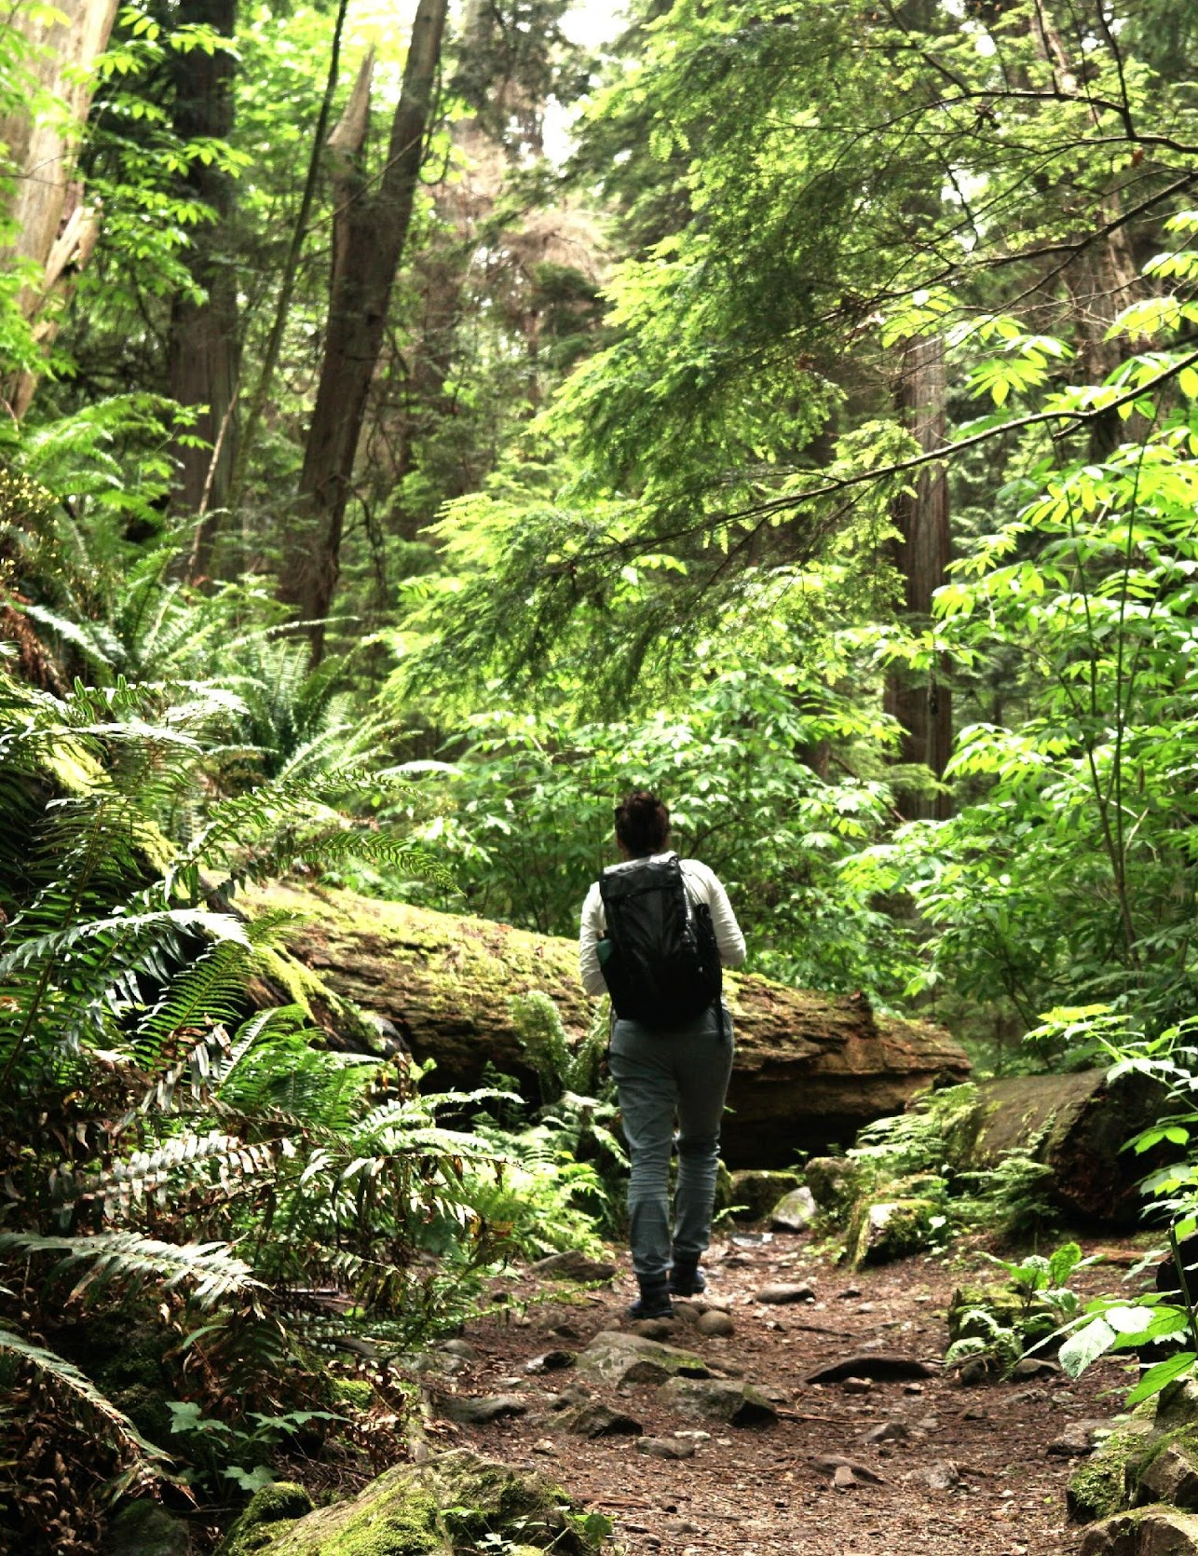
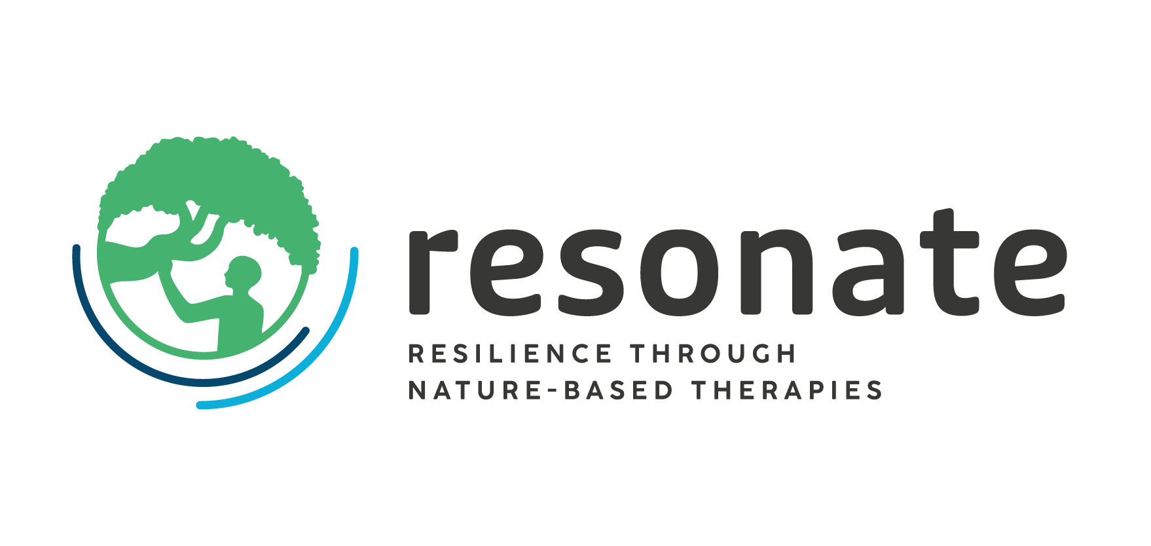


WP5: Environment
AZTI
María C. Uyarra & Sarai Pouso
AM25 Padova - 18/09/2025
The Resonate project is funded by the European Union’s Horizons Europe Research and Innovation programme under grant agreement No. 101081420 and co-funded by the UK Research and Innovation grant award No. 10063874

Slide 2

Objectives of the WP
5a) Assessment of CS impact on ecosystems and estimation of “maximum carrying capacity”
5b) Monitoring changes in pro-environmental attitudes/behaviours by CS participants/ stakeholders“

Slide 3


Updates on data collection and analysis
NbT-ERA methodological implementation
5a) Assessment of CS impact on ecosystems and estimation of “maximum carrying capacity”
Steps | Objective | Padua | Salzburg | Barcelona | Uppsala
Matrix development | Develop all the spreadsheets needed to carry out the NbT-ERA
CS and therapy description | Gather comprehensive knowledge on CS and NbT for adequate risk assessment |  |  |  | To be completed
Delphi round 1 | NbT-ERA assessment with experts (AZTI + CSs)
Delphi round 2 | Contrast NbT-ERA rd 1 results with experts (AZTI + CSs)

Slide 4
Updates on data collection and analysis
NbT participants questionnaires
5a) Assessment of CS impact on ecosystems and estimation of “maximum carrying capacity”
5b) Monitoring changes in pro-environmental attitudes/behaviours by CS participants/ stakeholders“
      Support CS in questionnaire adaptation and solving doubts
      Participation in statistics workshop (August 2025)
      Reviewing relationships and evaluating possible statistical test… while waiting to data

Slide 5
Upcoming challenges
Very tight timing for all the analysis included in WP5 (before Deliverable 5.1, July 2026)
NbT-ERA
CS and therapy description data missing has delayed the launch of the Delphi process (in communication with WP3)
Ensure the CSs participation in Delphi 1 & 2 in due time (31st October, Milestone 17)
NbT participants questionnaires
Uncertainty about the data that each CS has finnaly included in questionnaires and number of responses (it may limit the scope of the analysis)
Analysis for PEB changes and we see timing very tight considering data access (delays) and AZTI team’s availability

Slide 6
Publication ideas + Needs for collaborations
1. Naturalness matters: status of environmental features impacts NbT outcome. Are people aware on the environment during NbT sessions? Do they perceive the presence and their quality? Do they affect the therapy outcome?
Collaboration: optional, those interested will be invited
2. Environmental risks associated to NbTs: The NbT-ERA methodology. How can we measure the environmental risks associated to this new human activity? Outcomes from CSs
Collaboration: optional, those that participated as experts in Delphi processes will be invited
3. Can nature-based therapies promote pro-environmental behaviours? Does participation in a NbT, increase people's PEB, environmental attitudes and associated concepts?
Collaboration: ideally Mat (?), Lewis(?), and others that may support us with their expertise → ECR stay?
4. Designing eco-sustainable NbTs. What have we learnt in RESONATE-WP5? Promoting positive environmental impacts from the designing phase, evaluating risks and proposing adaptation and mitigation measures.
Collaboration: optional, CS leaders & those interested individuals will be invited

Slide 7
Publication ideas + Needs for collaborations
5. Environmental determinants that can condition NbTs success and/or outcomes (conceptual paper) In what way do different environmental factors impact the exposure to nature vs. human health relationship? How this relationship may be relevant for designing NbTs in the future?
Collaboration: WP2, Coordination team and those with interest/knowledge on environment
6. From childhood experiences to pro-environmental behaviour scales, and all the scales in between: what they measure and how to select. Results from the reviewed scales to develop participants surveys. PEB and others scale analysis (type of questions, themes covered, gaps?); Suggest a “model of change”
(possible combination with publication nº3)
7. Measuring BLUE pro-environmental behaviours. To develop and test a new scale focused on marine PEB
(possible master student)
Write here

Slide 8
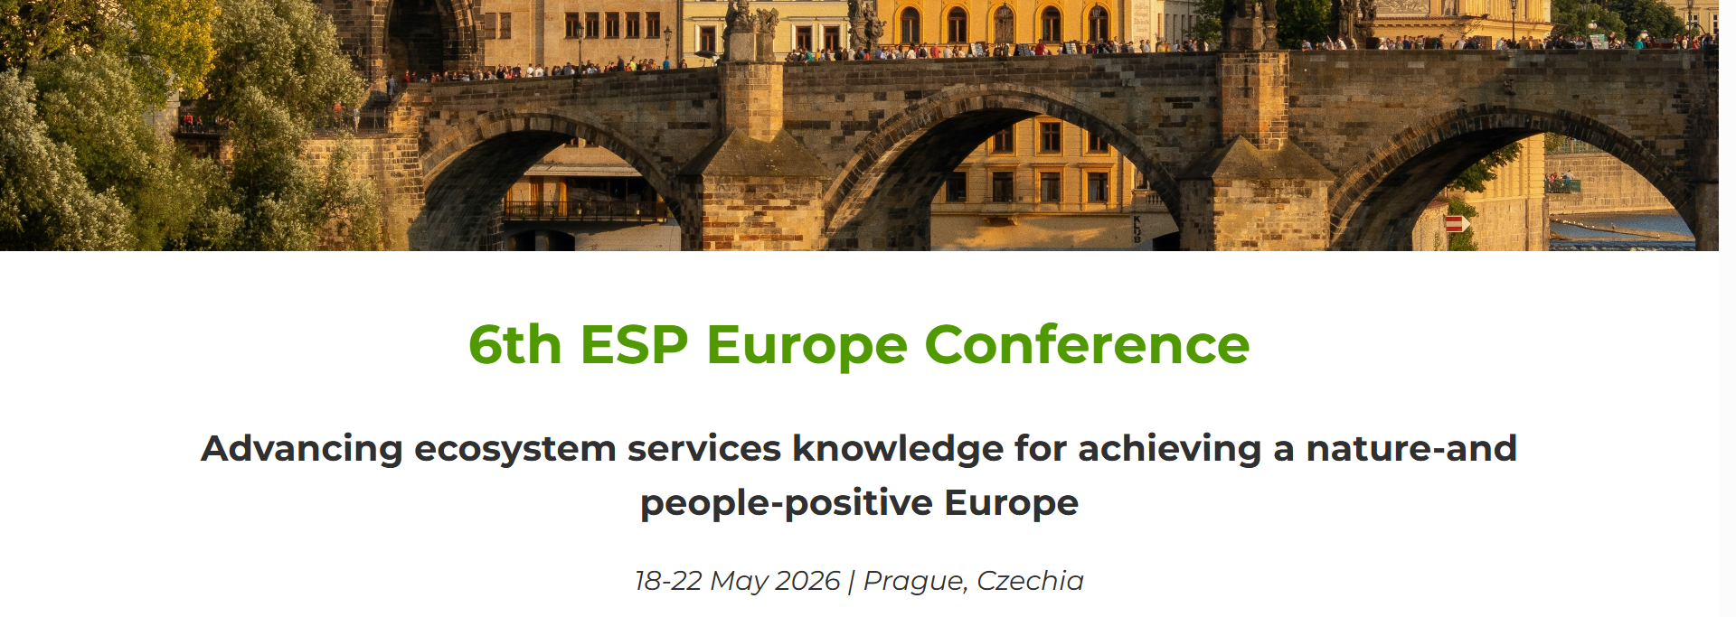
Publication ideas + Needs for collaborations
Propose a session (NbTs focusing on the ”N”) together with sister projects (deadline 30th September)

Slide 9
Timeline and next steps
May - Jul 2026
Working on deliverable & input from collaborators
Nov-2025 Apr-2026
Data analysis
Oct 2025
Finalize data collection: Delphi 1&2 (NbT-ERA), RedCap (Milestone 17)
Apr 2026
Data analysis completed (Milestone 18)
Jul 2026
Finalize Deliverable
5.1.
Until end of project finalizing publications
9

Slide 10
Thank you
AZTI
The Resonate project is funded by the European Union’s Horizons Europe Research and Innovation programme under grant agreement No. 101081420 and co-funded by the UK Research and Innovation grant award No. 10063874

