Slide 1
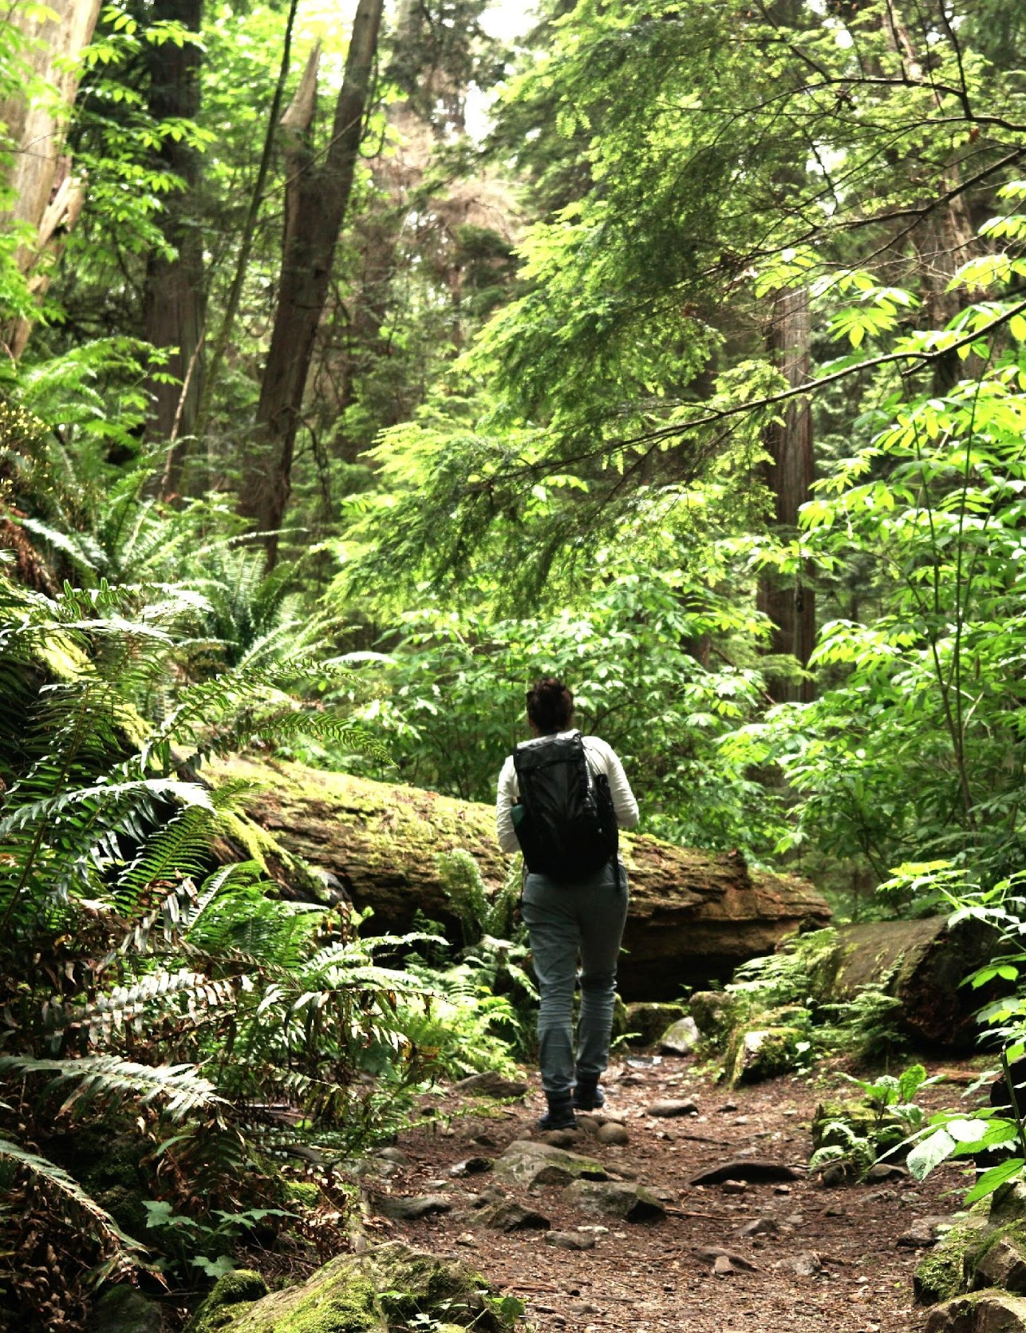



WP8
UNEXE
Lewis Elliott
AM25 Padova - 18/09/2025
The Resonate project is funded by the European Union’s Horizons Europe Research and Innovation programme under grant agreement No. 101081420 and co-funded by the UK Research and Innovation grant award No. 10063874

Slide 2

Objectives of the WP
8a) Conduct process evaluations of Level 2&3 CSs to investigate ‘what works’ in terms of intervention delivery
8b) Conduct cross-sectoral scenario analyses to estimate the combined health, environmental, economic, and societal impact (benefits & risks) of scaling-up (increasing participants) of selected CSs at the local level, and scaling-out (replicating) across different geographical and/or socio-economic contexts;
8c) Provide a comprehensive 360° cross-sectoral view of successful NbT processes, impacts, and futures.

Slide 3
Updates on data collection and analysis
Honestly, it didn’t matter to me. Even if I had been alone, I would have participated and done it the same way.
Group processes?
Task 8.3:
Collection and analysis methods outlined in protocol publication (in preparation).
CS4: 20 pseudonymised transcripts received from first wave.
(Awaiting other CS transcripts through RedCap).
Beginning thematic analysis with CS4 batch: Familiarisation, initial codes, initial themes, review themes, define themes.
When we were in a group, there are various people who maybe express their difficulties, and you understand that maybe you manage to face them more quickly or you manage to avoid these problems
Being with other normal people like me made me feel good and not different from others. It made me realize it was a perfectly normal situation.

Slide 4
Upcoming challenges
Task 8.3:
Uncertain data delivery times – analysis peaks.
Variation of data across case studies.
Large volume of data.
Potential for multiple publications…

Slide 5
Publication ideas + Needs for collaborations
We had originally envisaged two key publications – a protocol paper (in preparation) and a synthesised process evaluation paper covering implementation, context, and mechanisms of change (synthesised across case studies).
As we analyse the data, we could make the case for separate publications on e.g. implementation and mechanisms of change separately.
Collaboration will be similar to the protocol paper – people very involved with the CS (inc. at least 1 ECR), plus UNIVIE / EHN / EAB where applicable.

Slide 6
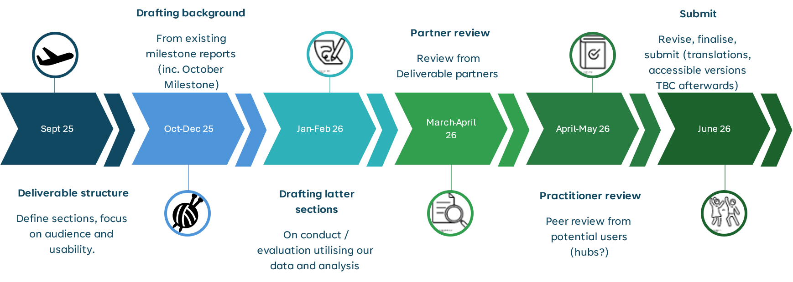
Timeline and next steps (D8.1 – NbT Process evaluation guide)

Slide 7
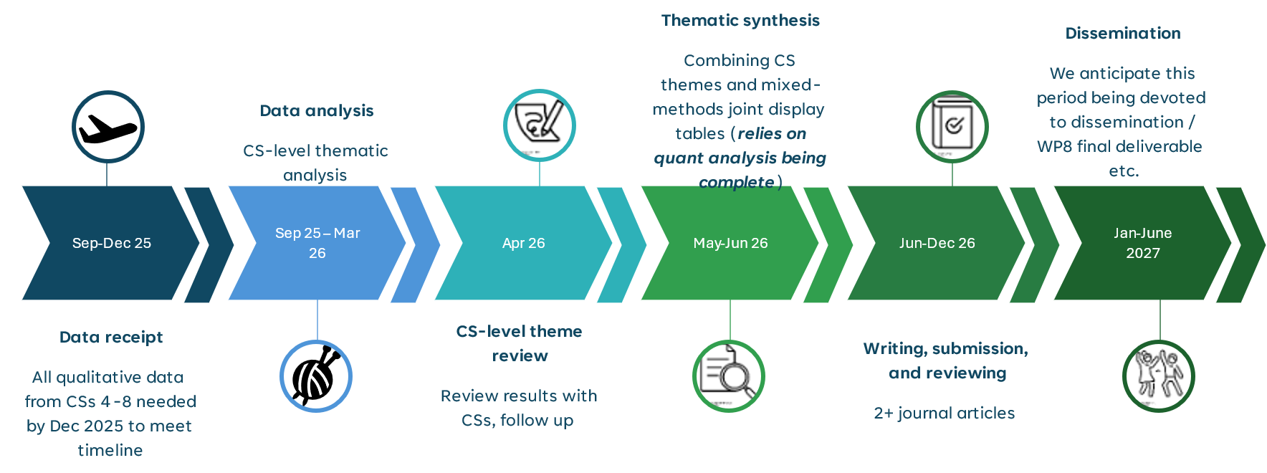
Timeline and next steps (analysis)

Slide 8
WP8
AZTI
Sarai Pouso & Maria C. Uyarra
AM25 Padova - 18/09/2025
The Resonate project is funded by the European Union’s Horizons Europe Research and Innovation programme under grant agreement No. 101081420 and co-funded by the UK Research and Innovation grant award No. 10063874

Slide 9
Objectives of the WP
8a) Conduct process evaluations of Level 2&3 CSs to investigate ‘what works’ in terms of intervention delivery
8b) Conduct cross-sectoral scenario analyses to estimate the combined health, environmental, economic, and societal impact (benefits & risks) of scaling-up (increasing participants) of selected CSs at the local level, and scaling-out (replicating) across different geographical and/or socio-economic contexts;
8c) Provide a comprehensive 360° cross-sectoral view of successful NbT processes, impacts, and futures.

Slide 10

Updates on data collection and analysis
Task 8.6: Support the CSs collect the relevant scenario data
Semi-quantitative models (SSP1 & SSP2):
Data collection tool | Objective | Participants | Padua | Salzburg | Barcelona
Literature Review | Relevant literature on health, social, economic, environmental trends | AZTI UNIVIE
Questionnaire (RedCap) | Local stakeholders perceptions on how the area may develop under different scenarios | AZTI UNIVIE UniPd/Etifor ISGLOBAL PMU | 18 responses | 9 responses | 5 responses (+3 partial)
Stakeholders’ Workshop | Build Fuzzy Cognitive Maps | AZTI UniPd/Etifor ISGLOBAL PMU |  | Planned (5th November) | Planned (2nd October)

Slide 11
Updates on data collection and analysis
Task 8.6: Support the CSs collect the relevant scenario data
Quantitative model (only Barcelona – blue therapies):
Steps | Objective | Participants | Barcelona
Internal workshop | Build a Causal Loop Diagram | AZTI ISGLOBAL | October (date TBD)
Model building | Build a Bayesian belief Network | AZTI | Once the CLD is completed
Validation and scenario simulations | Validate the model and test how it develops under constrasting scenarios | AZTI (ISGLOBAL)

Slide 12
Upcoming challenges
Task 8.7. Data analysis
Semi-quantitative models
Questionnaire responses AND Workshop transcriptions → Translation to English
Quantitative model
Changed to BBN to reduce complexity and ISGlobal/RH burden
Need to develop the CLD asap so our modellers can start building a first sketch and running simulations → 8 months to complete the whole analysis!!!
We need the support from local partners UniPd/Etifor + UniVie/PMU
We need the support from ISGlobal

Slide 13
Publication ideas + Needs for collaborations
Planned publications:
1. Future risks and challenges for NbTs in three european regions
Results of FCM (semi-quantitative models)
Collaborators We will invite the people very involved with the questionnaire distribution and workshop organization (2 people per CS?), plus UNIVIE. Assess with CS leaders if adequate to invite stakeholders (deliverable? article?) TBD.
2. How does a coastal NbT work? Building a socioecological model with BBN
Results from BBN (quantitative model)
Collaborators: We will invite people from ISGlobal involved in the CLD development and model validation.

Slide 14
Timeline and next steps
Nov-2025 Feb-2026
Data analysis (FCM) & model building (BBN)
May 2026
Scenario data analysis completed (Milestone 33)
Nov 2026
Contribution to “What works” report (Deliverable 8.2.)
Oct 2025
Finalize data collection: workshops, questionnaire, build CLD (Milestone 32)
Mar 2026
Review FCM results with CSs leaders, Validate BBN model with ISGlobal
May-Oct 2026
Working on deliverable/ publications
Until end of project finalizing publications
14

Slide 15
Thank you
The Resonate project is funded by the European Union’s Horizons Europe Research and Innovation programme under grant agreement No. 101081420 and co-funded by the UK Research and Innovation grant award No. 10063874

