Slide 1

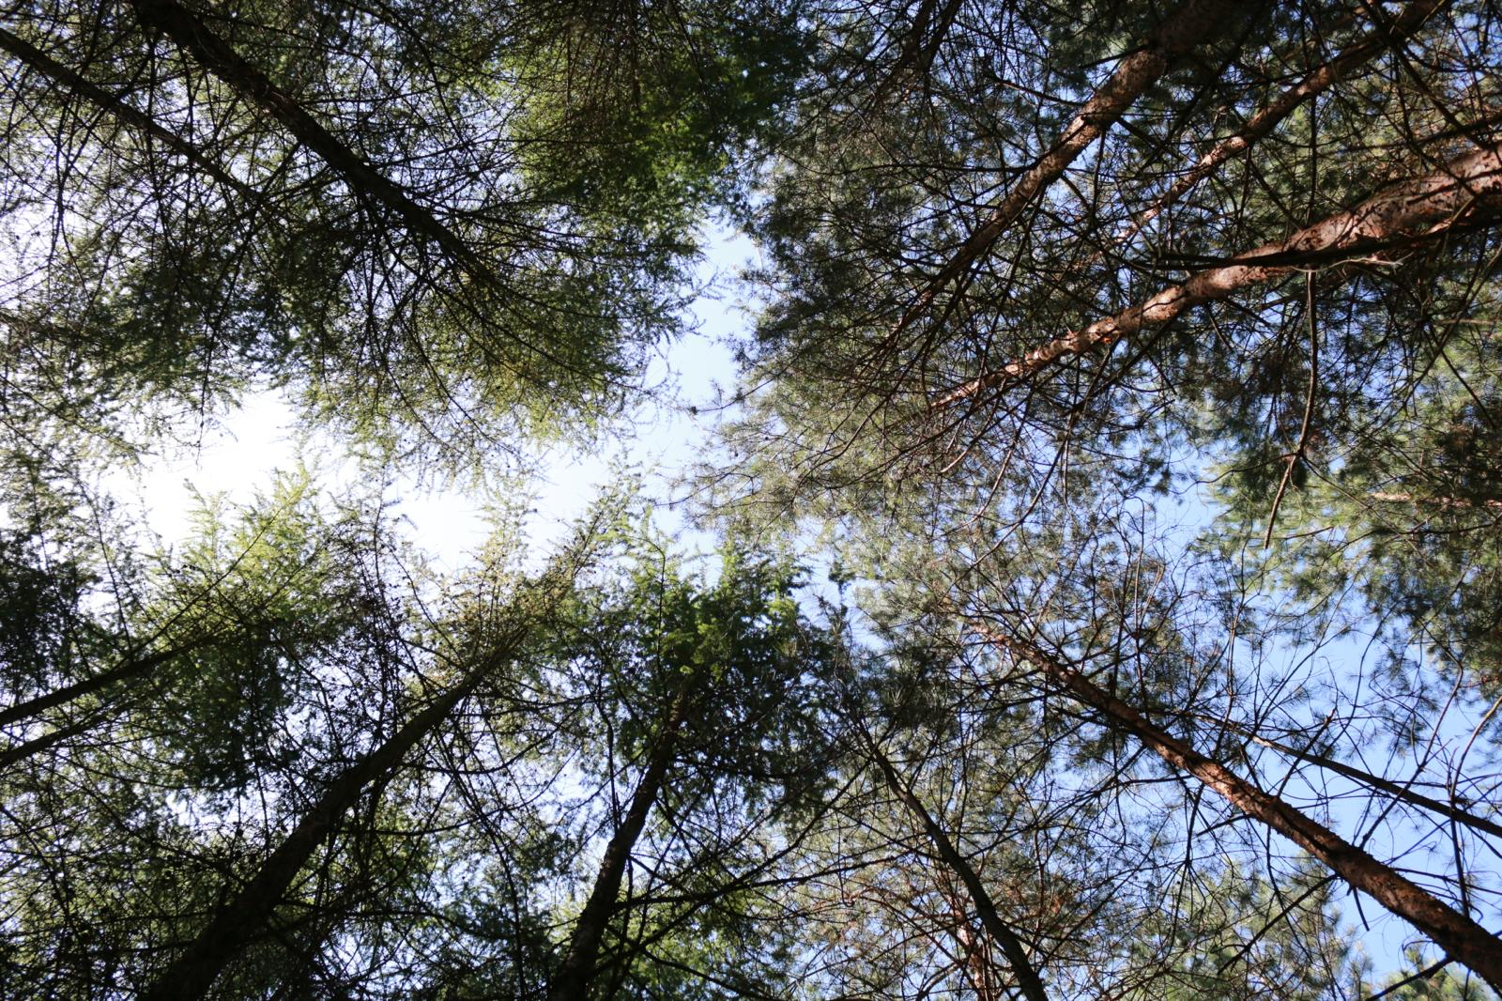
CS1 Associations between nature contact and well-being: mediation by self-efficacy
University of Exeter
James Grellier
AM25 Padova - 18/09/2025

Slide 2



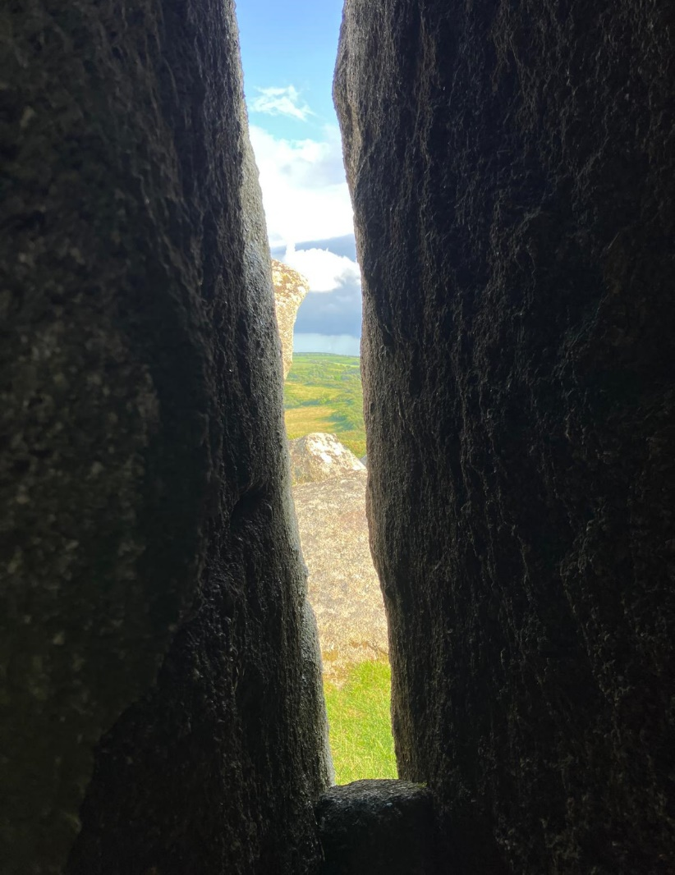
Objectives of CS1
Analysis of
secondary
longitudinal
panel survey
data
Research question
Does contact with nature help adults build resilience (self-efficacy) that allows them to cope better (in terms of their subjective well-being) with stress (specifically, with increased volatility in their income)?
Hypotheses
Higher nature contact is associated with higher levels of SWB (specifically GHQ-12 score (the “main effect” hypothesis).
Association between nature contact and SWB in subsequent waves is due to increased resilience (specifically generalised self-efficacy) (the “mediation hypothesis”)
Increase in income volatility attenuates the nature contact-SWB relationship; no change or a decrease in income volatility is associated with a stronger nature-SWB relationship (the “moderation hypothesis”).
UKHLS
www.understandingsociety.ac.uk

Slide 3
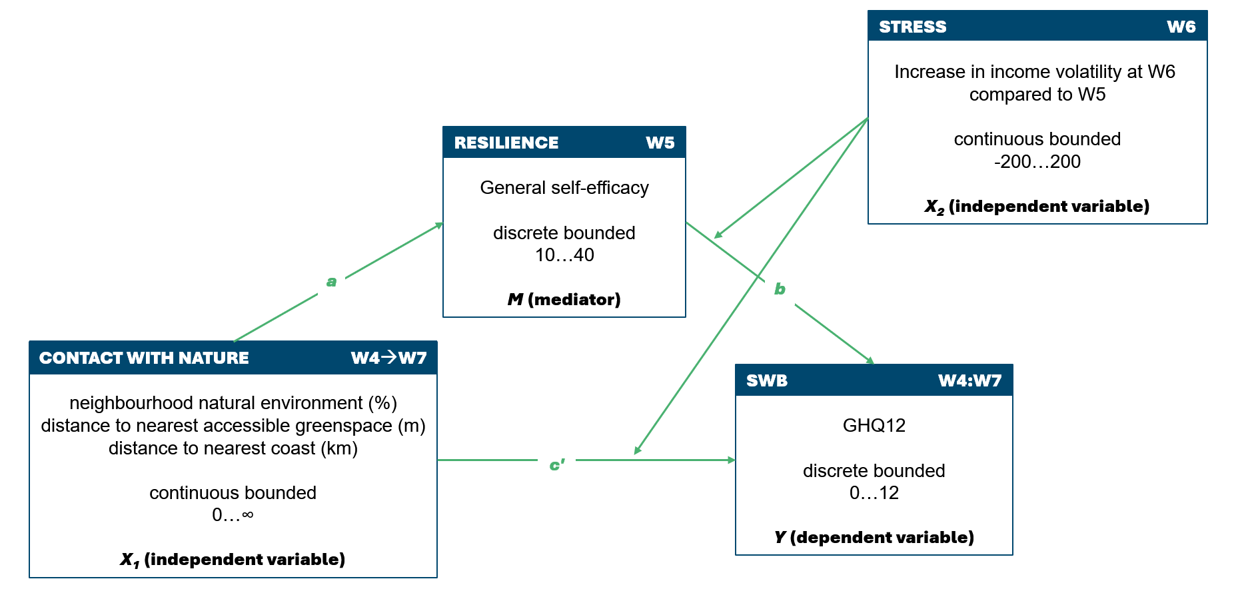

Slide 4
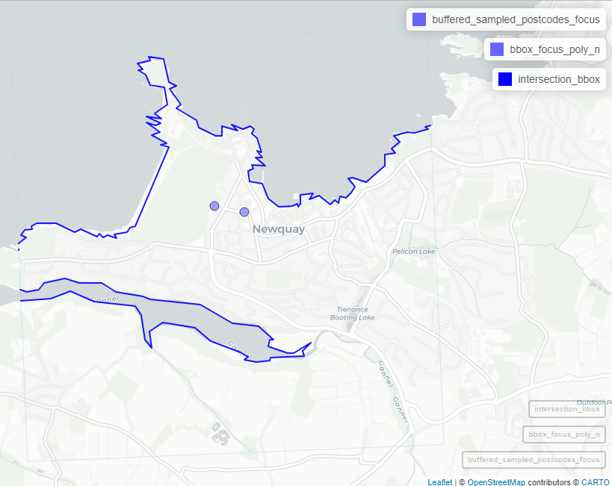
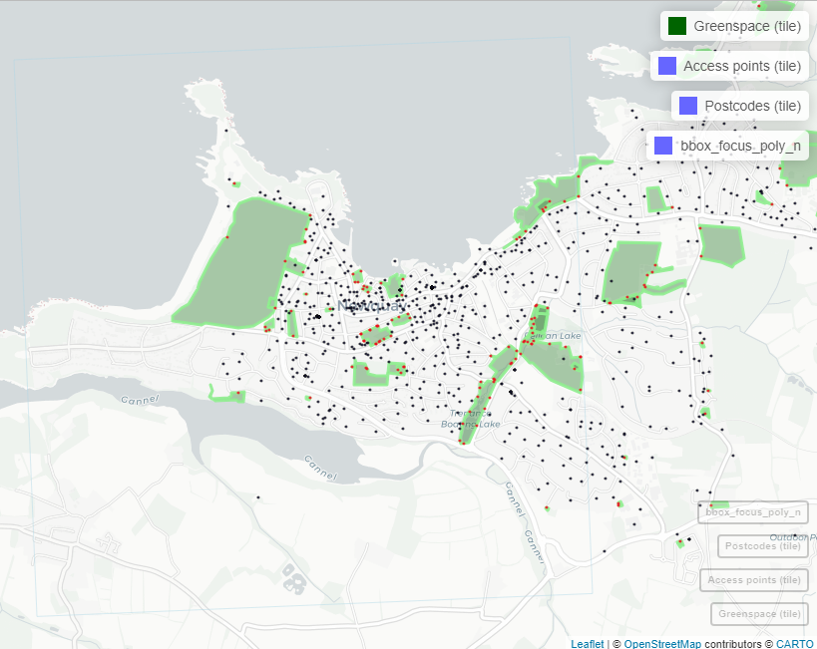
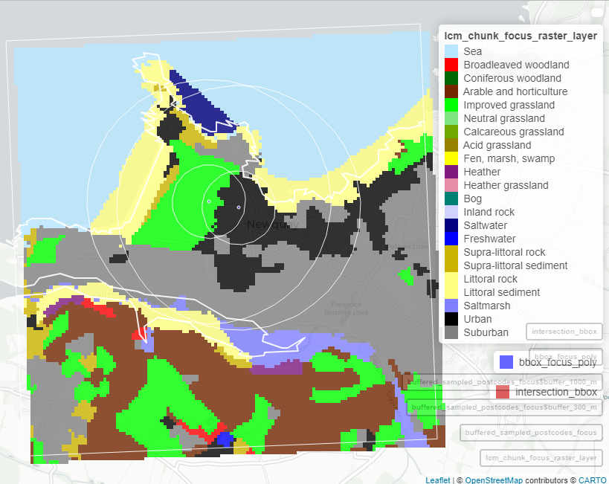
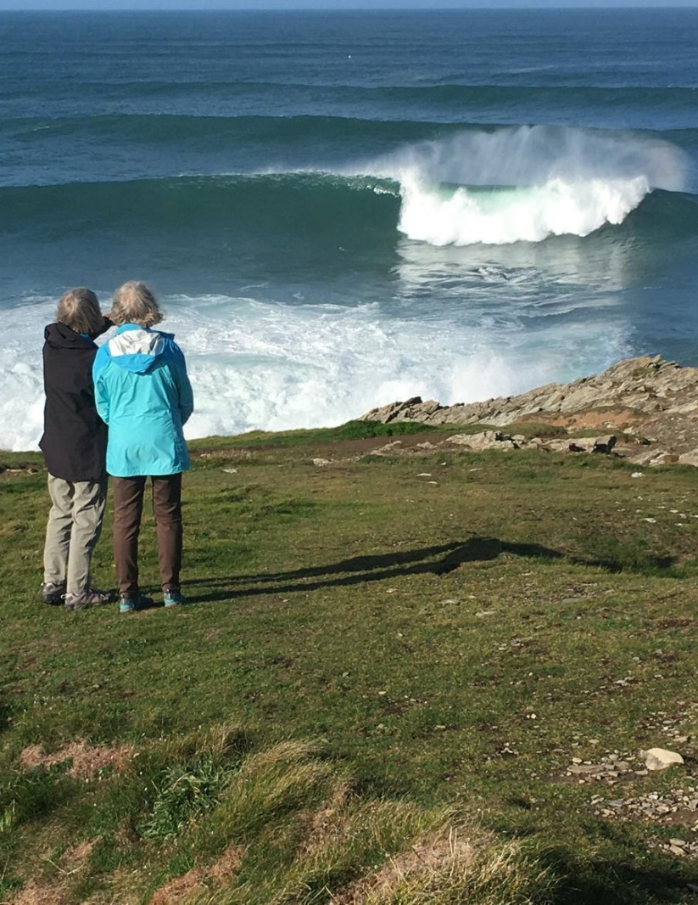
Update on data collection and analysis
Three derived exposure metrics assigned to 2.5 million GB postcodes
Proportions of 21 classes of land cover in 300m and 1000m radial buffers of postcode centroids
Euclidean distance (m) to nearest greenspace and greenspace access points from postcode centroids
Euclidean distance (m) to nearest coastline
Draft structural equation modelling (SEM) script developed in R, using lavaan package
Based on conceptual SEM
Pending import into SecureLab
Notes:
All analysis takes place on the UKDataService SecureLab.
SecureLab is a highly secure environment on which all postcode-level UKHLS data analysis takes place.
For reference, a UK postcode typically contains up to 100 households, but usually is nearer to 15.
Producing nature exposure data can be done inside the SecureLab, but it is cumbersome, as data imports are all subject to application and approval processes, which take into consideration licensing issues etc.
I therefore decided to use Geographical Information Systems packages in R to produce full nature exposure data sets for every postcode centroid in Great Britain ~2.5 million postcodes.
The scale of the data made it necessary to implement chunked pipelines, avoiding memory overload and prohibitively long processing times.
These derived data have now been approved and imported into the SecureLab.

Slide 5
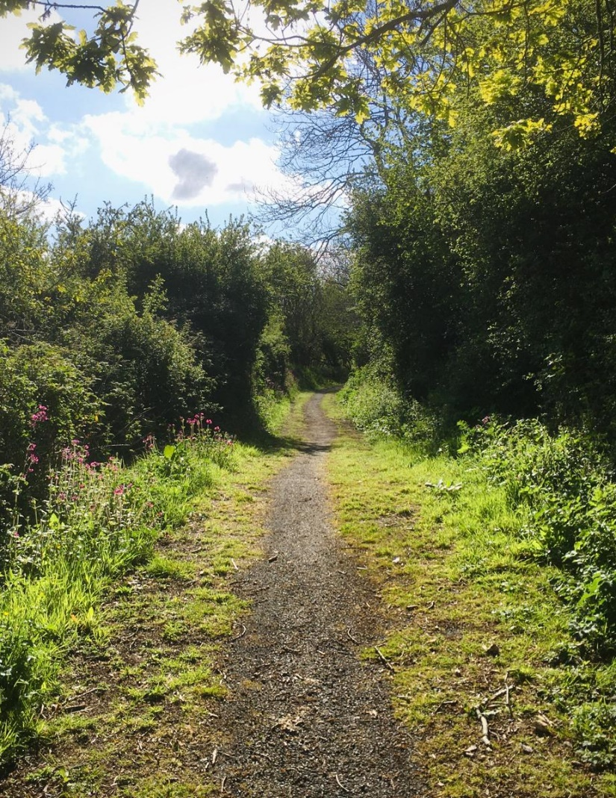
Upcoming challenges
Wrangling UKHLS data
Very large data set: 40,000 households, 2,000-4,000 variables per wave
Documentation
Secure environment – import
Managing disclosure risk – export
Analytical challenges
Accounting for multiple respondents living in the same household (treatment of clustering in longitudinal/multilevel SEM? randomly select on respondent per household?)
Weighting (necessary? use lavaan.survey?)

Slide 6

Publication ideas + Needs for collaborations
“The mediating role of self-efficacy in nature contact’s moderation of stress and wellbeing”
Aim to submit to Environ Int by March 2026

Slide 7

Timeline and next steps
Wrangle UKHLS data Sept 2025
Linkage between exposure metrics and UKHLS households/respondents Sept 2025
Run SEM and interpret results Oct 2025
Provide results to MUP for level 1 synthesis (D3.1) Dec 2025
Write manuscript and submit February 2026

Slide 8

Thank you
j.grellier@exeter.ac.uk

