Slide 1


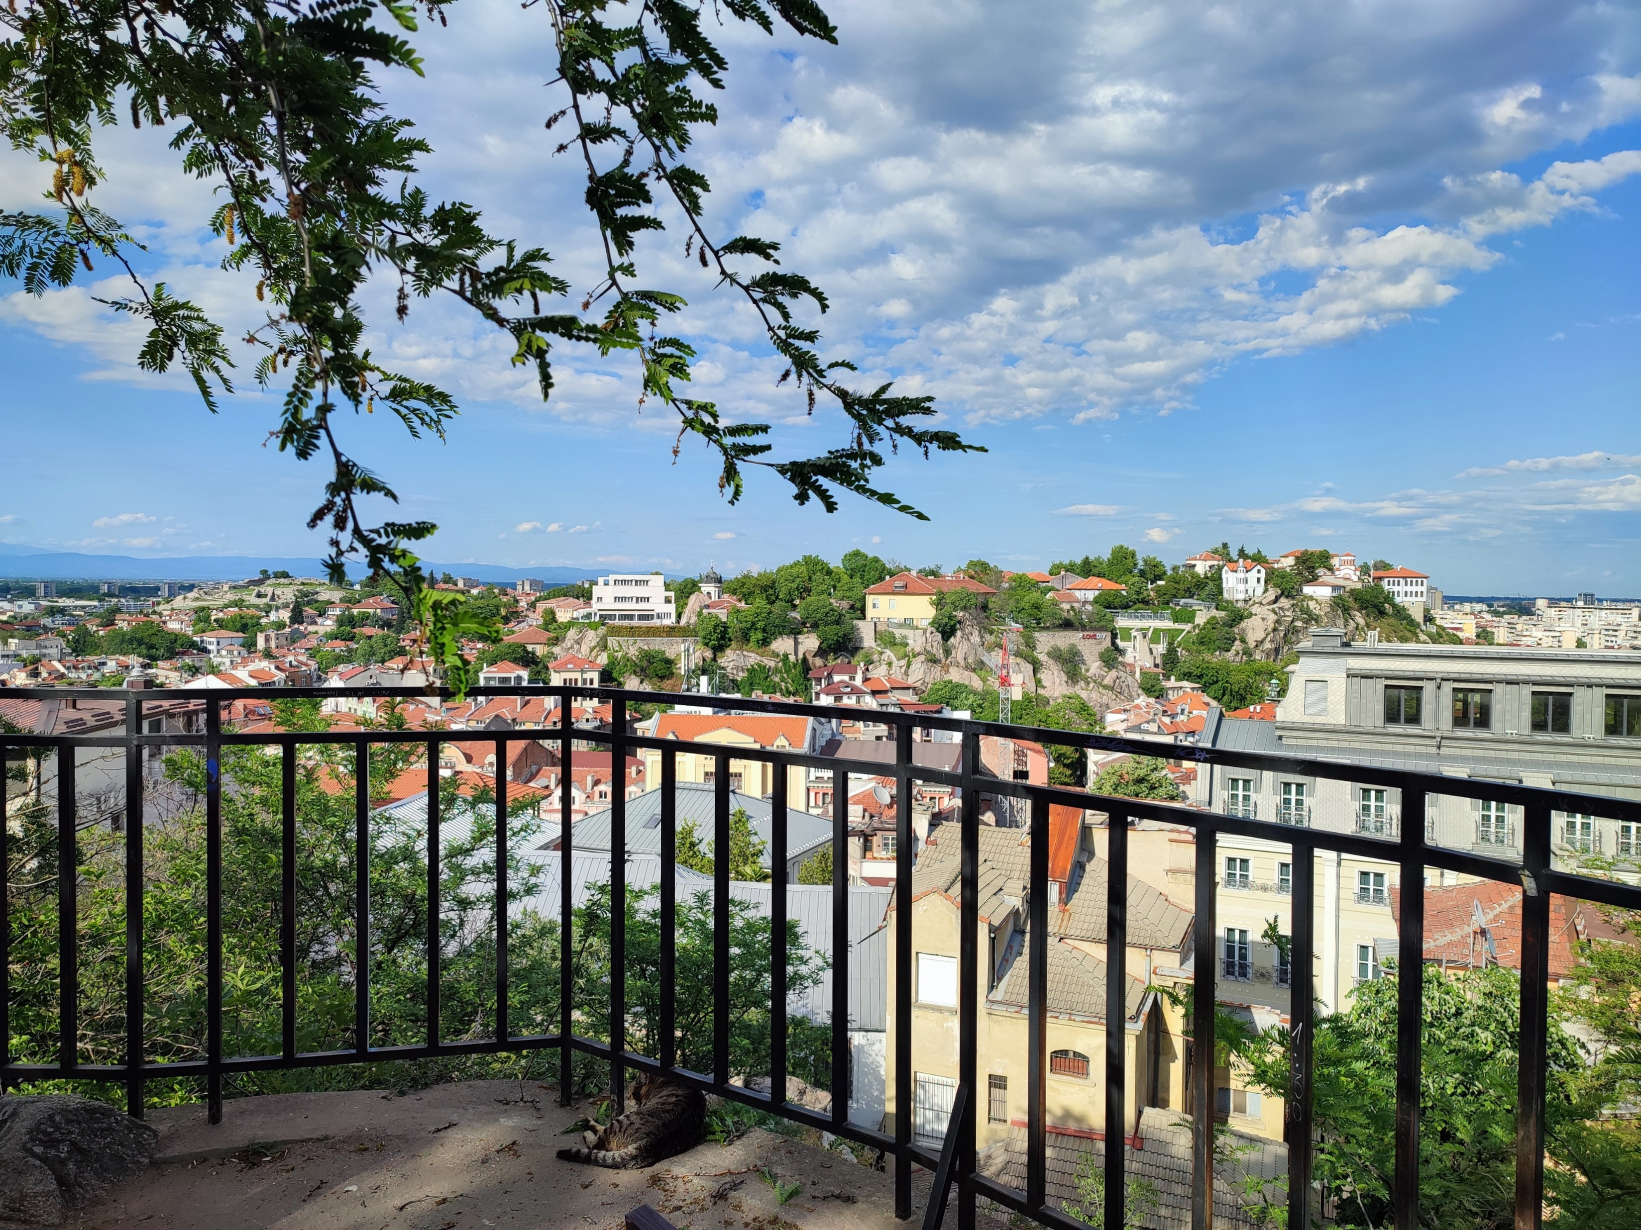


Case Study 3
Angel Dzhambov
Environmental Health Division,
Research Institute,
Medical University of Plovdiv, Plovdiv, Bulgaria
AM25 Padova - 18/09/2025
The Resonate project is funded by the European Union’s Horizons Europe Research and Innovation programme under grant agreement No. 101081420 and co-funded by the UK Research and Innovation grant award No. 10063874

Slide 2

Objectives of CS3
Explore the frequency, duration, and form of habitual exposure to green/blue spaces and, in general, contact with nature
Explore the contribution of nature contact to different types of biopsychosocial resilience and, through that, mental/physical health
Test if nature contact mitigates the impact of everyday and environmental stressors on mental and physical health via enhanced biopsychosocial resilience
Explore the underlying pathways linking nature contact, resilience, and mental health, including the potential of nature contact to buffer the impact on mental health of harmful physical exposures
Explore the patterns and determinants of proenvironmental behaviours and attitudes

Slide 3
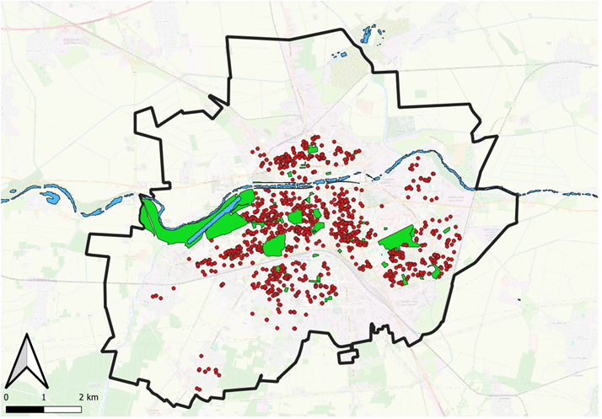
Updates on survey data collection
Data collection completed on 20.06.2025
    First wave (May-July 24): N=1506
    Second wave (Oct-Dec 24): N=1348
    Third wave (May-June 25): N=1103
27% attrition

Slide 4
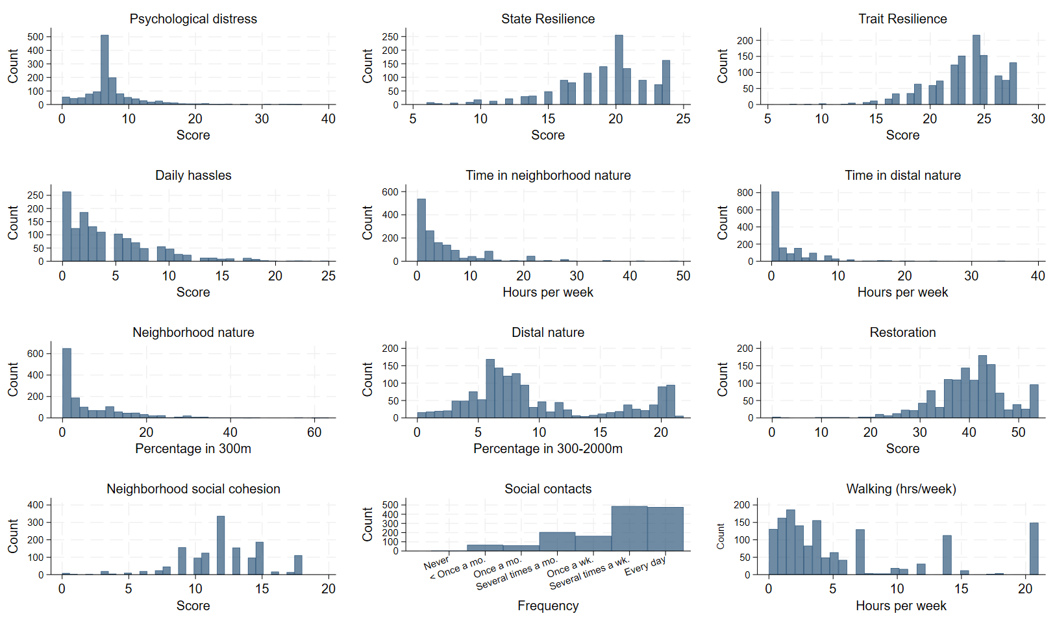
Survey data
Participant characteristics (Wave 1):
  Age: 48 (18-94) years
  Female: 53%
  Bulgarian: 92%
  Primary/no education: 9%
  Representative of the city population

Slide 5
Update on laboratory data collection
1st Wave data collection completed on 28.05.2025 (N=256)
    Questionnaire completed: May 2024-Mar 2025
    Blood collected: Oct 2024-Mar 2025
Original sample N=62 (24%)
    Age: 55 (20-76) years
    Female: 76%
    Bulgarian: 97%
    Primary education: 6%
Snowball sample N=194 (76%)
Age: 49 (19-87) years
Female: 71%
Bulgarian: 99%
Primary education: 0%
2nd Wave data collection completed on 09.09.2025 (N=170, 34% attrition)
      Questionnaire completed: May 2025-July 2025
      Blood collected: June 2025-Sep 2025

Slide 6
Updates on laboratory data
HBA1C
Cortisol
CRP
NK cells
IL-6
IL-10
TNF-a
Thyroid disease N= 40 (16%), CVD N=38 (15%), Diabetes N=17 (7%), Autoimmune N=17 (7%), Kidney disease N=4 (2%), Liver disease N=3 (1%), Leukemia ~2 (1%)

Slide 7
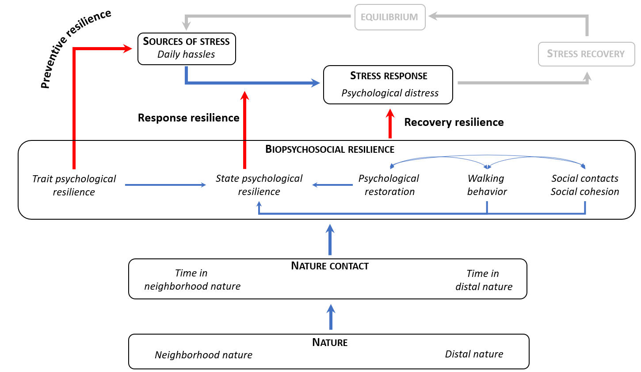
Testing NBRT with the CS3 Wave 1 survey data

Slide 8
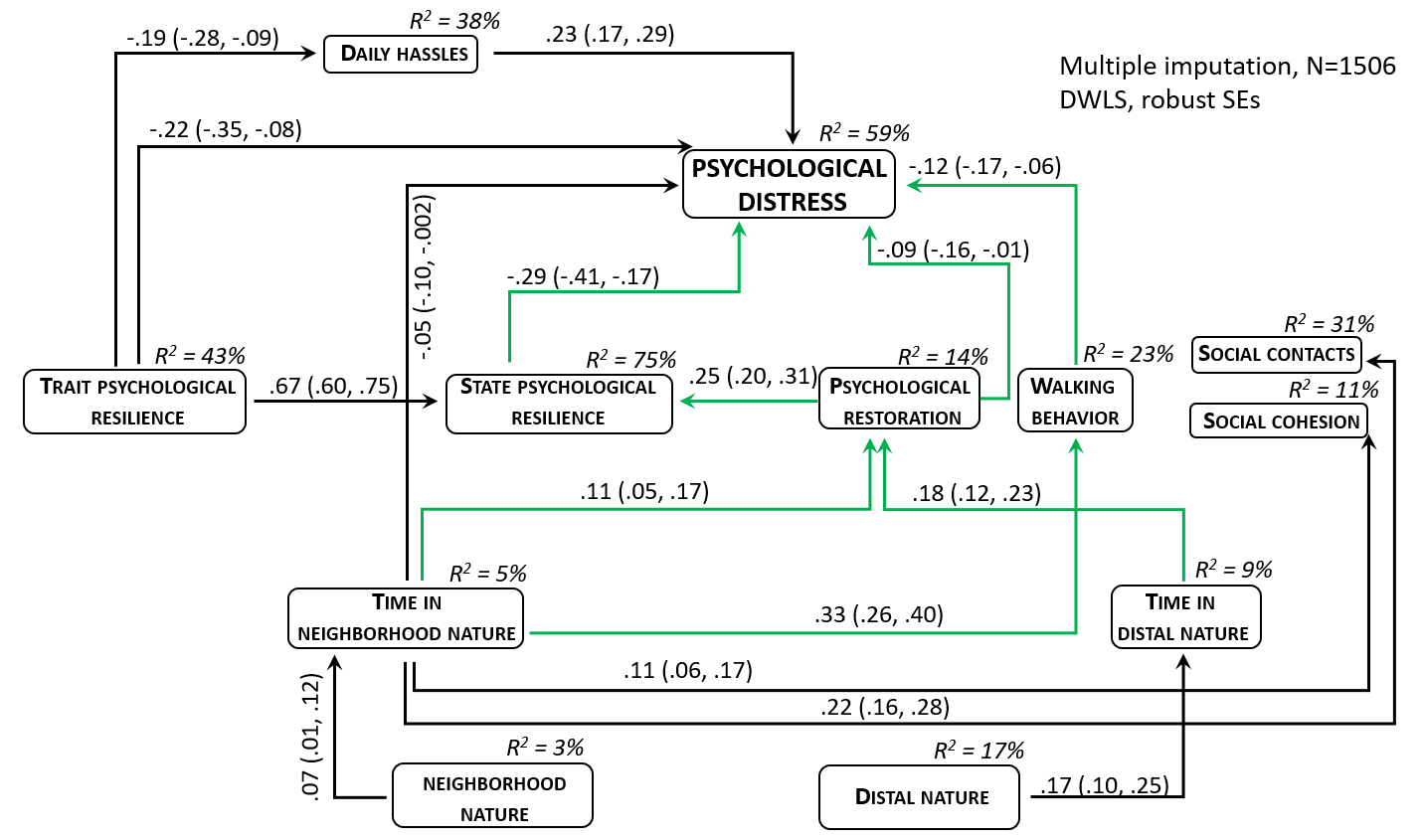
Nature contact associated with better mental health via a series of pathways involving resilience
Model fit:
χ² ₍₅₀₎ = 442.07, p < 0.001
CFI = 0.92
RMSEA = 0.06
SRMR = 0.06
PNFI = 0.23
Variables not displayed:
Age, Gender, Ethnicity, Education, Marital Status, Perceived Income

Slide 9
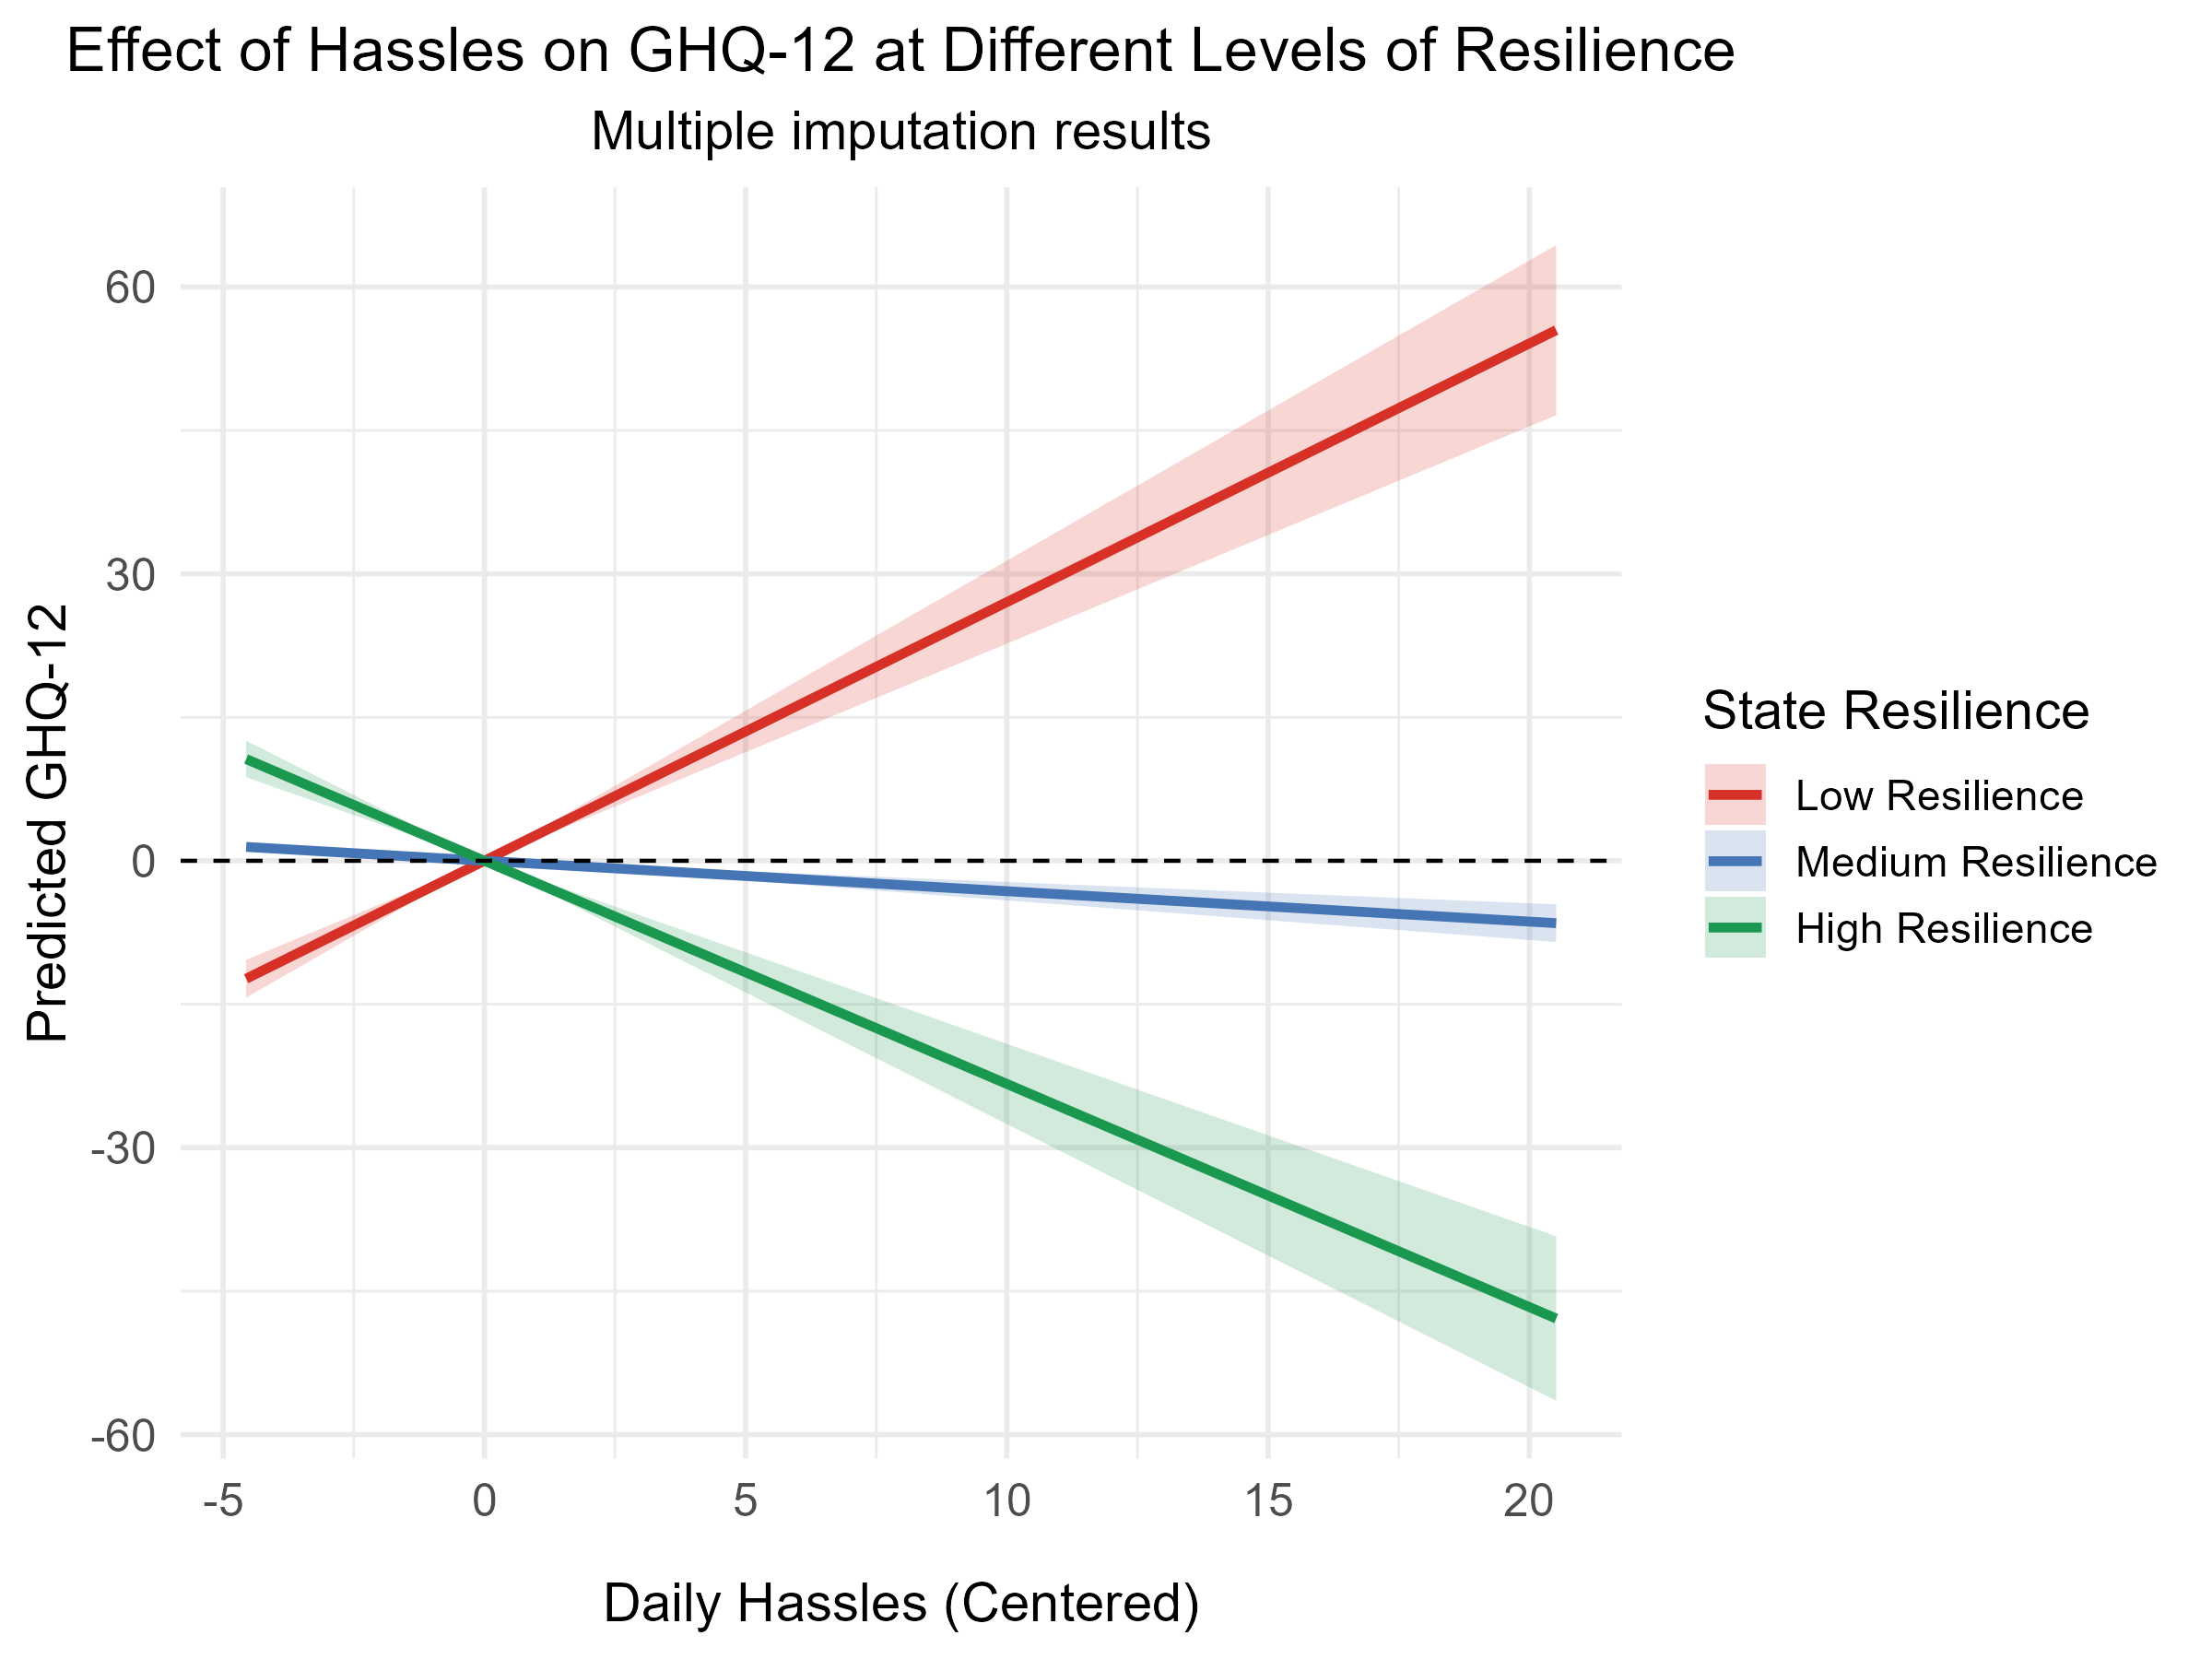
Resilience buffers the effect of daily hassles on mental health but not because of nature contact
Interaction “state resilience*daily hassles” = -0.50 (-0.59, -0.42)
Index of mediated moderation (“nature time->state resil.” * ”interaction term->GHQ-12”)
= 0.0001 (-0.02, 0.02) for neigh. nature time
= -0.02 (-0.03, 0.002) for distal nature time

Slide 10
Publication ideas
+ Needs for collaborations
Nature resilience mediated moderation paper – collaboration with UniVie, UU …
Natural and built environment exposures and biomarkers paper – collaboration with PMU (CS5), UniVie …
Nature and loneliness paper – collaborations with ISG, UniVie, UU, Iana Markevych

Slide 11
Timeline and next steps
Nature resilience mediated moderation paper – completed by the end of 2025
Data management and cleaning of laboratory datasets – completed by the end of 2025
Linkage of additional GIS variables to all survey waves – Spring 2026
Deliverable D3.1 – Level 1 CS synthesis report – M34 (March 2026)
Natural and built environment exposures and biomarkers paper – completed by Spring 2026
Nature and loneliness paper – completed by Summer 2026

Slide 12
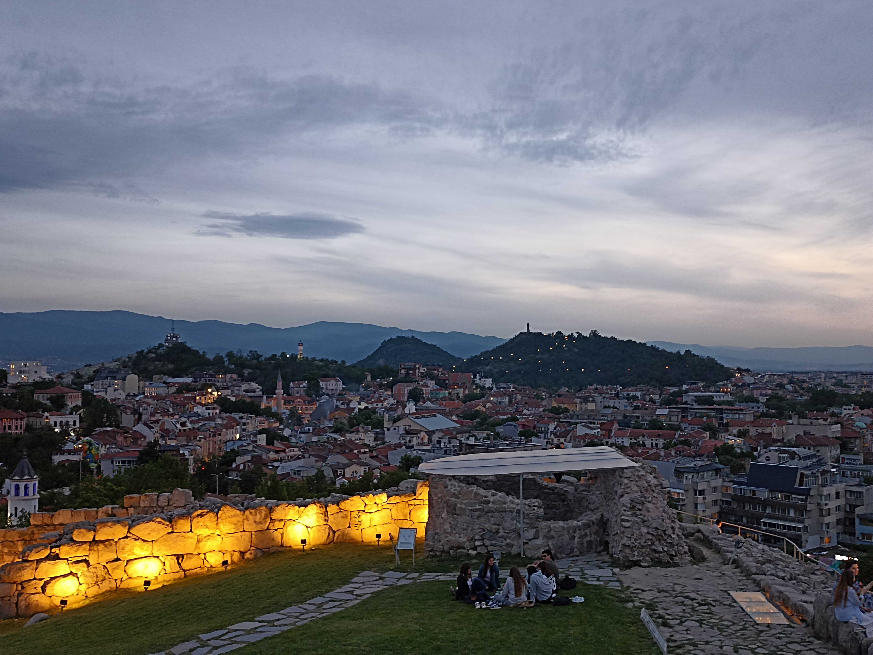
Thank you
Angel Dzhambov
Enviroentmal Heath Dsiviosn,
Research Insittue at MU-Plovdiv
angel.dzhambov@mu-plovdiv.bg
The Resonate project is funded by the European Union’s Horizons Europe Research and Innovation programme under grant agreement No. 101081420 and co-funded by the UK Research and Innovation grant award No. 10063874

