Slide 1
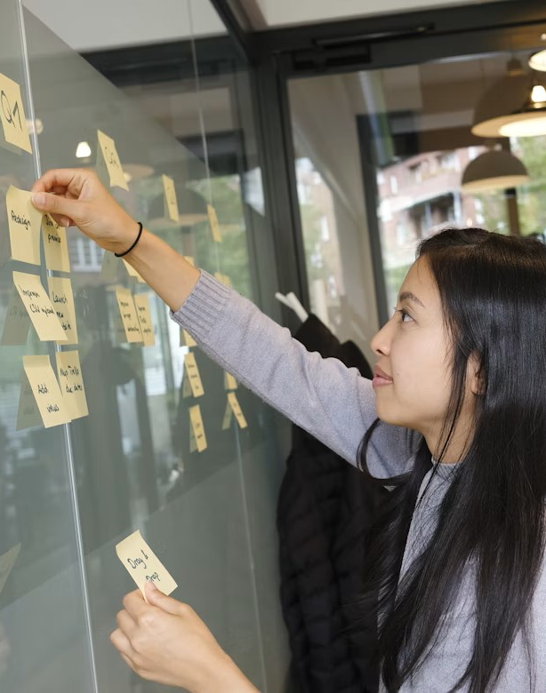



Collective Timeline Opportunities, Deadlines, Connections
Addi Wala and most importantly all of us together.
The Resonate project is funded by the European Union’s Horizons Europe Research and Innovation programme under grant agreement No. 101081420 and co-funded by the UK Research and Innovation grant award No. 10063874

Slide 2

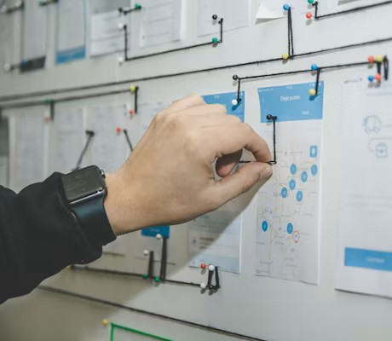
Session Goals
Gain a more holistic understanding of the remaining project.
Highlight synergies, opportunities, and even expected difficulties.
Communicate potential delays and a realistic future timeframe.

Slide 3
Procedure
You are here
13:30: Explanation & distribution of envelopes
13:35: Add events to collective timeline+ add additional timepoints, tasks, and external events not covered by the envelope.
13:45: Look at other people’s events and add additional notes to highlight synergies or extra information.
13:50: Reflect and look at timeline together.
14:00: “Bringing it all together” rotating sessions.

Slide 4
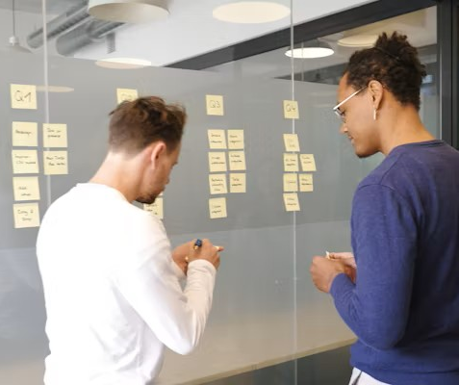
You will receive…
… an envelope that contains tasks, events, and deadlines related to your CS/WP.
Please also make use of…
the blank sticky notes
the pens,
and the people around you ☺

Slide 5
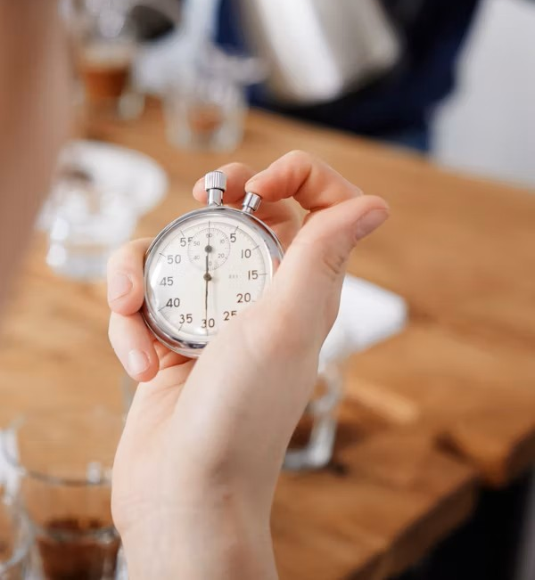
Please populate the timeline!
We will keep an eye on the time (literally).

Slide 6
Procedure
13:30: Explanation & distribution of envelopes
13:35: Add events to collective timeline+ add additional timepoints, tasks, and external events not covered by the envelope.
13:45: Look at other people’s events and add additional notes to highlight synergies or extra information.
13:50: Reflect and look at timeline together.
14:00: “Bringing it all together” rotating sessions.
You are here

